Slide 1

Overview of AI4NWP activities at NOAA
Presented: Sergey Frolov, Daryl Kleist
AI4NWP tiger team: Isidora Iankov, Jebb Stewart, Kevin Garrett, Daryl Kleist, John Ten Hoeve, Corey Potvin, Adam Clark, Monica Youngman, Maoyi Huang
NOAA EMC: Jun Wang, Sadegh Tabas
NOAA GSL/CIRA: Jacob Radford, Imme Ebert-Uphoff, Daniel Abdi
NOAA NSSL: Monte Flora
NOAA PSL: Tim Smith, Niraj Agarwal, Laura Slivinski, Jeff Whitaker
EPIC: Mariah Pope, …
UIFCW, July 22, 2024

Slide 2
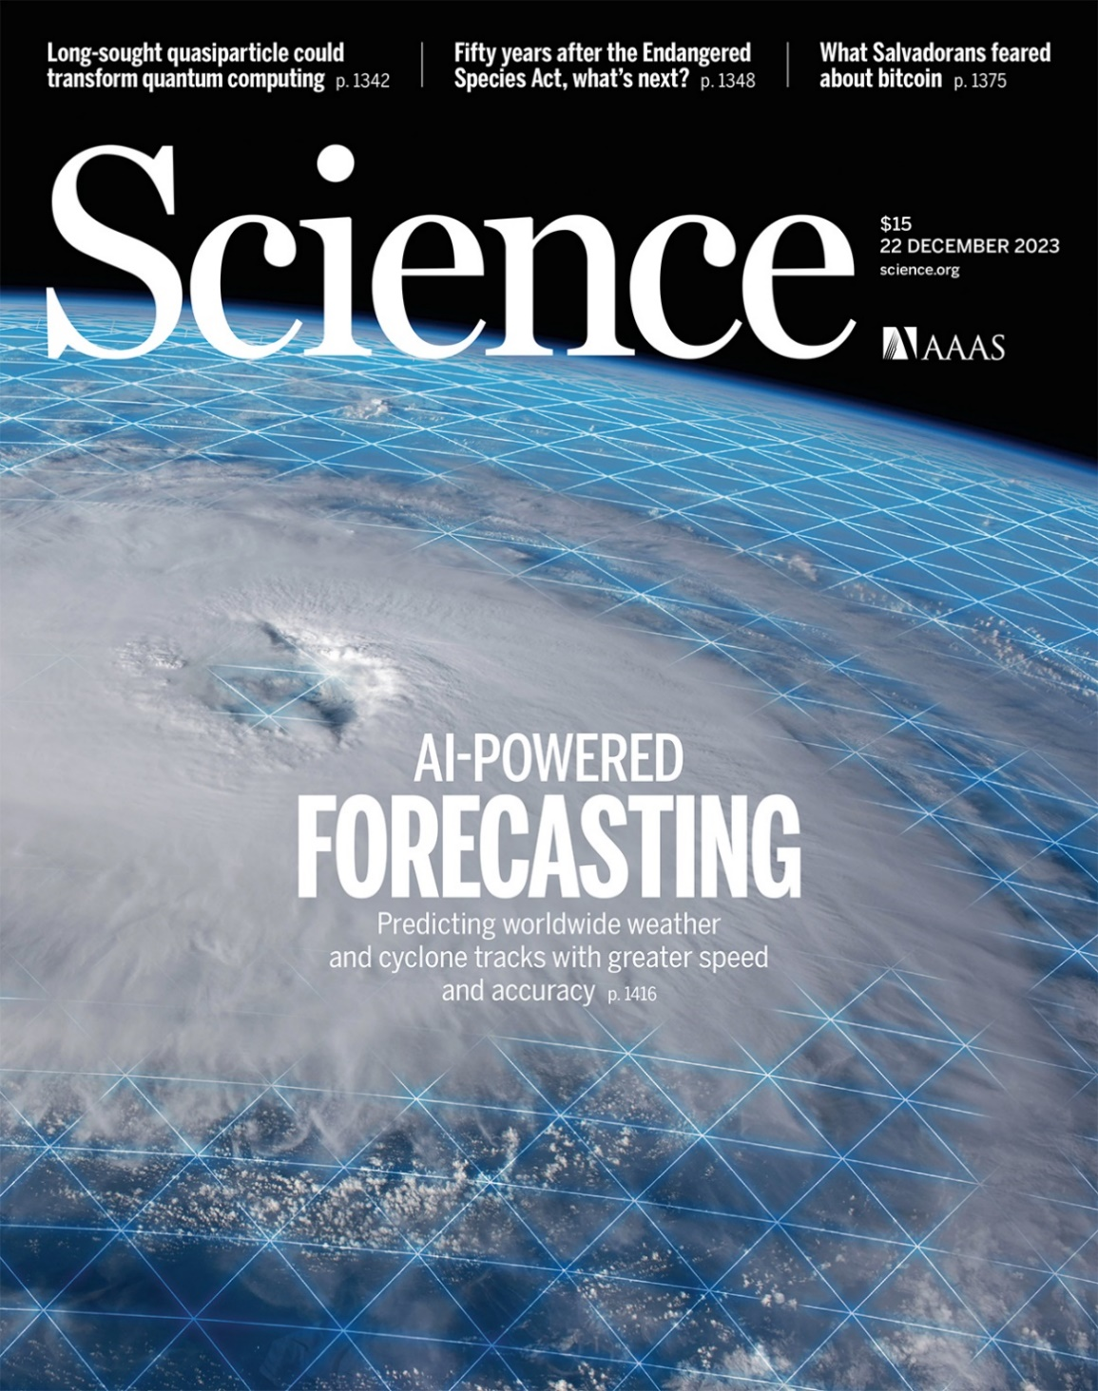
Outline
State of science at ECMWF
Current activities at NOAA:
  Recommendations from the AI4NWP workshop report.
  Highlights of current activities
Strategies for convergence across NOAA

Slide 3
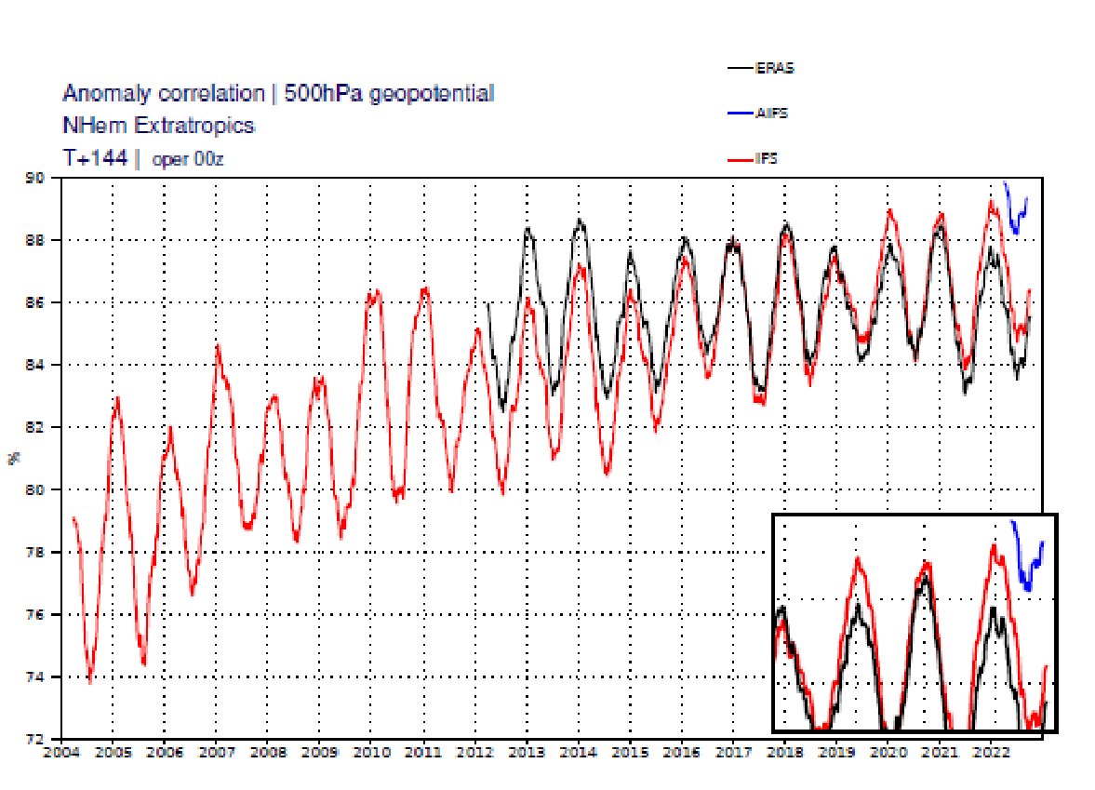
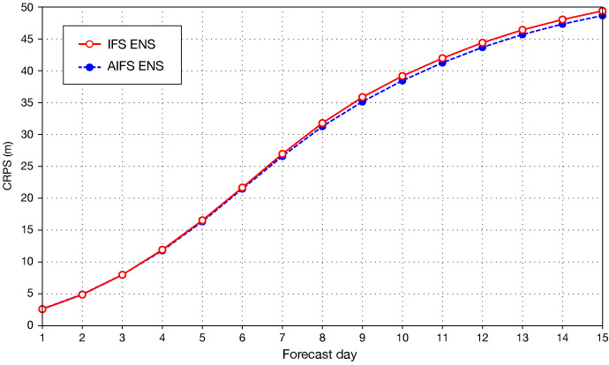
Status of AI forecasting at ECMWF
AIFS v2 is a leap forward (equivalent to the last 7 years of advancement in deterministic IFS)
IFS ops continue to improve at ~1% a year
ERA5 performance is flat (circa IFS from 2017)
Ensemble performance of AIFSv3 is similar to IFS ensemble

Slide 4
Status of AI forecasting at ECMWF
AIFS v2 is a leap forward (equivalent to the last 7 years of advancement in deterministic IFS)
IFS ops continue to improve at ~1% a year
ERA5 performance is flat (circa IFS from 2017)
January 2023: evaluation of external models
Summer 2023: AIFS development commences
Fall 2023: AIFS V1 introduced
Winter 2024: AIFS V2
Spring 2024: LAM AIFS
Summer 2024: Ensemble AIFS
Ensemble performance of AIFSv3 is similar to IFS ensemble

Slide 5
What is happening at NOAA
Evaluation starts
AIFS starts
AIFS v1
AIFS v2
AIFS v3
AIFS release
ECMWF
UFS workshop
AI4NWP group formed
AI4NWP workshop
(see BAMS report)
White House focus on AI4NWP
Grass-roots independent progress across NOAA
Need for convergence
NOAA
Jan 2023
July 2023
Jan 2024
July 2024
Jan 2025

Slide 6
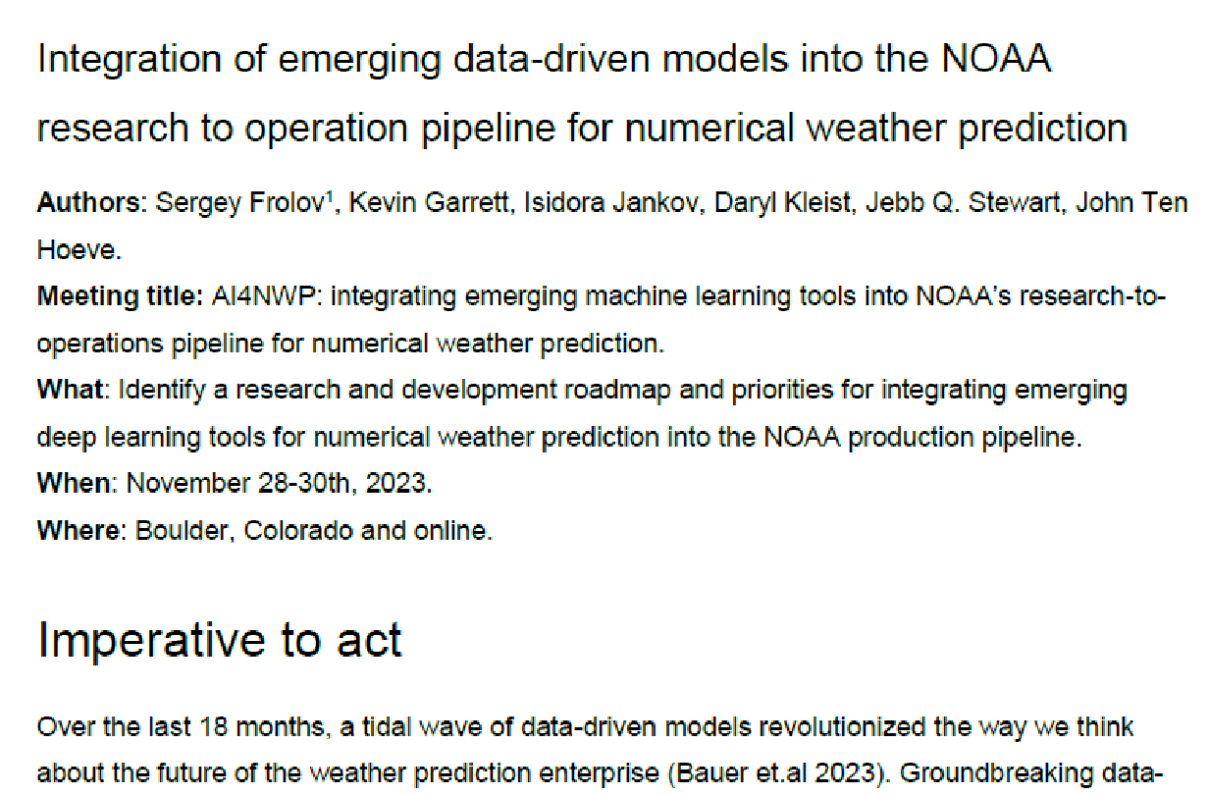


Highlights from the AI4NWP report
Outcomes
Urgency to act:
Technology is developing rapidly
Potential has been demonstrated by the private industry
Investment at ECMWF (~20 FTE), UKMO (~20 FTE) and private sector (multiple of ~10 FTEs and several organizations).
https://doi.org/10.1175/BAMS-D-24-0062.1

Slide 7
Highlights from the AI4NWP report
Outcomes
Opportunities:
Ensemble forecasts represent the majority of computational expenses at NOAA R&D and operations.
Replacing ensemble forecasts with AI4NWP tools presents a great opportunity for both skill improvement and cost reduction.
Significantly large ensembles should:
  Better represent extreme events,
  Improve initial conditions.
Reduce cost of R2O, operational forecasts, and reanalysis production.
Excitement for NOAA to do things differently, be more agile!
https://doi.org/10.1175/BAMS-D-24-0062.1

Slide 8
Grand challenge 1: Focus on global coupled ensemble forecast
Augment the GEFS system using AI capabilities:
Start with GEFSv12 parallel (demonstration) forecasts
Develop coupled ML emulators for Medium-Range Weather and S2S forecasts
Develop ML emulators for short forecasts for use in Data Assimilation (DA)
AI-based large ensembles for both short and long forecasts
Post Processing, knowledge discovery for large ensemble forecast guidance
Downstream positive impact on reanalysis development and DA innovation

Slide 9
Grand challenge 2: data-driven models for km- (storm) scale
Develop AI-based km-scale forecasting system:
Start with regional CONUS datasets
Partnership with DOE for generating km-scale training data
Formulate set of metrics for km-scale models
Evaluate feasibility of using AI4NWP tools for RRFS and HAFS ensembles
ML Emulators for WoFS application
ML emulators for km-scale global prediction

Slide 10
Highlights of existing efforts
Evaluation (GSL/CIRA/NSSL/EMC):
  Reforecast database from GFS I.C.,
  Near real-time forecasts,
  Evaluation of precipitation and TC verification,
  Spring forecasting experiment.
Training of NOAA models:
  NSSL: WoFS-Cast,
  EMC: Fine tuning of Graphcast & ForeCastNetv2 on GFS/GDAS analysis, exploring use of AI-based models in ensemble forecasting, AI-based bias correction.
  PSL: Training of the fully coupled AI4NWP model,
  PSL/GSL/EPIC: evaluate AIFS model in the nested configuration.
Application of AI4NWP for data assimilation:
  PSL: cycling EnKF with AI4NWP models,
  PSL/GSL: training of the GraphCast for DA applications,
  EMC: evaluating feasibility of AI-based tangent-linear & adjoints.

Slide 11
CIRA/GSL: reforecast archive
Data Accessibility - Easy + open access to AIWP data is crucial!
Two approaches:
Reforecast Archive
Goal: Facilitate feature-based verification
Details:
  Public access to AIWP reforecasts (FCNv2, PW, GC) via NODD
  Sep. 2020 to present
  00 and 12 UTC runs initialized with GFS
2. Real-Time Visualization
Goal: Allow viewers to develop intuition for model performance
Details:
  Web-based viewer
  Compare FCNv2, PW, GC, and AIFS to GFS and IFS
  00 and 12 UTC runs initialized with GFS
https://noaa-oar-mlwp-data.s3.amazonaws.com/index.html
https://aiweather.cira.colostate.edu

Slide 12
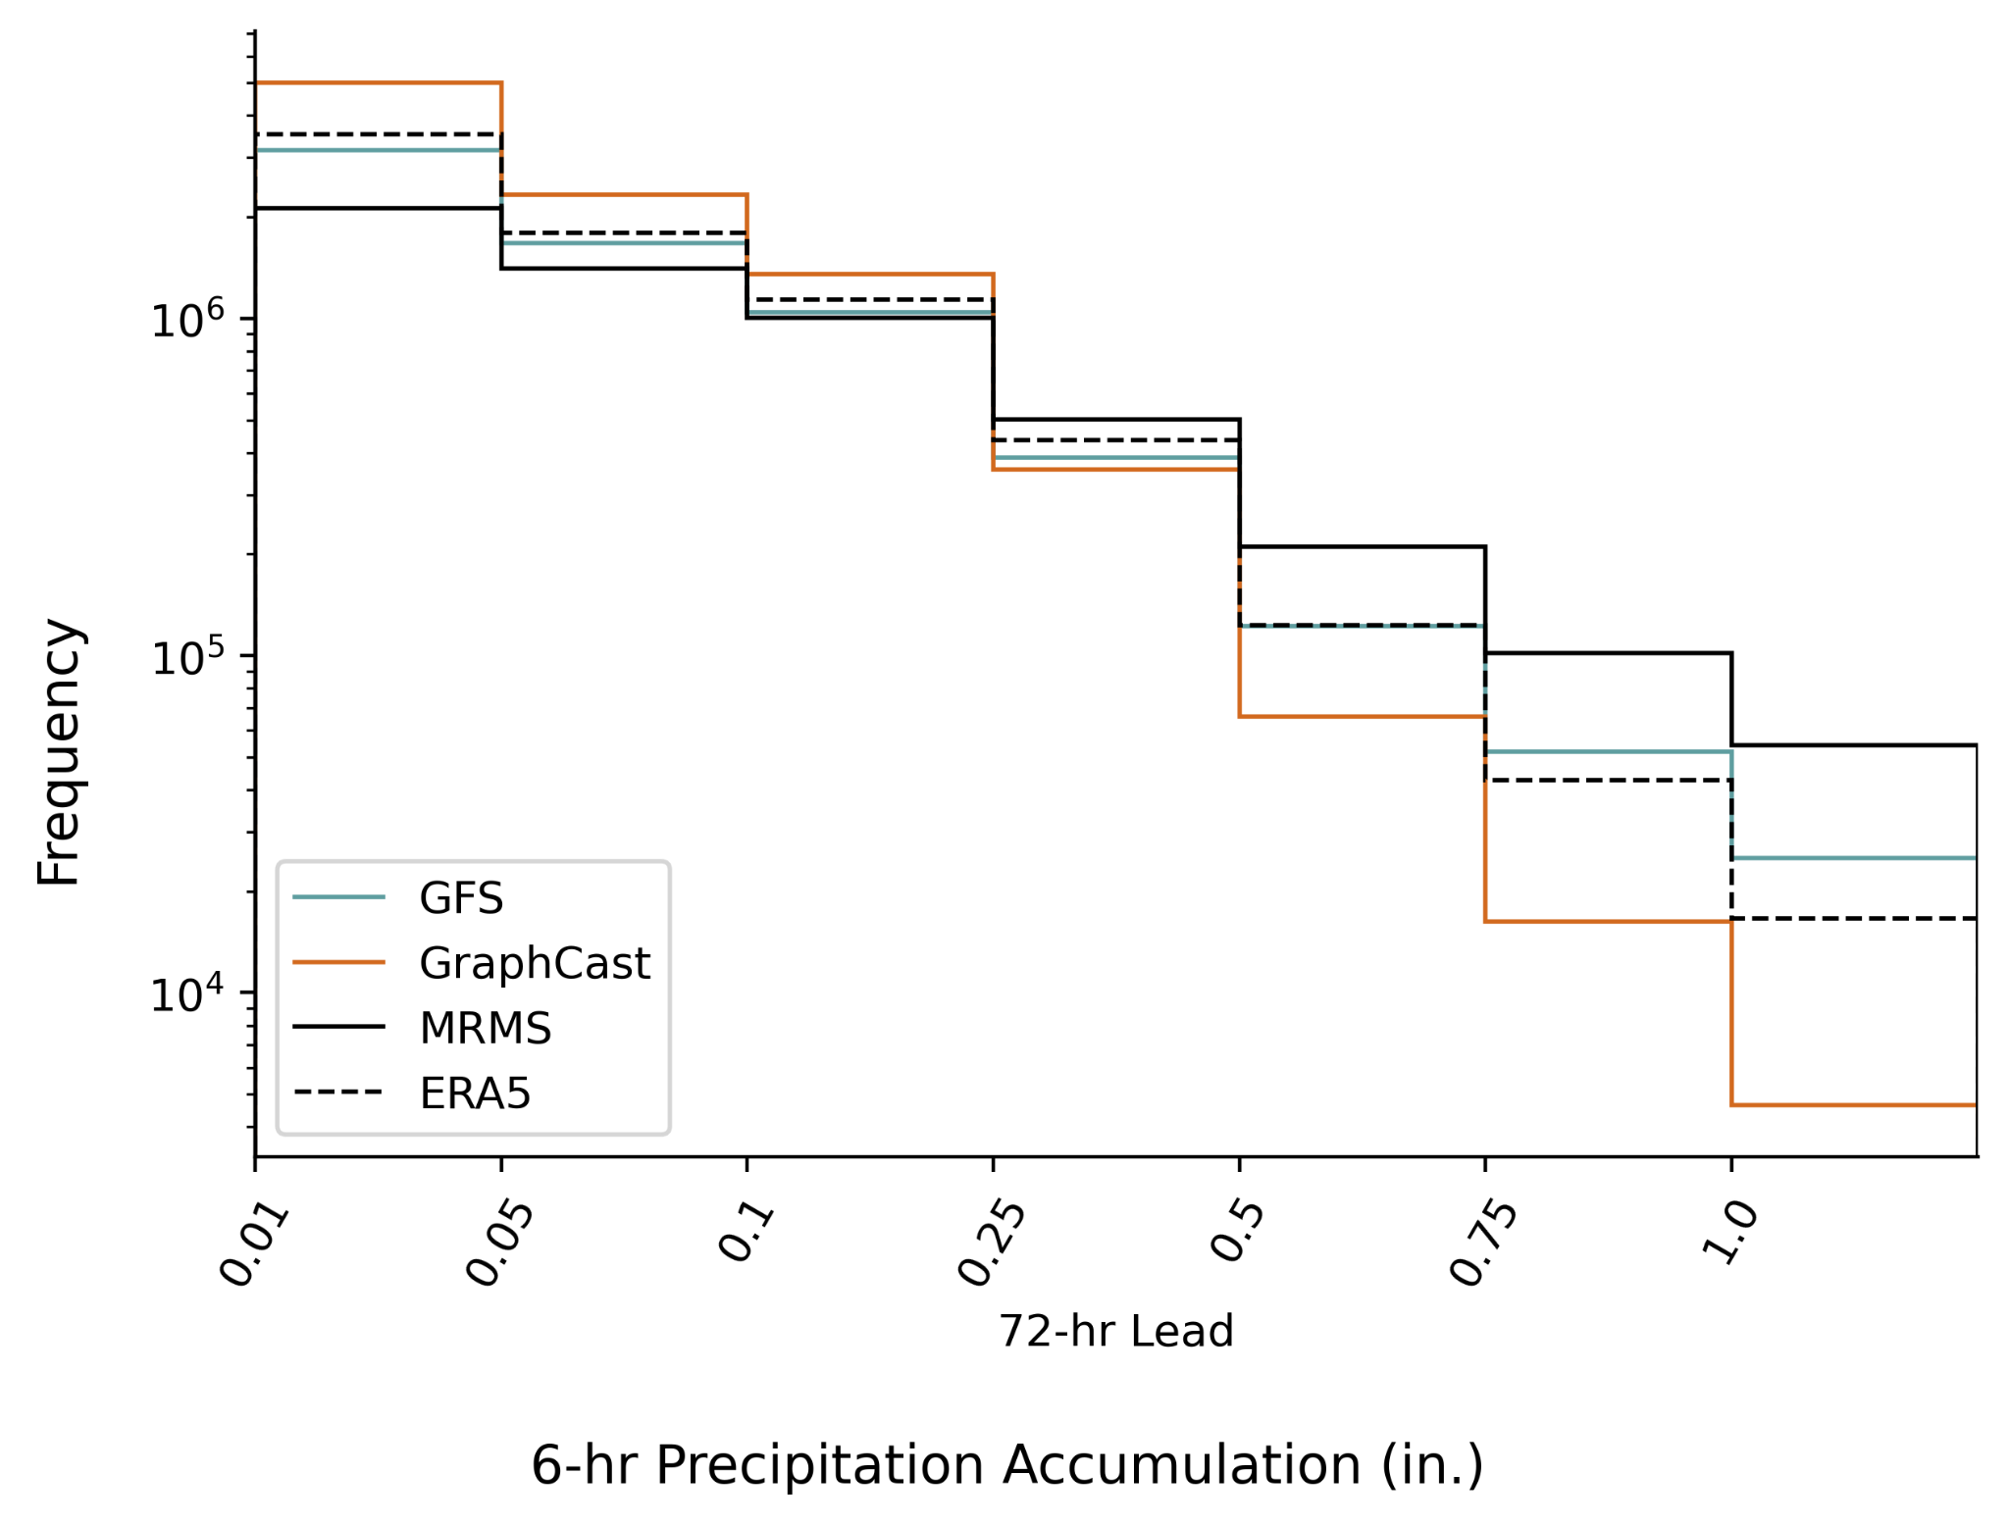
CIRA/GSL: precipitation evaluation
Lead: Jacob Radford (CIRA/GSL)
Model evaluation - How do AIWP models perform for impactful features?
GraphCast shows low frequency of intense precipitation
Precipitation (Only GC)
Applied grid-based and object-oriented verification for two years of reforecasts
GraphCast has lower RMSE and SEEPS than GFS
Over-predicts light precipitation
Under-predicts intense precipitation

Slide 13
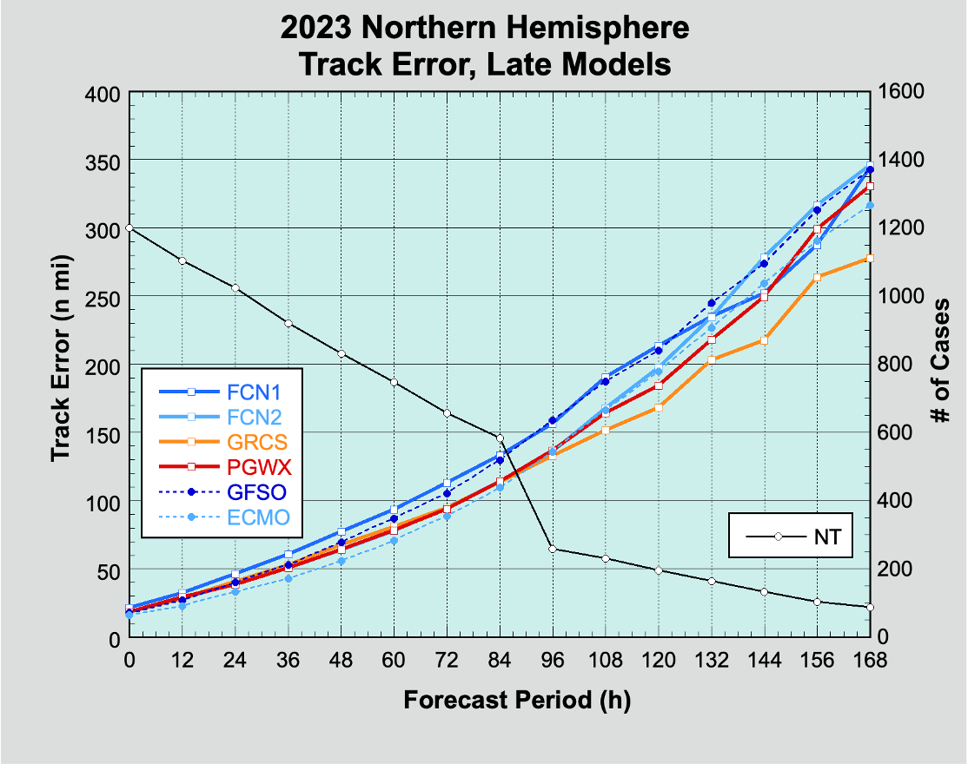
CIRA/GSL: TC evaluation
Research Team: CIRA/CSU Tropical Cyclone and AI Groups, and GSL
Lead: Mark DeMaria (CIRA)
Verification of May-Nov 2023 Tropical Cyclone Track Forecasts using the National Hurricane Center Verification Methodology
FCN1 = FourCastNet original
FCN2 = Updated FourCastNet
GCRS = GraphCast
PGWX = PanguWeather
GFSO = NCEP GFS global Model
ECMO = ECMWF-IFS global model
A) Track results (on left):
Model track errors very similar between NWP and AI4WP models, except:
FCN1 a bit worse through 96 h,
GraphCast was better than all models after 96 h.
B) Intensity results (not shown here):
All AIWP models have extreme low bias.

Slide 14
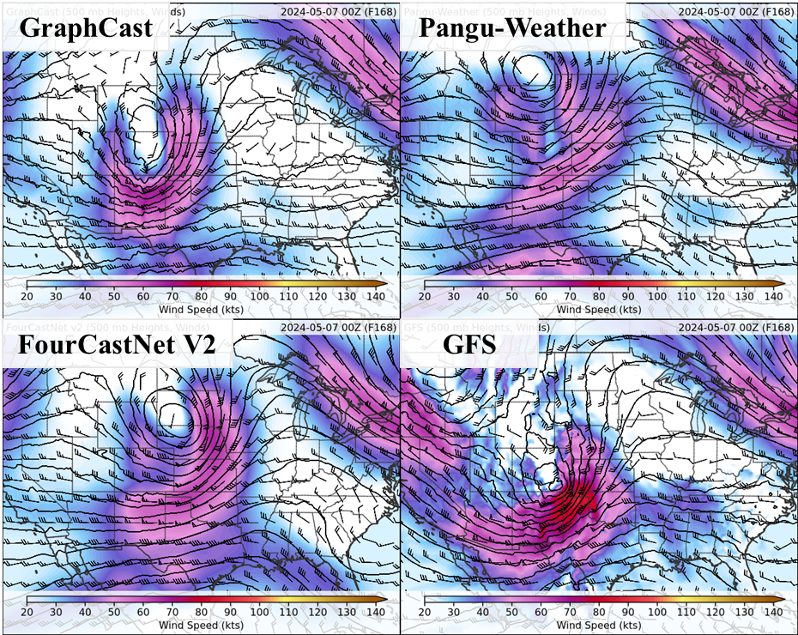
AI-Generated Global NWP Emulators in the 2024 HWT SFE
~150 participants evaluated AI-generated global forecasts compared to operational GFS and GFS Analysis
Publicly available versions of the AI models run by CIRA:
  NVIDIA’s FourCastNet V2
  Huawei Cloud’s Pangu-Weather
  Google’s GraphCast
Evaluations centered on the Day 7 forecast (F156 – F180) across North America with focus on area of severe weather
Subjective scores were provided on a 10-point Likert scale in comparison to GFS analysis
Slide courtesy of David Harrison

Slide 15
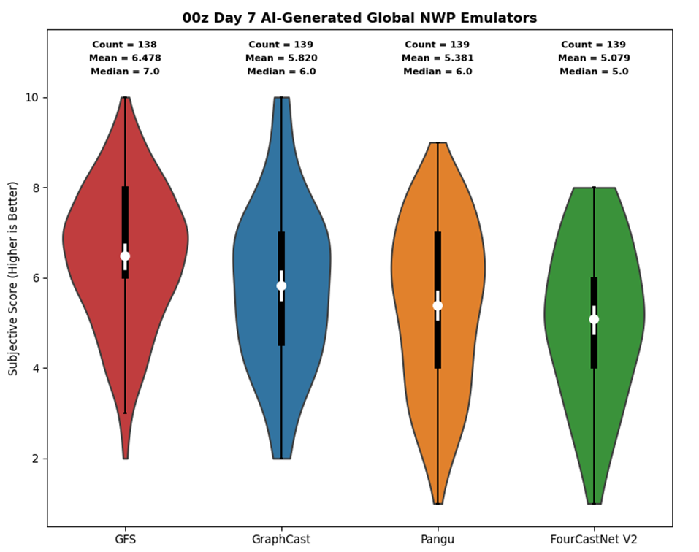
NSSL: Spring forecasting experiment results
GFS received the highest ratings on average, but GraphCast was statistically similar
AI models generally rated higher in strongly-forced environments; struggled with weak/subtle forcing and split-flow regimes
Derived soundings were physically realistic but very smooth – difficult to get inversions
AI models showed less run-to-run and day-to-day consistency than the GFS – the “best” AI model varied considerably each day
Participants impressed by current state of models but indicated there’s still work to do before they’re ready for operations
Slide courtesy of David Harrison

Slide 16
Training of NOAA-native models
Most current efforts are based on modification of the GraphCast code from DeepMind.
To train or fine-tune models the following had to be added (about 3-6 months of work):
Prepare and stage NOAA data;
Develop data loader for NOAA data;
Modify GraphCast code to work with NOAA grids and variables;
Develop training harness that works on multiple GPUs.
This has been undertaken in parallel by at least 3 groups at NOAA: EMC, NSSL, PSL/GSL.

Slide 17
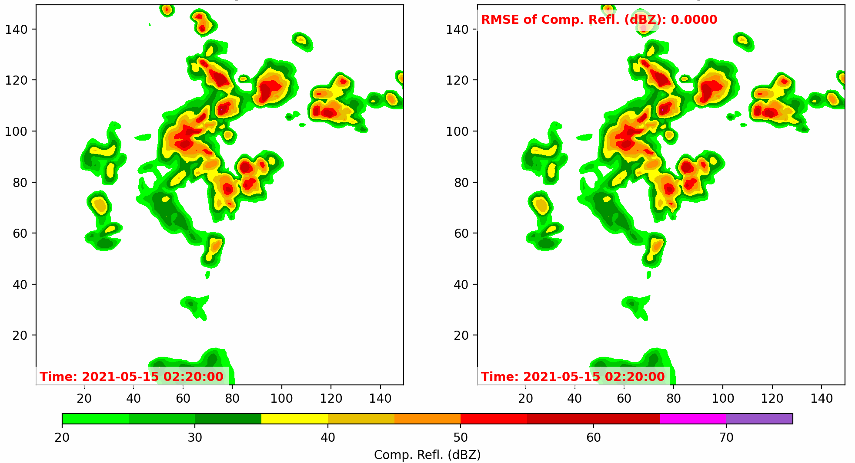
NSSL: WoFS-cast
WoFS (NWP)
WoFSCast
Modified GraphCast to allow for the regional domain with corrective diffusion.
Trained on the archive of the WoFS forecasts.
Slide courtesy of Potvin, Flora et.al.

Slide 18
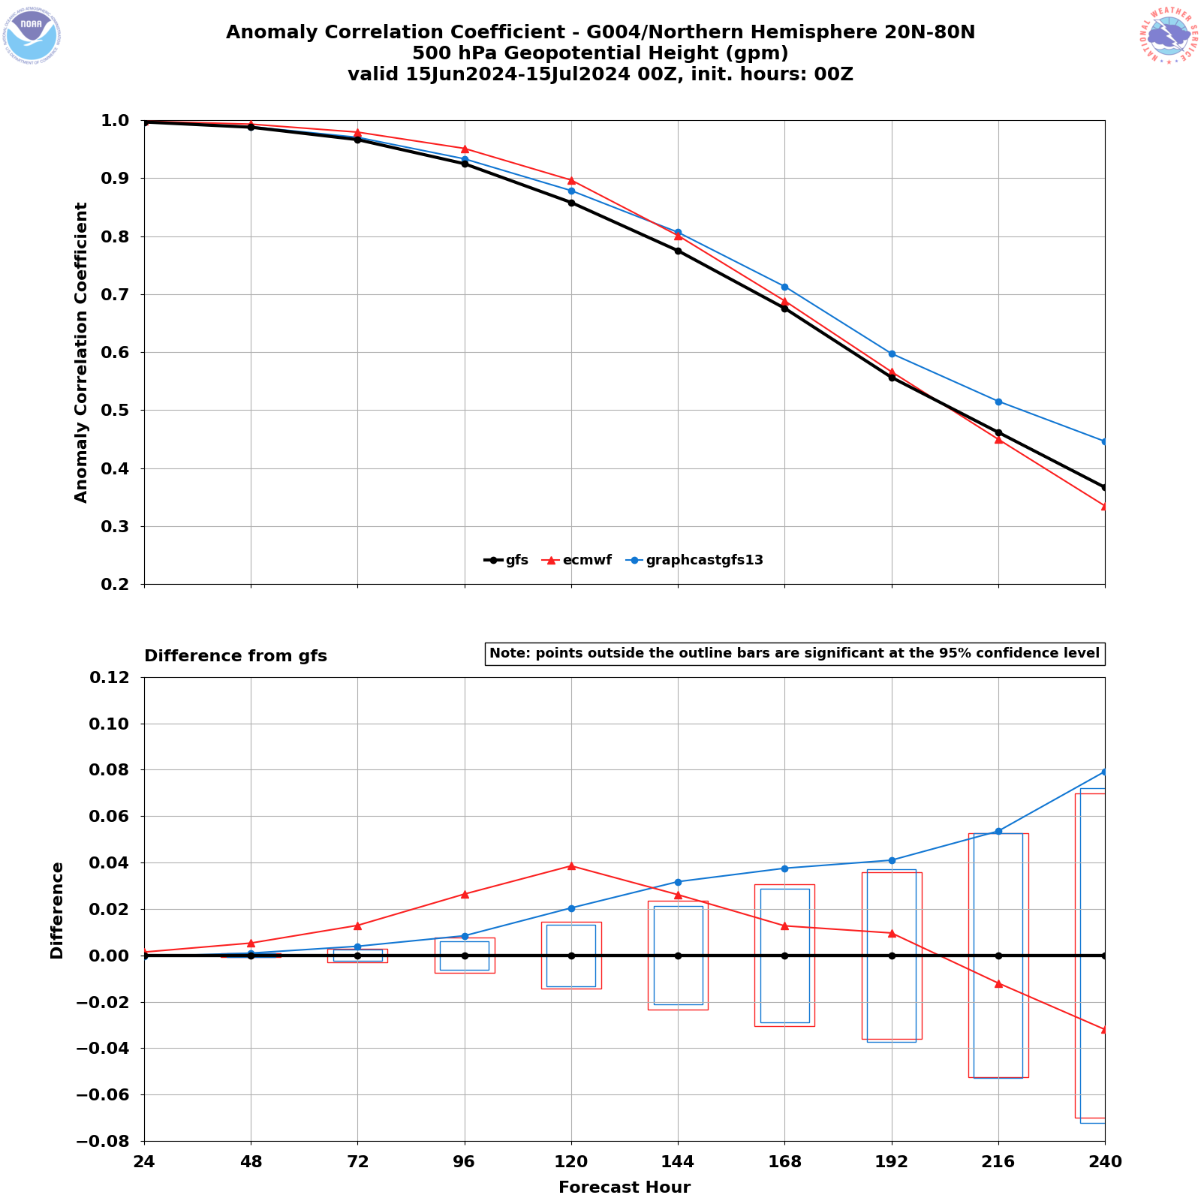
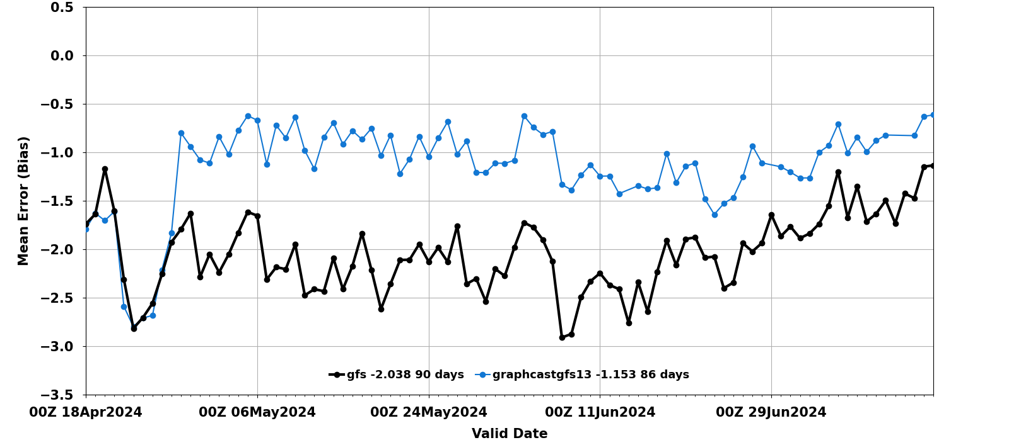
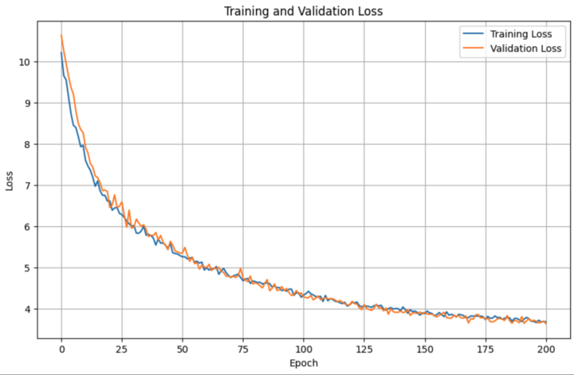
EMC: Training on GFS analysis
Goal: improve GraphCast forecasts from GFS initial conditions.
Approach: train and fine tune public GraphCast on the archive of GFS operational analysis.
First results are encouraging. More analysis and fine tuning are underway.
T2M bias (CONUS, 24 hour forecast)
Training and validation loss
switch to fine-tuned model
More information via Poster (Jun Wang et al.) and Talk (Sadegh Tabas, Thursday)
Slide courtesy of Wang, Tabas, Cui, Ling, Fu, Du, Row, Carley

Slide 19
PSL/GSL/DeepMind: GraphUFS for DA and coupled prediction
variable | GraphCast from DeepMind | GraphUFS DA | GraphUFS coupled
Surface | 5 variables | MSLP->Ps | -”-
Land | none | +soil +snow | -”-
3D atmos | T,U,V,Z,Q,W 13 or 37 levels top of 50 HPa | + ozone + 7 cloud variables + 40 model levels up to 1 Pa | -”-
Ice | none | none | + ice conc and thickness
Ocean | none | none | + sst, ssh, T, S, U,V, to 200 meters
Goal: develop a model to facilitate coupled data assimilation.
Approach:
  Increase set of variables to be compatible with data assimilation requirements.
  Train on model levels using GEFSv13 replay dataset.
Results:
  First generation of models are trained and undergoing evaluation.

Slide 20
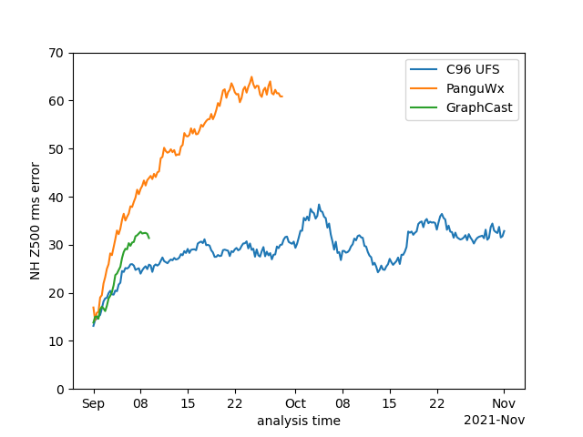
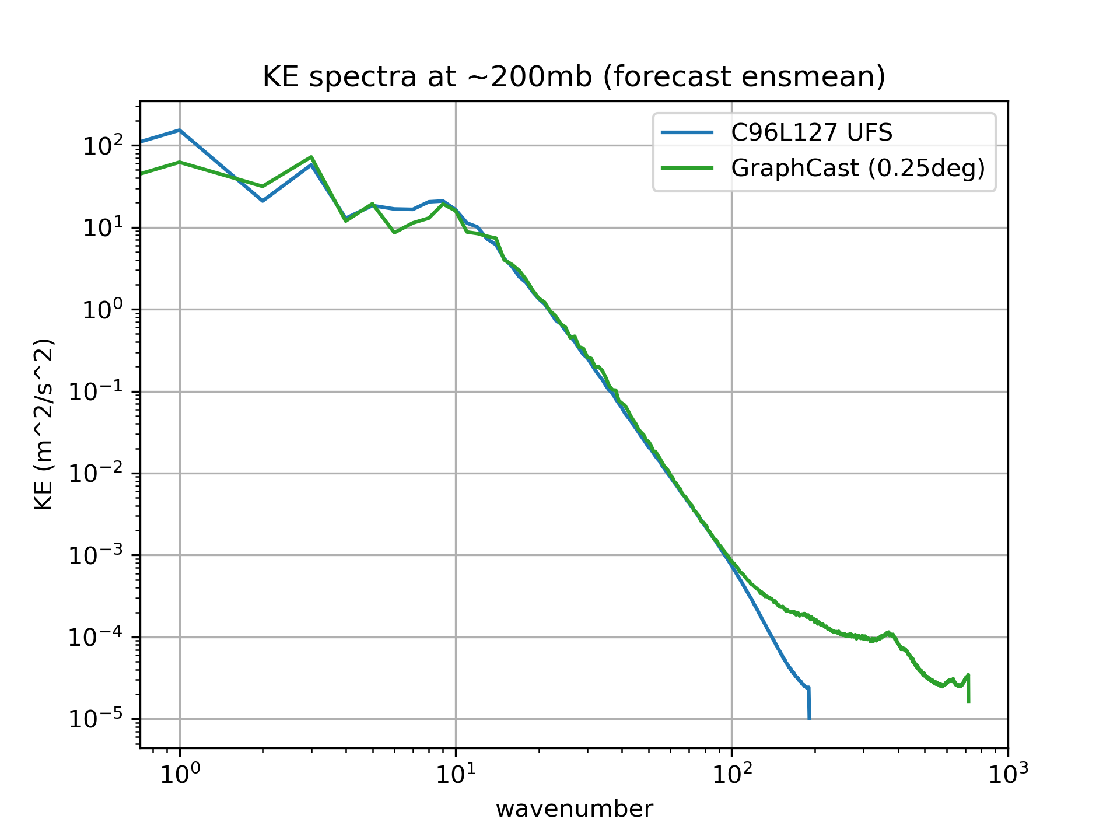
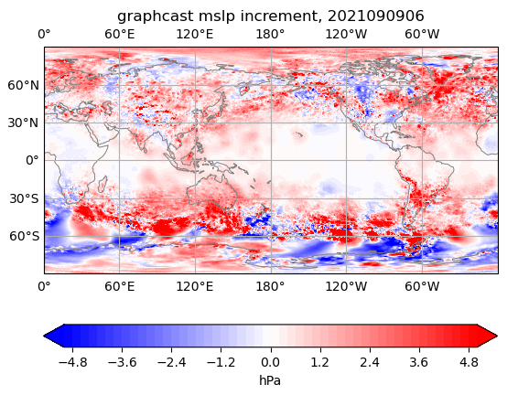
PSL: Cycling with emulators
Assimilation of surface pressure only observations as in 20CrV3 reanalysis using EnSrKF.
All deterministic AI4NWP models grow instabilities and “blow-up”.
Path forward: train our own models that can be resilient to high-frequency noise in initial conditions, reduce non-physical noise in the analysis states.
See more Thursday pm Whitaker

Slide 21
Moving forward: balancing fast progress and need for convergence
Grass-roots independent progress across NOAA
Need for convergence
NOAA
Jan 2023
July 2023
Jan 2024
July 2024
Jan 2025
Ideas for convergence:
  EPIC is developing website to highlight and connect activities across NOAA.
  EPIC/PSL/GSL: evaluating suitability of Anemoi/AIFS as platform for convergence of AI4NWP activities.
  GSL/PSL/EPIC: developing verification pipeline for models over CONUS.
  EMC/EPIC/GSL/PSL/?: could we converge on the official R2O pipeline for training and evaluation?
  Investigating path forward to generate high-resolution, high-quality training data.

