Slide 1
JEDI-Based Atmospheric Composition Data Assimilation Progress at NWS
July 25, 2024
Cory R Martin, Hyundeok Choi, Jianping Huang, Daryl Kleist, Jeff McQueen, Ivanka Stajner, Andrew Tangborn, Yaping Wang, Hongli Wang, Jérôme Barré

Slide 2
GFSv17 Aerosol DA Plans
Currently one of the few (only?) operational centers to not have aerosol DA initializing their aerosol prediction system
6-hourly cycles 4x a day with early and late cycles
Early cycle to initialize the GEFS long forecasts (one aerosol analysis provided, up to the ensemble forecast group to decide if/how to perturb)
Late cycle to initialize the high resolution GDAS forecast (without radiative feedback)
Analysis resolution C192L127 (~0.5 deg); background resolution C1152L127 (~9km)
3DVar FGAT with 3-hourly backgrounds
VIIRS EPS 550nm AOD from S-NPP, N20, N21

Slide 3
Error Covariance Estimation and Tuning
Because we are running a 3DVar analysis, the background error covariance matrix is essential to the performance of the system.
Multiple methods for computing B have been explored:
“NMC Method” (lagged forecast pairs
BUMP estimates from an ensemble
Results from this approach on subsequent slides
Time varying covariance
Uses background from each cycle to compute variance from neighboring gridpoints
Promising but still requires further testing/tuning
Will probably do a hybrid of this and the BUMP estimate

Slide 4
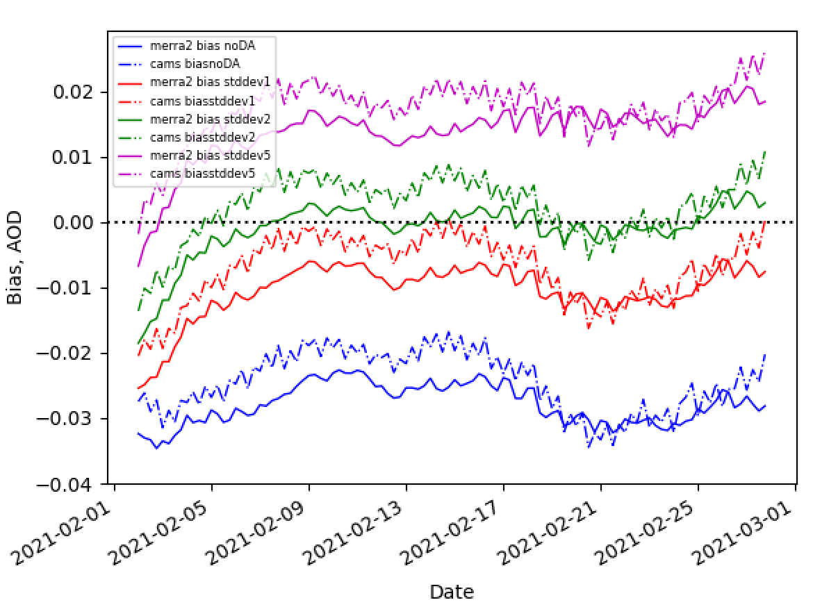
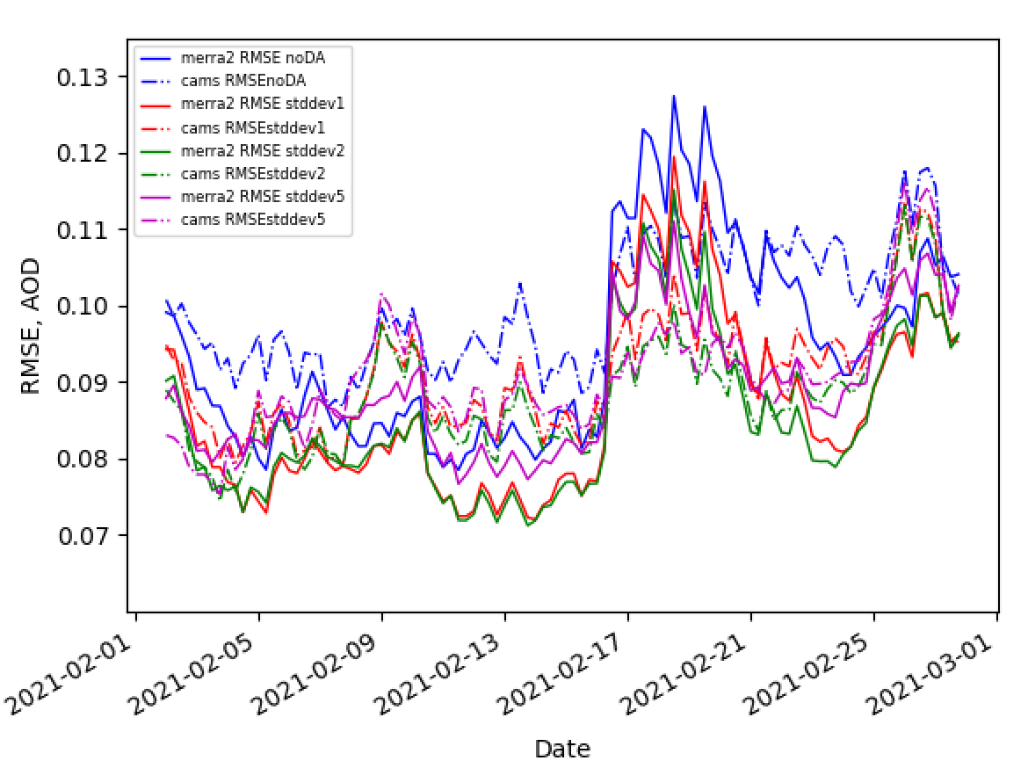
Global Comparisons - February 2021
GDAS - MERRA2 : Solid lines
GDAS - CAMS: Dash-dot
Bias RMSE
Globally, Stddev inflation of 1-2 appears optimal
GDAS is slightly smaller bias relative to CAMS, though the RMSE is higher.
Global AERONET comparisons:
NoDA bias=-0.0934 rmse=0.213
Stddev1 bias=-0.0694 rmse=0.193
Stddev2 bias=-0.0580 rmse=0.184
Andy Tangborn

Slide 5
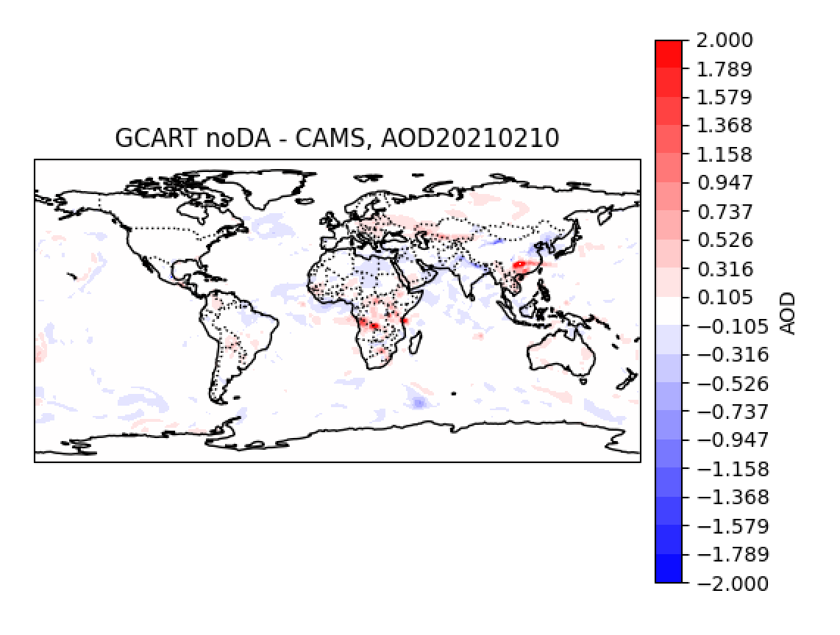
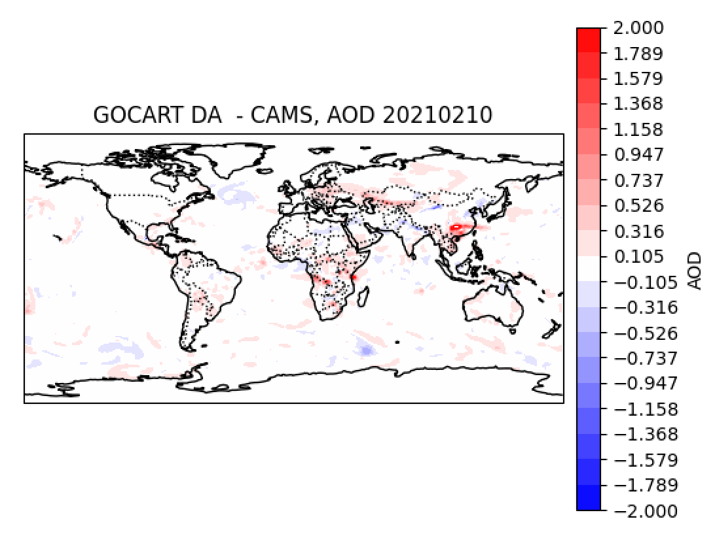
Global Difference with CAMS on February 10, 2021
NoDA
Stddev2
Negative bias over N. Africa and positive bias over central Africa are reduced.
High bias over eastern China persists.
Andy Tangborn

Slide 6
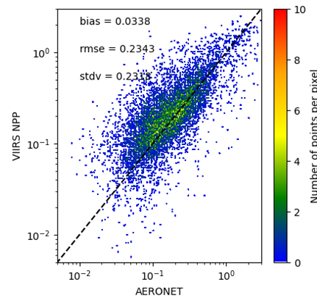
Thinning vs Superobbing
VIIRS observations are ~750m, far too dense to assimilate all. Exploring random thinning vs superobbing for assimilation performance
Thinned
Superobbed
Yaping Wang

Slide 7
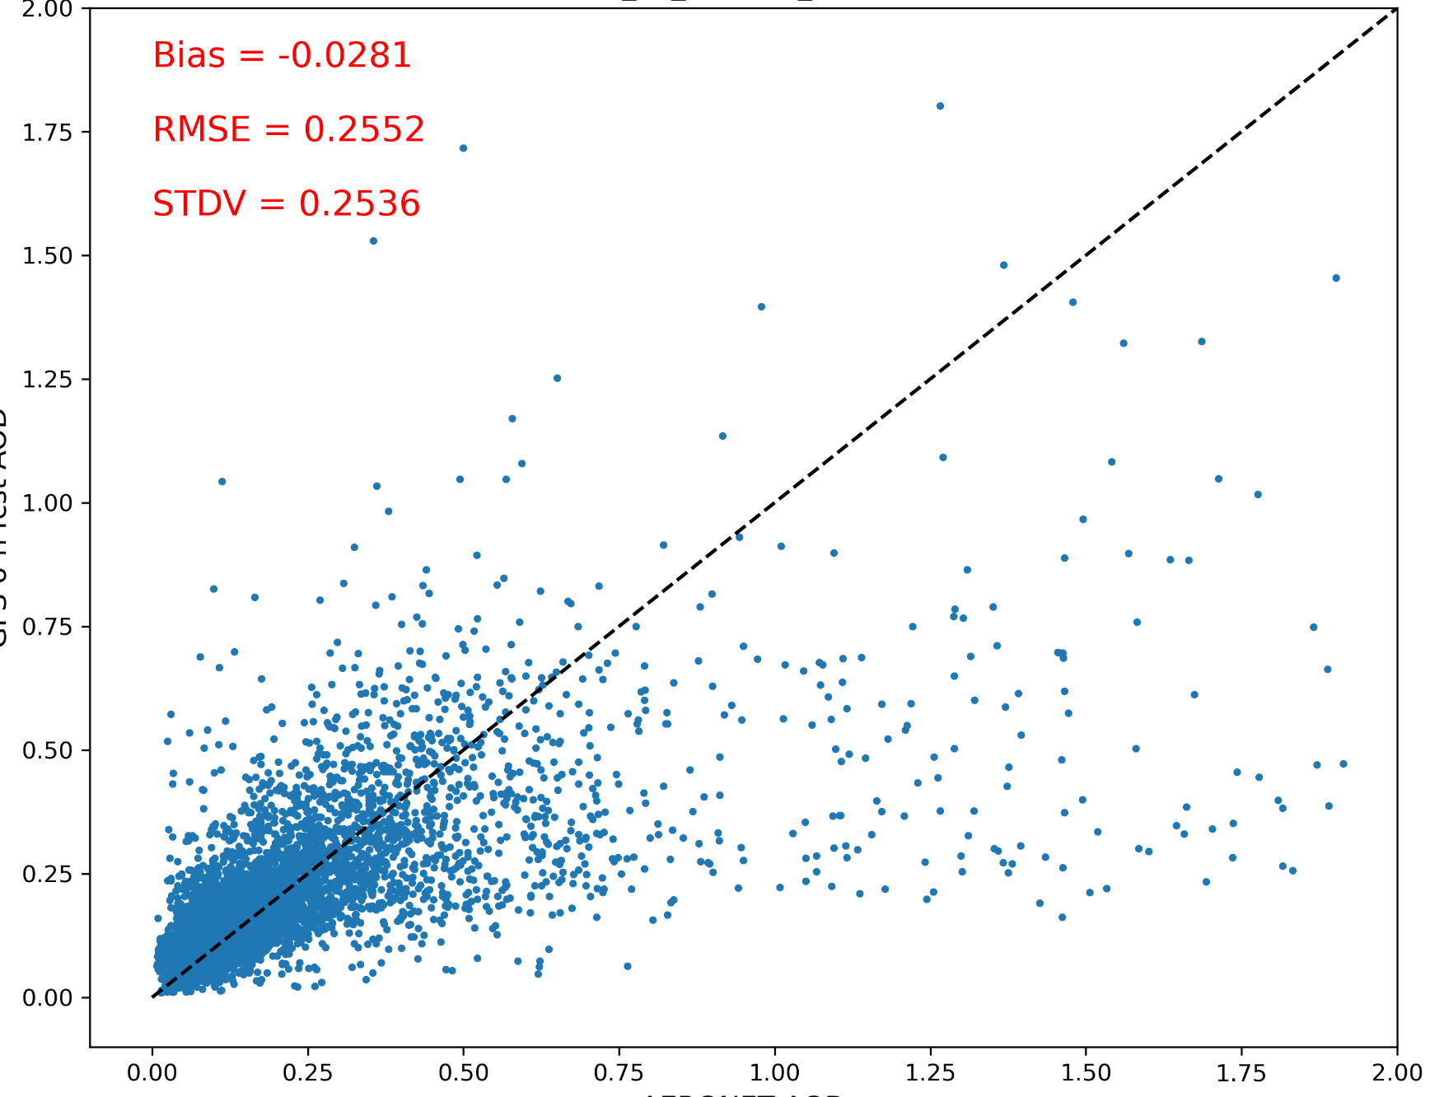
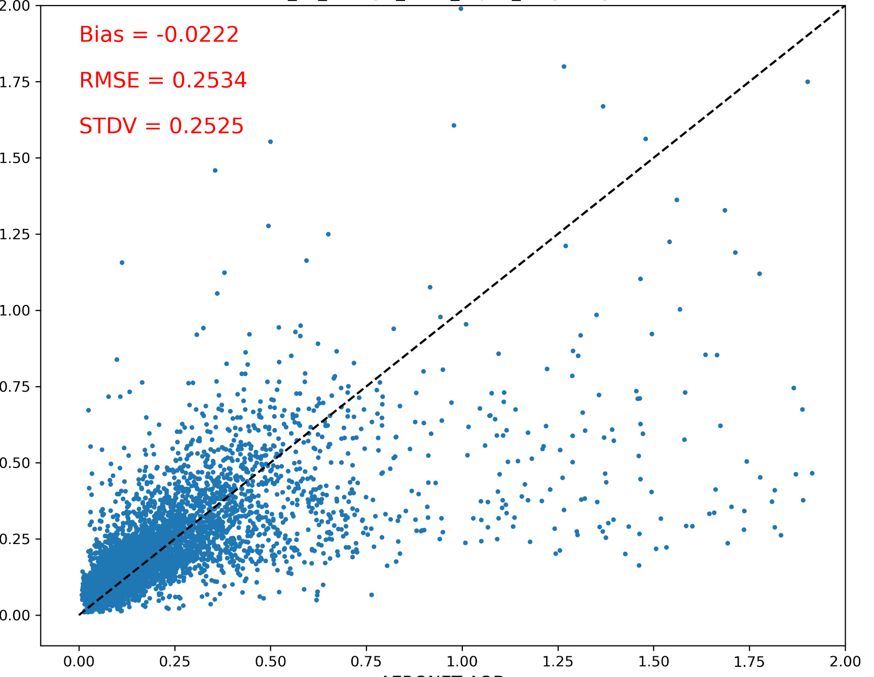
GOCART 6-h forecast verified against AERONET AOD
(01 Aug 2021 - 14 Aug 2021)
Thinning
Superobbing
global
global
On global scale, superobbing reduces the mean bias, RMSE and STDV, compared to thinning.
6-h forecasted AOD
6-h forecasted AOD
AERONET AOD
AERONET AOD
 | North America |  | Europe |  | South America |  | Africa |  | East Asia
 | Thin | Superob | Thin | Superob | Thin | Superob | Thin | Superob | Thin | Superob
BIAS | -0.0735 | -0.0669 | 0.0172 | 0.0199 | -0.0099 | -0.0043 | -0.0158 | -0.009 | 0.0027 | 0.0085
RMSE | 0.3644 | 0.3631 | 0.0904 | 0.0882 | 0.1128 | 0.1225 | 0.1275 | 0.1216 | 0.1867 | 0.1767
Yaping Wang

Slide 8
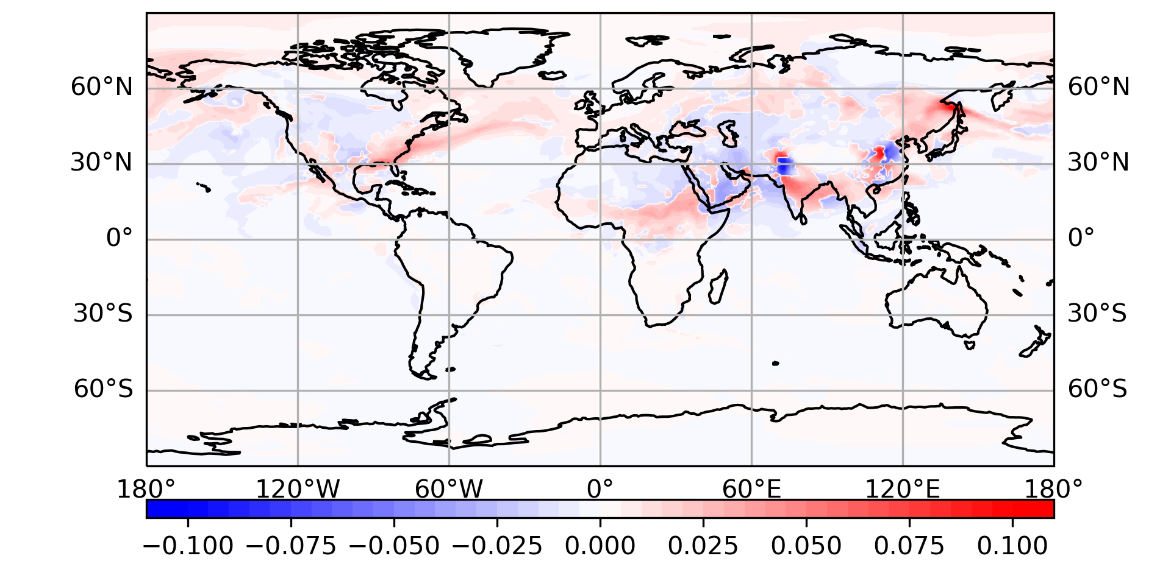
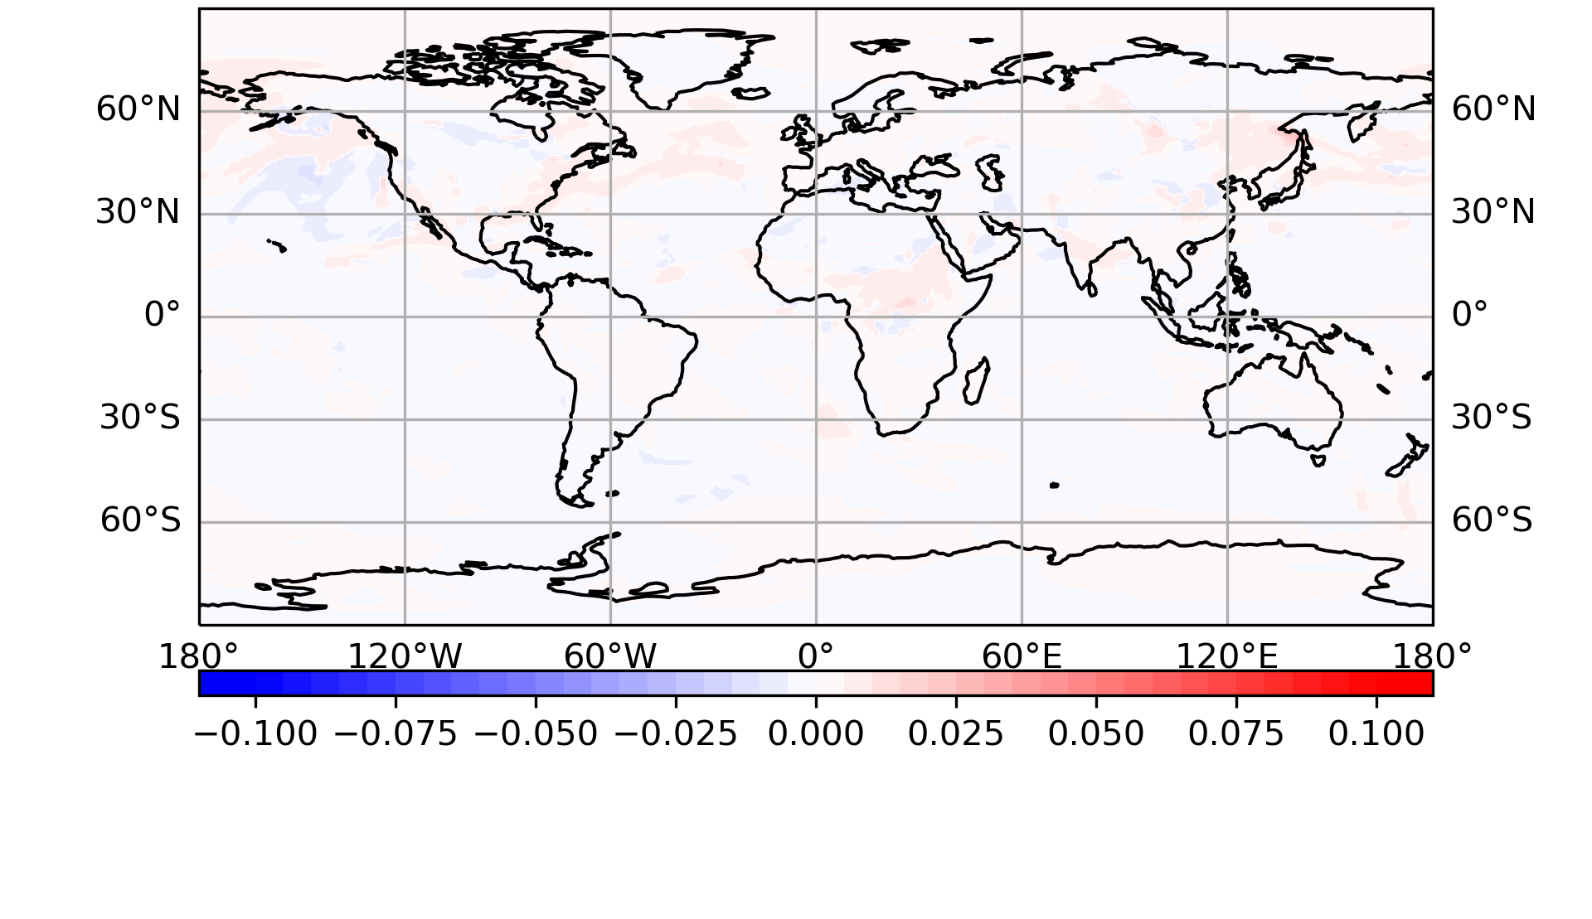
Variational Bias Correction
Exploring multiple bias predictors:
Difference of absolute error against CAMS (VarBC (sulfate) - CTRL)
Positive: VarBC has smaller error
Negative: CTRL has smaller error
Difference of absolute error against CAMS (VarBC (Constant) - CTRL)
Positive: VarrBC has smaller error
Negative: CTRL has smaller error
Varbc reduces the error over east Asia, central Africa, Europe and east North America.
Not much impact
Yaping Wang

Slide 9
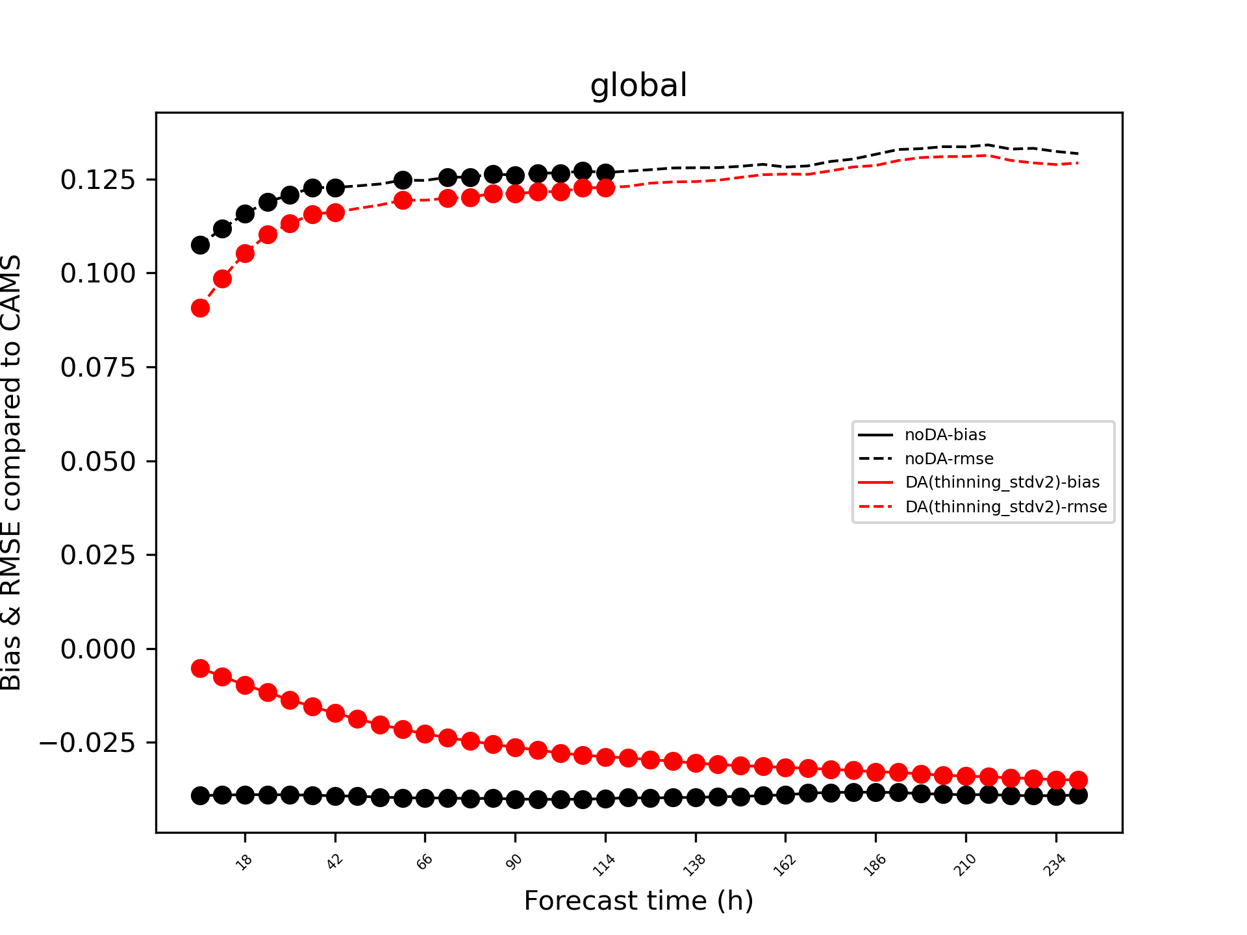
AOD Assimilation Impact
Student T-test suggests that (somewhat limited sample size) VIIRS AOD assimilation can have a significant impact on the model’s forecast of AOD.
“Significant” reduction of RMSE out to ~5 days and mean bias reduction out to ~10 days are possible.
Work/figures courtesy Yaping Wang, SAIC@EMC

Slide 10
Regional AQ DA
AQMv7 features UFS coupled regional FV3 with CMAQ, but no DA for initialization.
Nitrogen dioxide (NO₂) from TROPOMI (EMC)
AOD and PM (GSL)
Future: TEMPO, GeoXO; state + emissions adjustment through strongly coupled DA

Slide 11
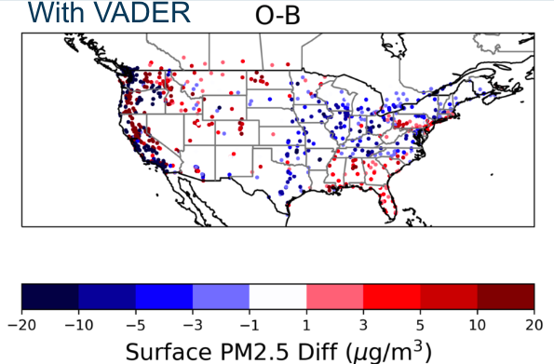
Regional AQ DA
Surface PM2.5 Assimilation
Work at GSL on generic PM2.5 variable transform in JEDI/VADER
VADER is a generic variable change tool, as part of JEDI, that can convert from different models to other fields (like CMAQ species to PM2.5)
Hongli Wang, Ruifang Li

Slide 12
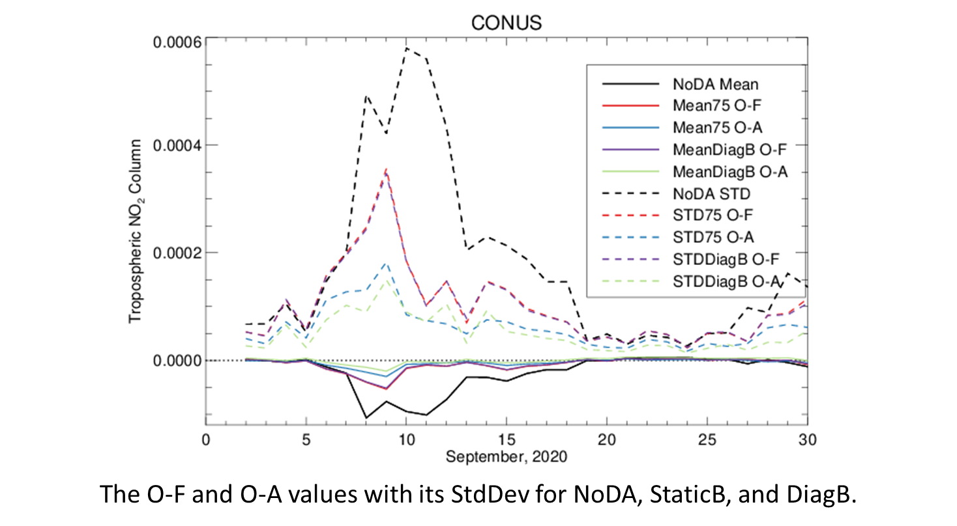
TROPOMI NO₂ DA
The JEDI DA capability was added to the regional model workflow. The Plot shows the O-F and O-A from the prototype cycling for NCEP’s air quality model with JEDI NO₂ DA.
Large departures the second week of Sept. due to wildfire NO₂ overestimated in the model, reduced by DA
Tuning of B matrix similar to that being done in the global system, leveraging lessons learned
Hyundeok Choi

Slide 13
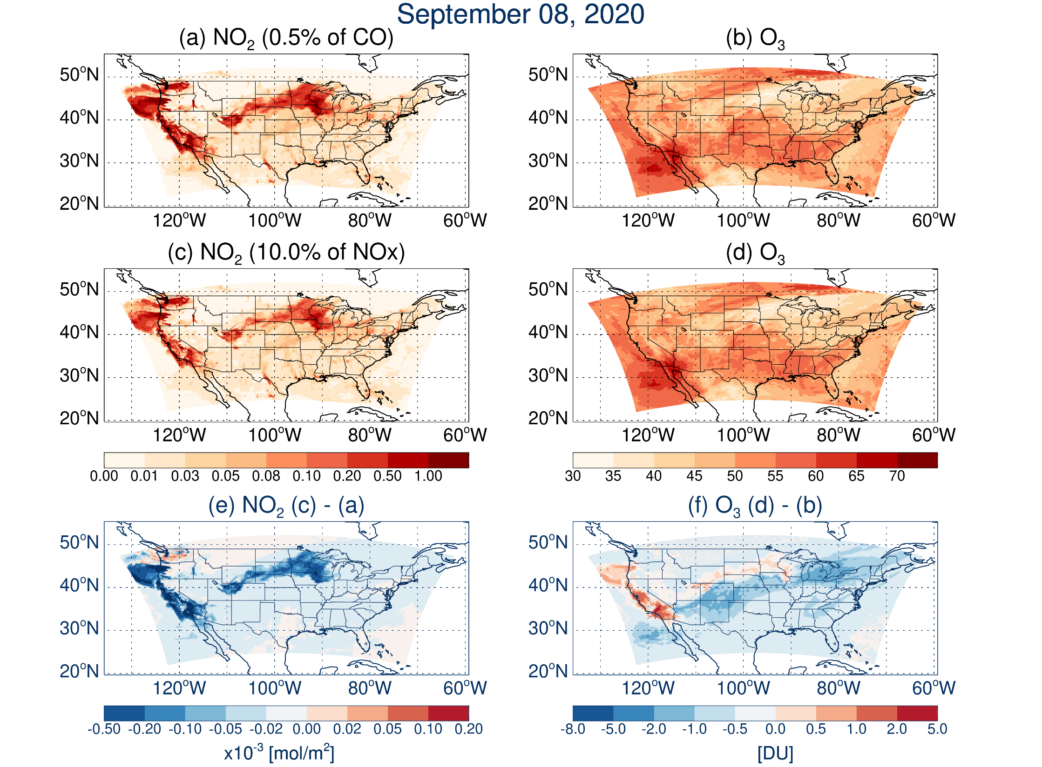
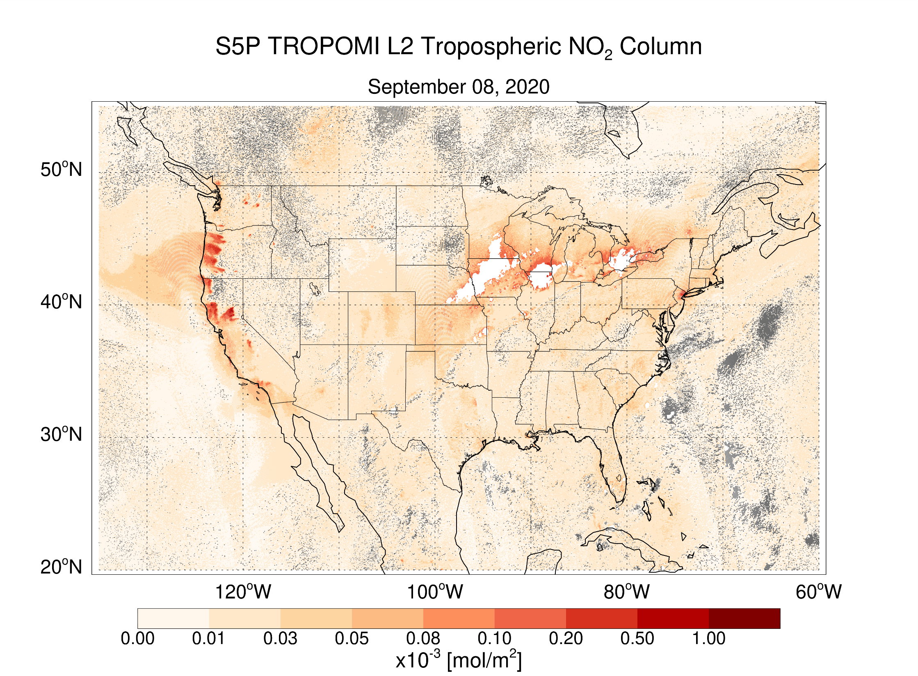
TROPOMI NO₂ DA
Testing of NOx emissions has shown that changes in how the emissions for wildfires are defined are better fitting the TROPOMI NO₂ obs, which in turn, improve O₃ prediction
This is important because DA is not great at fixing systematic biases, but can help identify them!
Hyundeok Choi

Slide 14
Questions
Summary
Work is progressing on NCEP’s first operational global aerosol analysis capability
JEDI-based system
Climatological background error covariance tuning + quality control and advanced observation usage testing is happening now
Target to implement as part of GFSv17/GEFSv13
Regional AQ DA efforts are underway but less mature
Longer term plans to include ensemble methods, simultaneous state and emissions estimation, and strongly coupled with the atmospheric DA
?
cory.r.martin@noaa.gov

