Slide 1
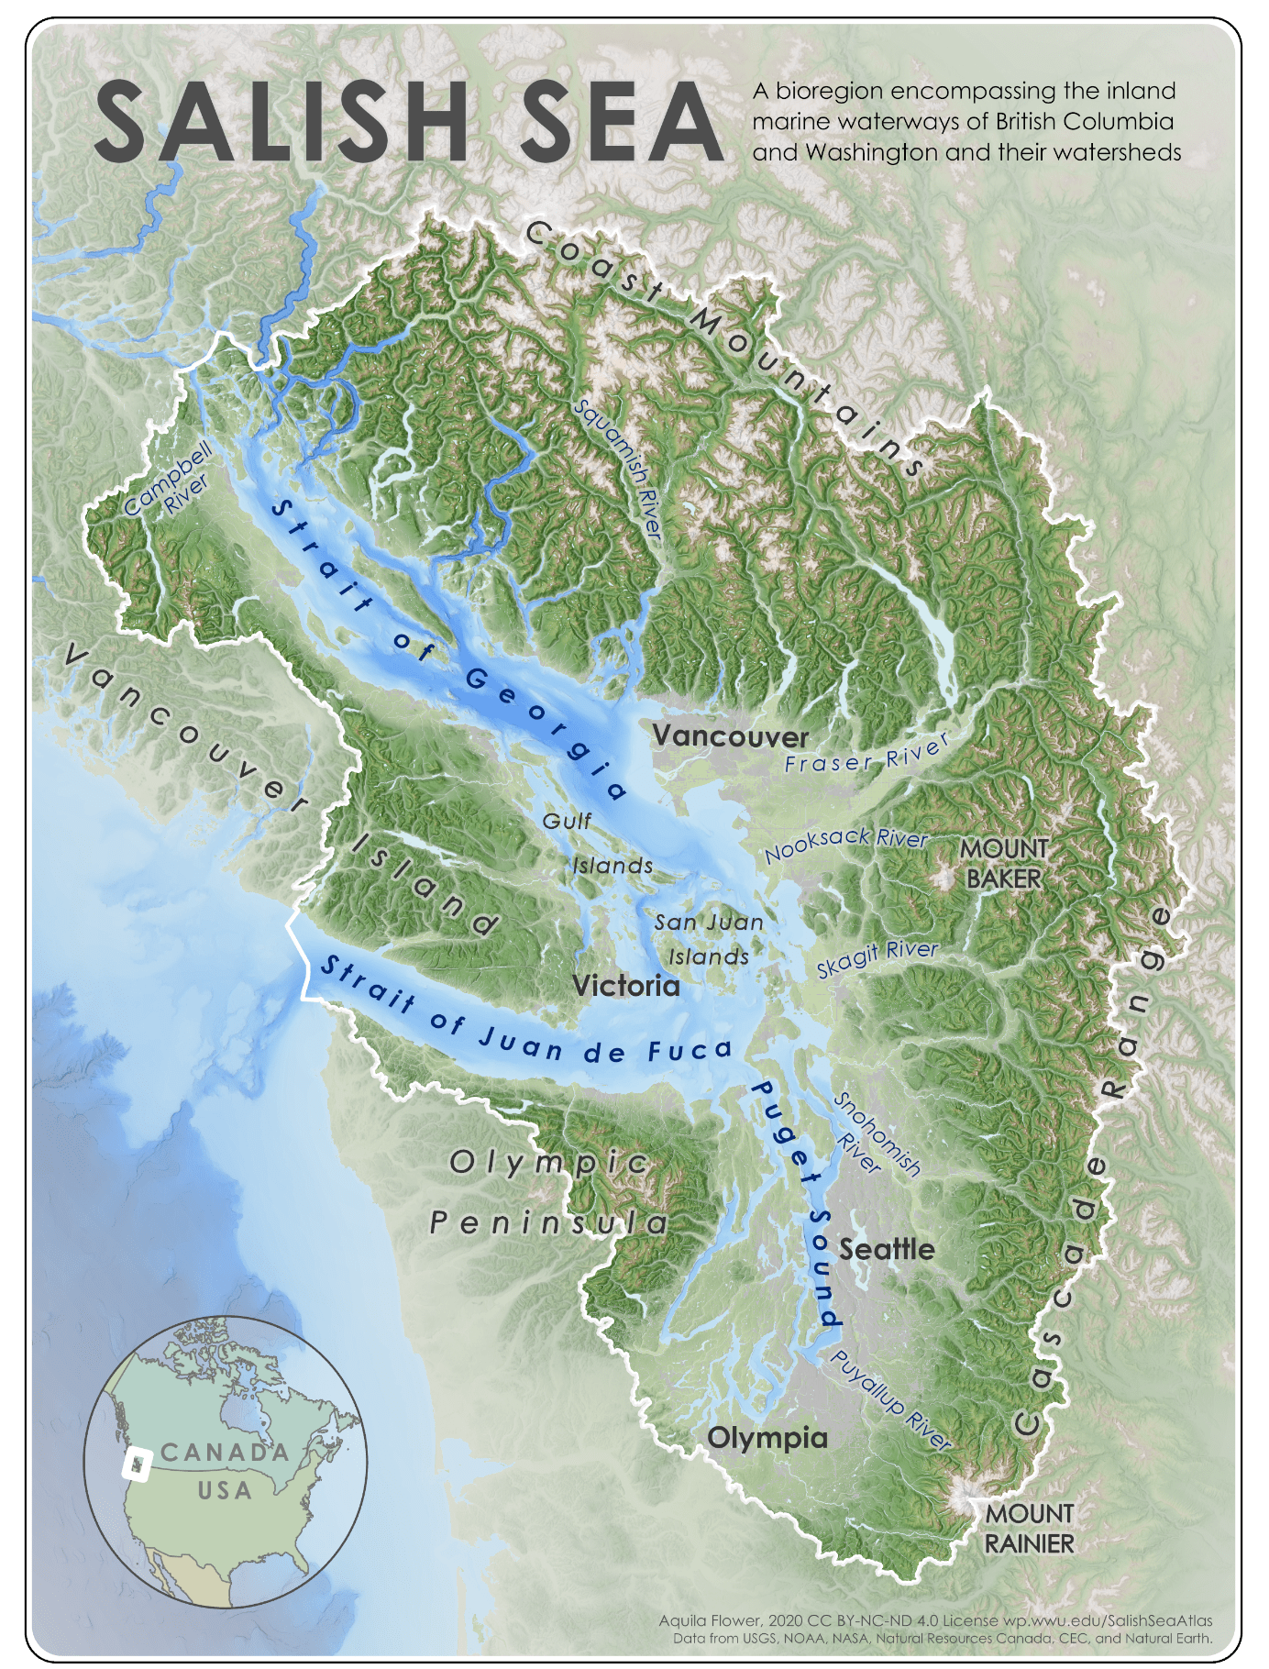
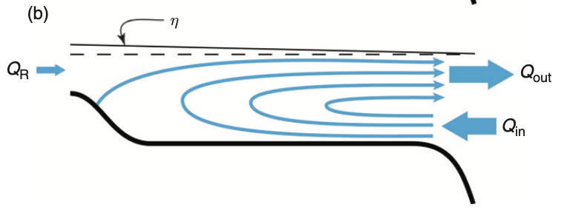
Impacts of exchange flow on multi-tracer budgets
in the Salish Sea
Canada
Jilian Xiong, Parker MacCready, Aurora Leeson
Pacific Ocean
Outflow
Estuarine circulation
Inflow
(MacCready and Banas, 2011)
U.S.
(Flower, 2021)
Jilian Xiong (jxiong7@uw.edu)

Slide 2
Exchange flow in the Salish Sea: ‘Underwater Amazon’
Estuarine circulation
(MacCready and Banas, 2011)
Chesapeake Bay (Xiong et al., 2021):
Jilian Xiong (jxiong7@uw.edu)

Slide 3
Exchange flow in the Salish Sea: ‘Underwater Amazon’
Estuarine circulation
(MacCready and Banas, 2011)
Chesapeake Bay (Xiong et al., 2021):
Question:
How important is exchange flow in controlling tracer budgets compared to other local processes?
(Heat, Total Nitrogen, Dissolved Oxygen)
Jilian Xiong (jxiong7@uw.edu)

Slide 4
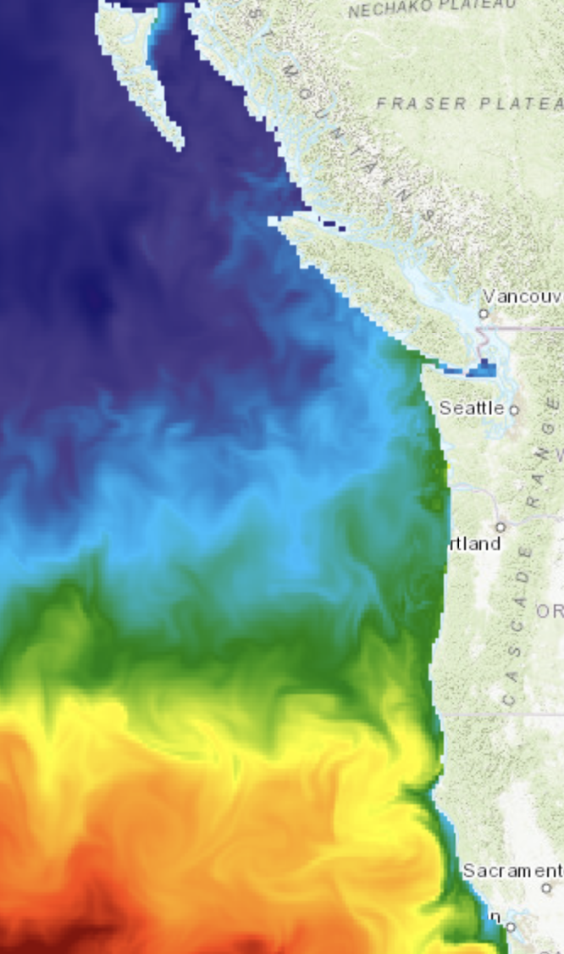
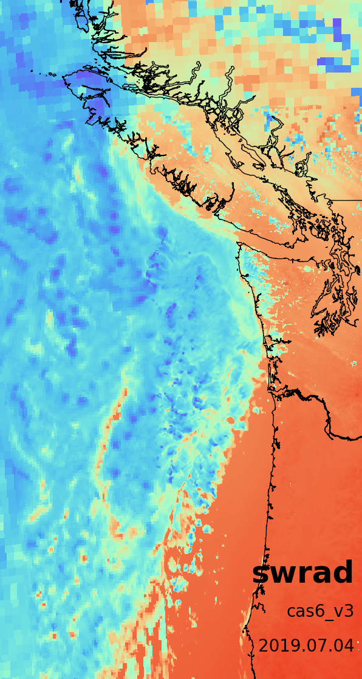
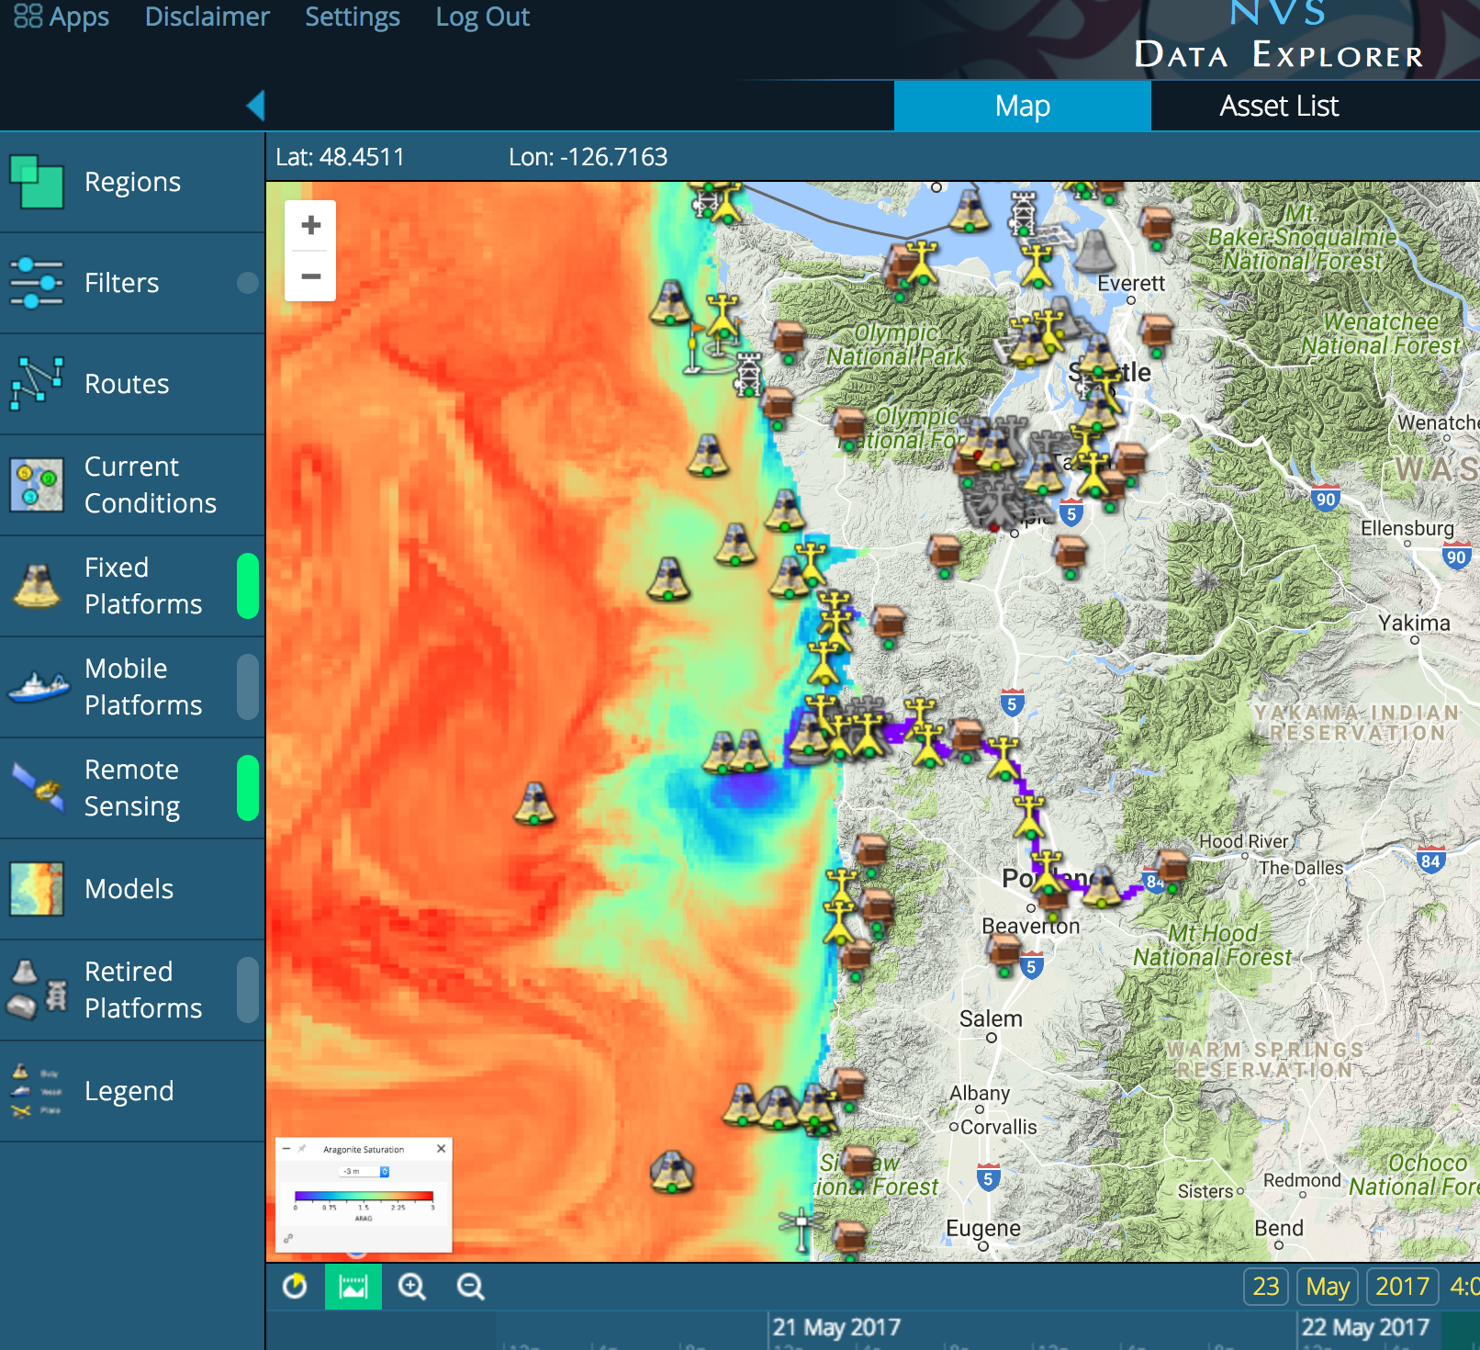
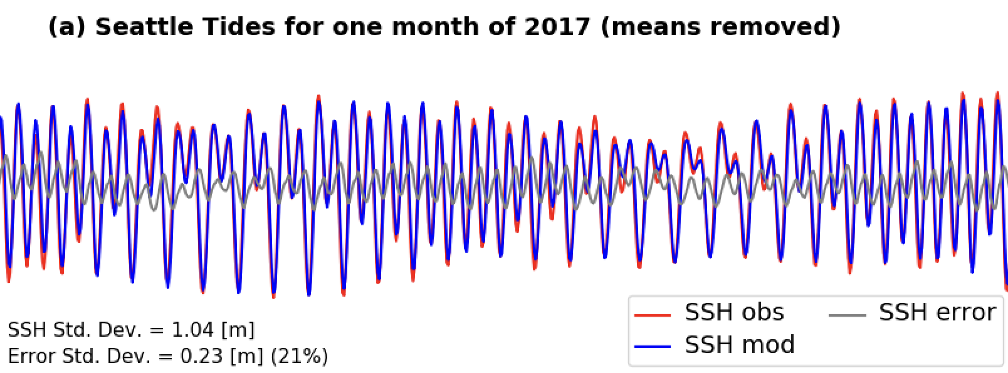
LiveOcean System Overview
3-day forecast appears daily on NANOOS NVS
HYCOM Ocean Fields
WRF Winds & Heating
Salish Sea
Vancouver
Island
TPXO Tides
Washington
Oregon
USGS & Canadian Rivers
Jilian Xiong (jxiong7@uw.edu)

Slide 5
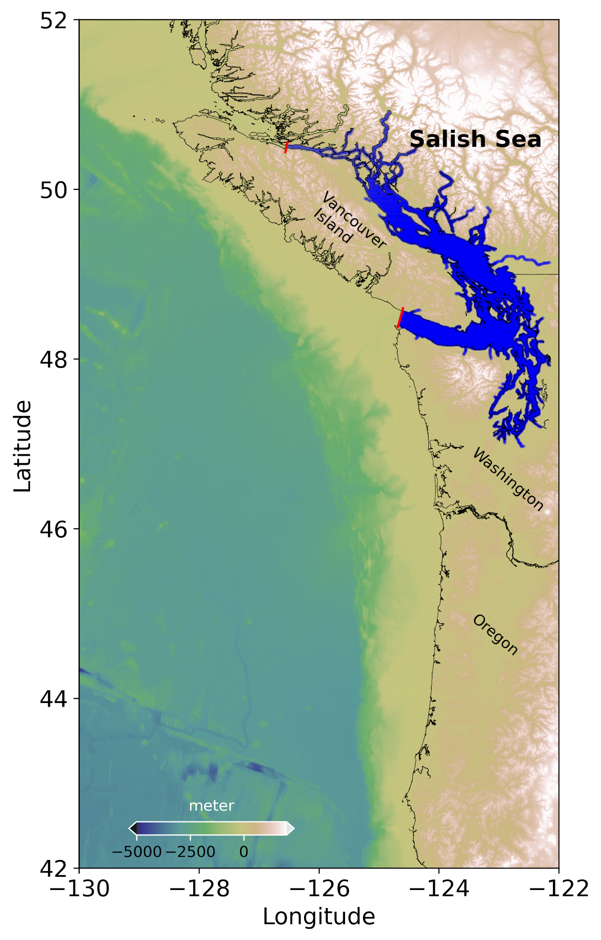
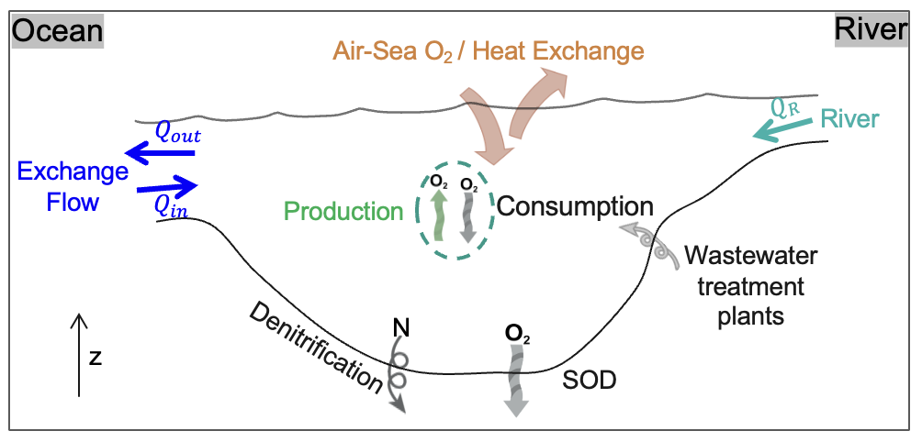
Tracer Budgets: Heat, Total Nitrogen, Dissolved Oxygen
LiveOcean domain
Salish Sea
Jilian Xiong (jxiong7@uw.edu)

Slide 6
Tracer Budgets
Downwelling
upwelling
Air-Sea heat flux
Heat
Exchange flow
Jilian Xiong (jxiong7@uw.edu)

Slide 7
Tracer Budgets
Downwelling
upwelling
Air-Sea heat flux
Heat
Exchange flow
Exchange flow
TN
Jilian Xiong (jxiong7@uw.edu)

Slide 8
Tracer Budgets
Downwelling
upwelling
Air-Sea heat flux
Heat
Exchange flow
Exchange flow
TN
Photosynthesis
Air-Sea O₂ flux
DO
DO consumption
Exchange flow
Jilian Xiong (jxiong7@uw.edu)

Slide 9
Seasonal cycle of exchange flow tracer budget – heat
Exchange Flow
Jilian Xiong (jxiong7@uw.edu)

Slide 10
Seasonal cycle of exchange flow tracer budget – heat
Exchange Flow
Outflow
Inflow
Normal Exchange Flow
Reversed Exchange Flow
Outflow
Warm
Inflow
Inflow
Cold
Outflow
Cold
Jilian Xiong (jxiong7@uw.edu)

Slide 11
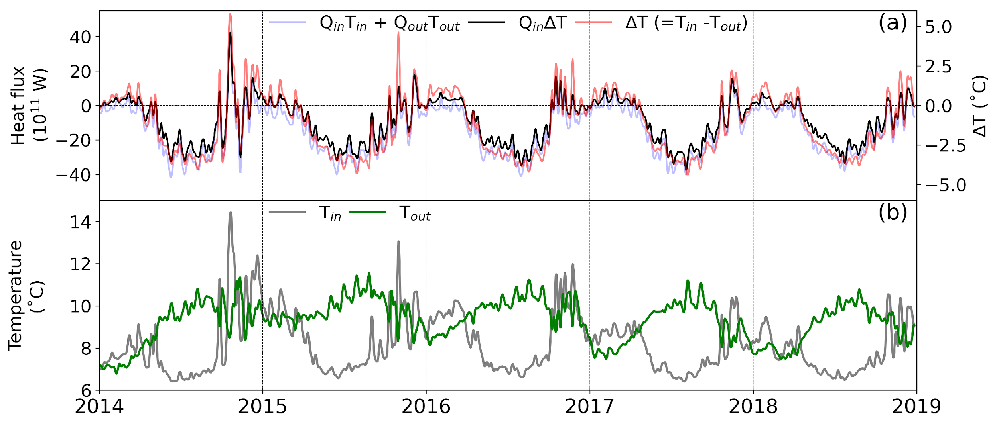
Impacts of exchange flow on multi-tracer budgets in the Salish Sea
Volume-integrated budgets for heat, total nitrogen, and oxygen are computed from LiveOcean for the Salish Sea estuarine system.
The exchange flow plays a leading role, with a clear annual cycle, but is balanced by a different collection of other terms in each budget.
The difference between inflow and outflow tracer concentrations (∆C) determines the distinct seasonality of the exchange flow budget term, and is more than the seasonal variation of the exchange flow volume transport.
Jilian Xiong (jxiong7@uw.edu)

