Slide 1

UFS-Coastal Applications for tropical storms using coupled SCHISM and WAVEWATCH III
Yunfang Sun^{1,7}, Jana Haddad¹, Panagiotis Velissariou², Ali Abdolali³, Ufuk Turuncoglu⁴, Ann Tsay⁴, Joseph Zhang⁵, Saeideh Banihashemi⁶, Ali Salimi-Tarazouj⁶, Armaghan Abed-Elmdoust¹, Saeed Moghimi¹
¹ NOAA/NOS/OCS ² NOAA/NWS/NHC
³ USACE/ERDC ⁴ UCAR/NCAR
⁵ VIMS ⁶ NOAA/NWS/EMC
⁷ ERT/SFI

Slide 2

Outline
Introduction of UFS-Coastal
Tropical storm (Hurricane Ian, 2022, as an example)
Numerical Experiments
Simulation Results
Summary
NOAA/NOS’ Office of Coast Survey
Contact: Yunfang.sun@noaa.gov

Slide 3
UFS-Coastal (Coastal Application)
The Unified Forecast System (UFS) is a community-based, coupled, comprehensive Earth modeling system. The UFS numerical applications span local to global domains and predictive time scales from sub-hourly analyses to seasonal predictions (https://ufscommunity.org).
The Unified Forecast System Weather Model (UFS-weather, https://github.com/ufs-community/ufs-weather-model) is a prognostic model that can be used for short- and medium-range research and operational forecasts.
Unified Forecast System Coastal model (UFS-Coastal) is forked from UFS-weather, and therefore, inherits driver functionality from the UFS weather model, is added coastal ocean models (https://github.com/oceanmodeling/ufs-weather-model), is a modeling framework for coupled coastal applications and regional forecasts.
NOAA/NOS’ Office of Coast Survey
Contact: Yunfang.sun@noaa.gov

Slide 4


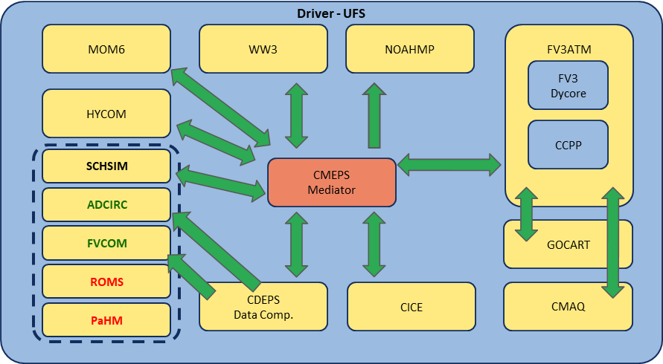
UFS-Coastal (Coastal Application)
https://github.com/oceanmodeling/ufs-weather-model
UFS Coastal Model Development Team
Hernan G. Arango
Changsheng Chen
Carsten Lemmen
Siqi Li
Saeed Moghimi
Edward Myers
Jianhua Qi
Yunfang Sun
Ufuk Turuncoglu
Panagiotis Velissariou
Joannes Westerink
Damrongsak Wirasaet
Y. Joseph Zhang
And more
NOAA/NOS’ Office of Coast Survey
Contact: Yunfang.sun@noaa.gov

Slide 5
Modules used in this study
Sa_u10m(atm)
Sa_v10m(atm)
Sa_pslv(atm)
Sw_wavsuu(wav)
Sw_wavsuv(wav)
Sw_wavsvv(wav)
CMEPS
Mediator
Sa_u10m(atm)
Sa_v10m(atm)
Sa_pslv(atm)
So_u(ocn)
So_v(ocn)
NUOPC Cap
NUOPC Cap
Sa_u10m(atm)
Sa_v10m(atm)
So_u(ocn)
So_v(ocn)
SCHISM
CDEPS
Sw_wavsuu(wav)
Sw_wavsuv(wav)
Sw_wavsvv(wav)
NUOPC Cap
WW3
NOAA/NOS’ Office of Coast Survey
Contact: Yunfang.sun@noaa.gov

Slide 6
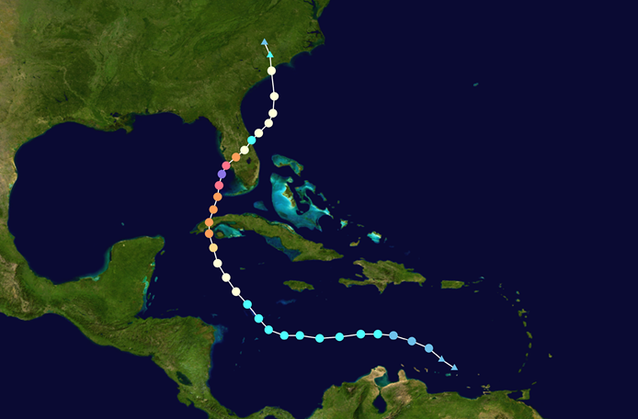
Tropical Storm (Hurricane Ian, 2022)
A tropical storm is a swiftly rotating meteorological phenomenon featuring a central low-pressure system, a closed atmospheric circulation at lower levels, robust winds, and an orderly configuration of thunderstorms that yield substantial precipitation and squalls.
Hurricane Ian originated from the coast off west Africa, moved northwestward through the Caribbean Sea. Upon entering the Gulf of Mexico, it landed in southwest Florida on September 28, 2022, with peak marine winds reaching up to 72 m/s (161 mph). Storm surge heights exceeded 2.1 m in Fort Myers and approximately 4 m in Fort Myers Beach. After traversing central Florida, it returned offshore into the Atlantic and made its final landfall in South Carolina.
Hurricane Ian 2022 was classified as a Category 5 Atlantic hurricane, resulting in significant wind damage and flooding, becoming one of the most costly natural disasters on record.
NOAA/NOS’ Office of Coast Survey
Contact: Yunfang.sun@noaa.gov

Slide 7
Numerical Experiments with UFS-Coastal
ID | UFS-Coastal test cases
1: coastal_ian_sch | SCH
2: coastal_ian_ww3 | WW3
3: coastal_ian_ww3_obc | WW3 (with obc)
4: coastal_ian_atm2sch | ATM+SCH
5: coastal_ian_atm2ww3 | ATM+WW3
6: coastal_ian_atm2ww3_obc | ATM+WW3 (with obc)
7: coastal_ian_atm2sch2ww3 | ATM+SCH+WW3
8: coastal_ian_atm2sch2ww3_obc | ATM+SCH+WW3 (with obc)
SCH: Semi-implicit Cross-scale Hydroscience Integrated System Model ( two-dimensional: depth-averaged)
WW3: WAVEWATCH III
ATM: Atmospheric forcing (ERA5 here, the fifth generation ECMWF reanalysis)
OBC: open boundary condition
NOAA/NOS’ Office of Coast Survey
Contact: Yunfang.sun@noaa.gov

Slide 8
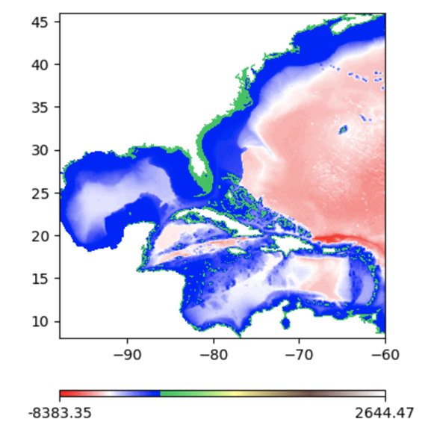
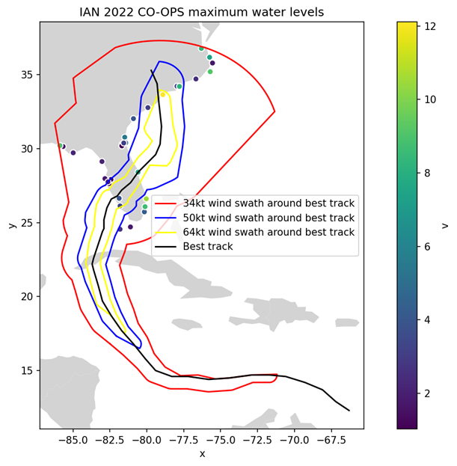
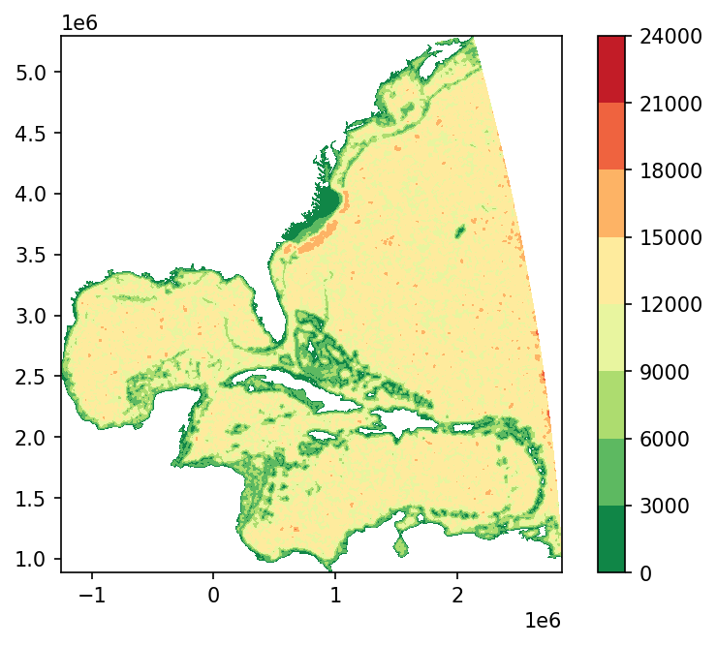
SCHISM computational domain
Bathymetry
Mesh Resolution: 1-20km
557481 nodes
1070195 cells
Hurricane Ian
Mesh size
NOAA/NOS’ Office of Coast Survey
Contact: Yunfang.sun@noaa.gov

Slide 9
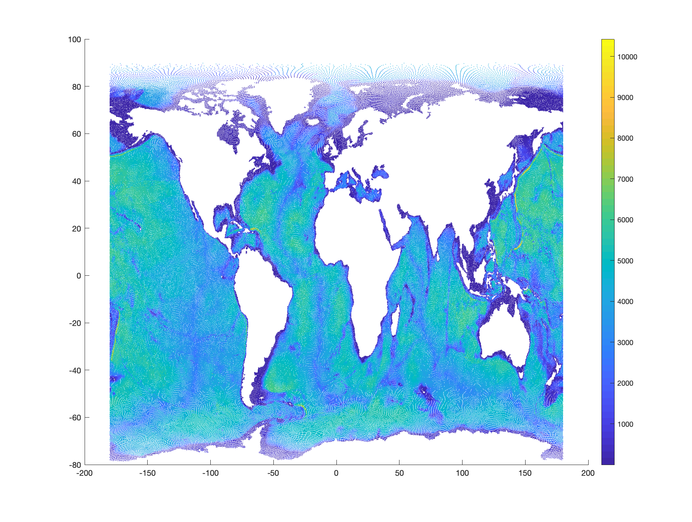
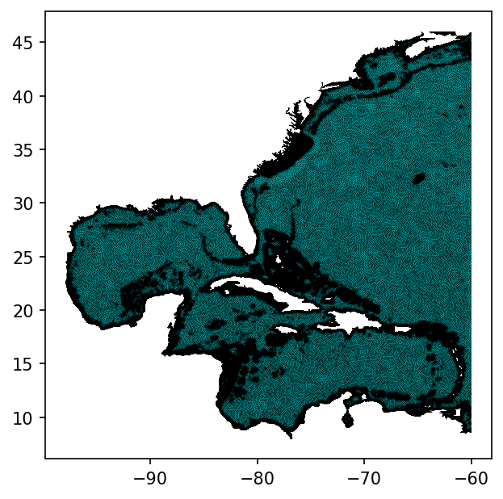
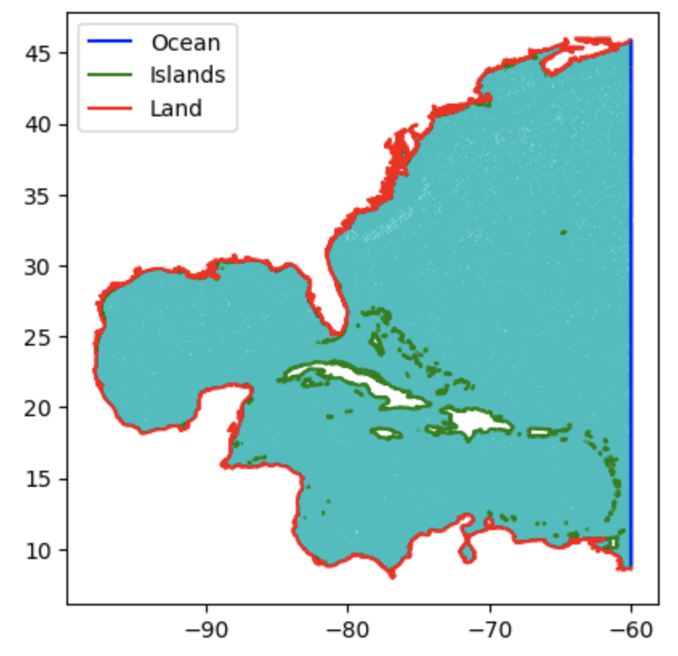
WW3 Domain and its open boundary
WW3 mesh:
557481 nodes
1070195 cells
Global WW3 domain
Global Stand-alone WW3 nodes (655113 nodes, 1290999 cells) and bathymetry (provide the 50 spectra bin in 36 directions in the 348 Atlantic WW3 boundary nodes)
NOAA/NOS’ Office of Coast Survey
Contact: Yunfang.sun@noaa.gov

Slide 10
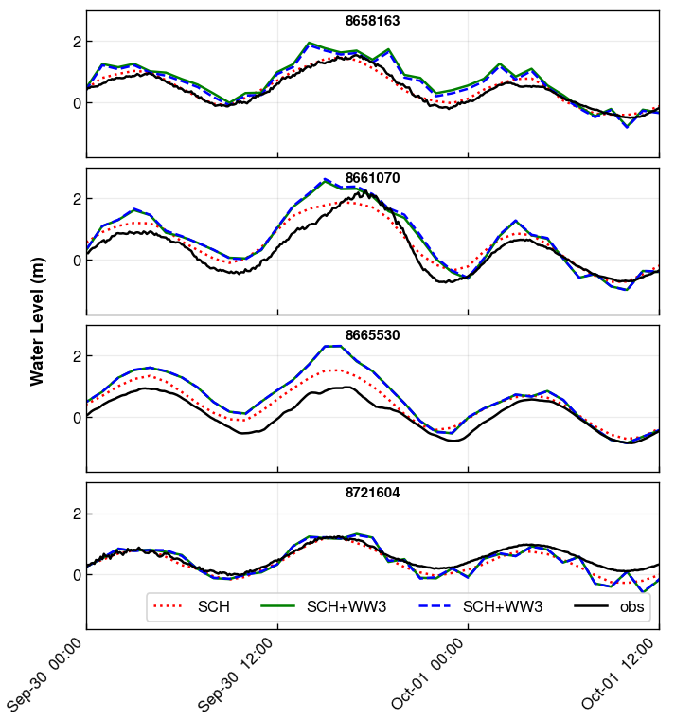
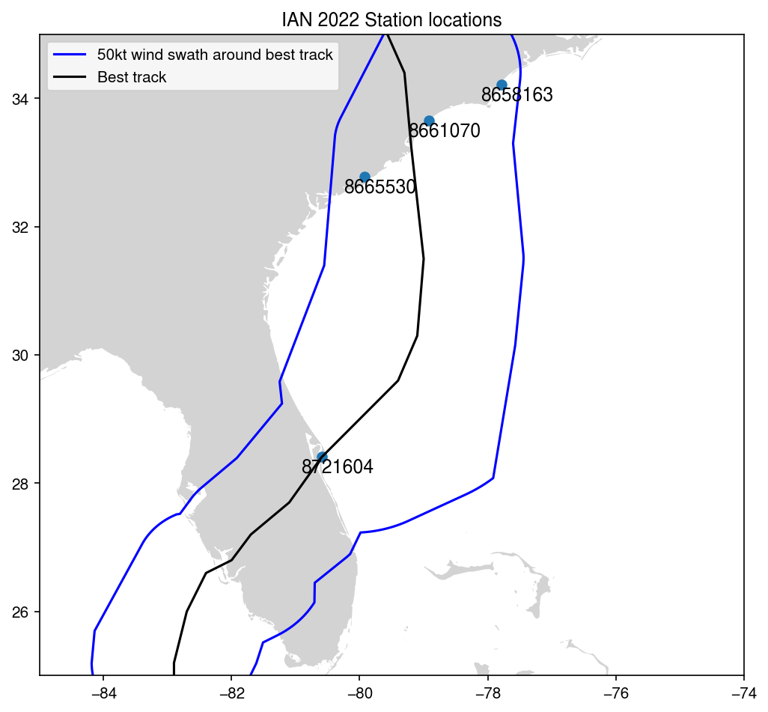
Sea level comparisons
CO-OPS Stations
NOAA/NOS’ Office of Coast Survey
Without wave obc
With wave obc
Contact: Yunfang.sun@noaa.gov

Slide 11
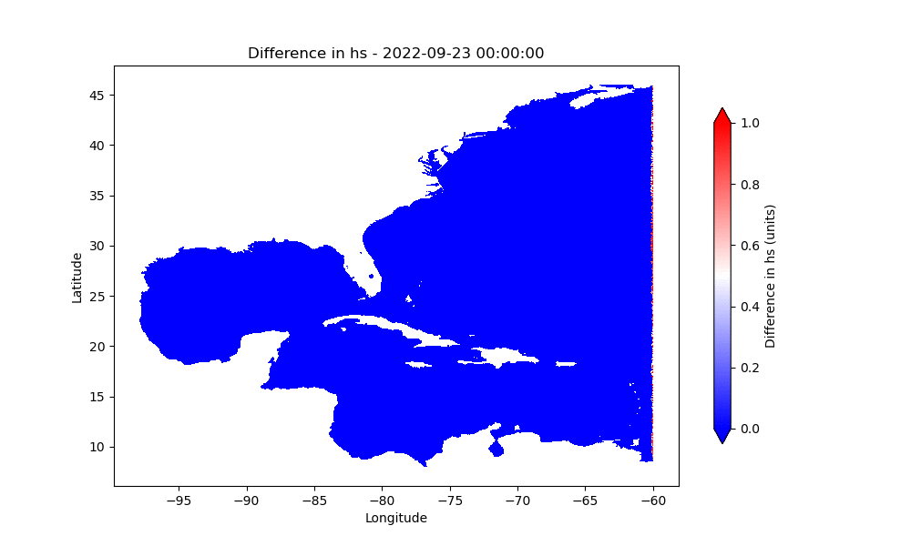
Wave boundary effects
Significant Wave Height
NOAA/NOS’ Office of Coast Survey
Contact: Yunfang.sun@noaa.gov

Slide 12
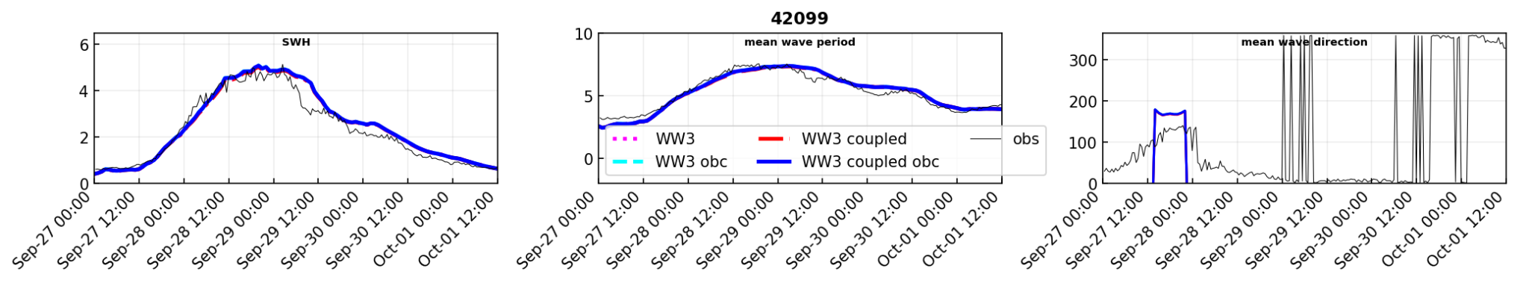
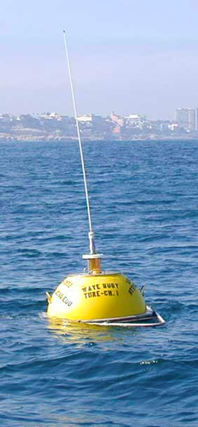
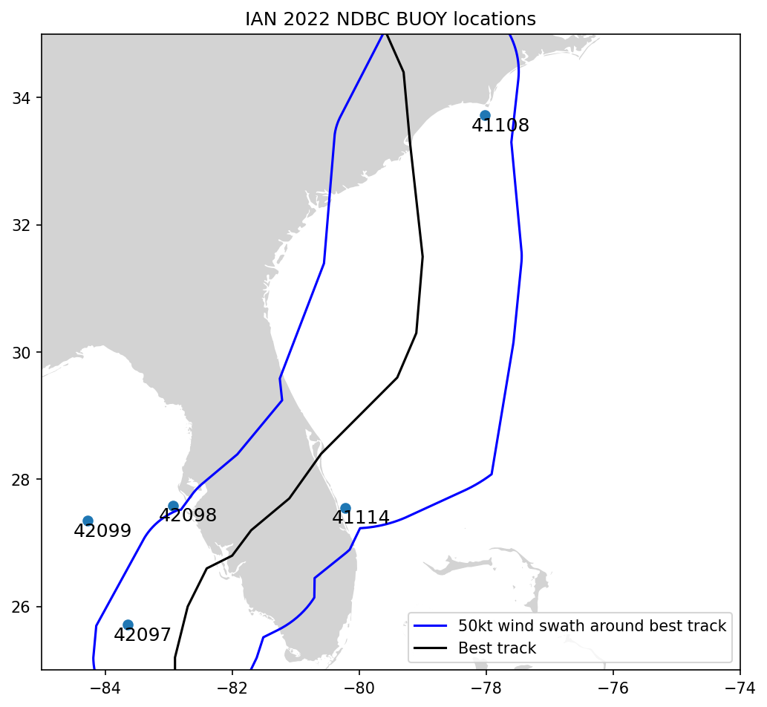
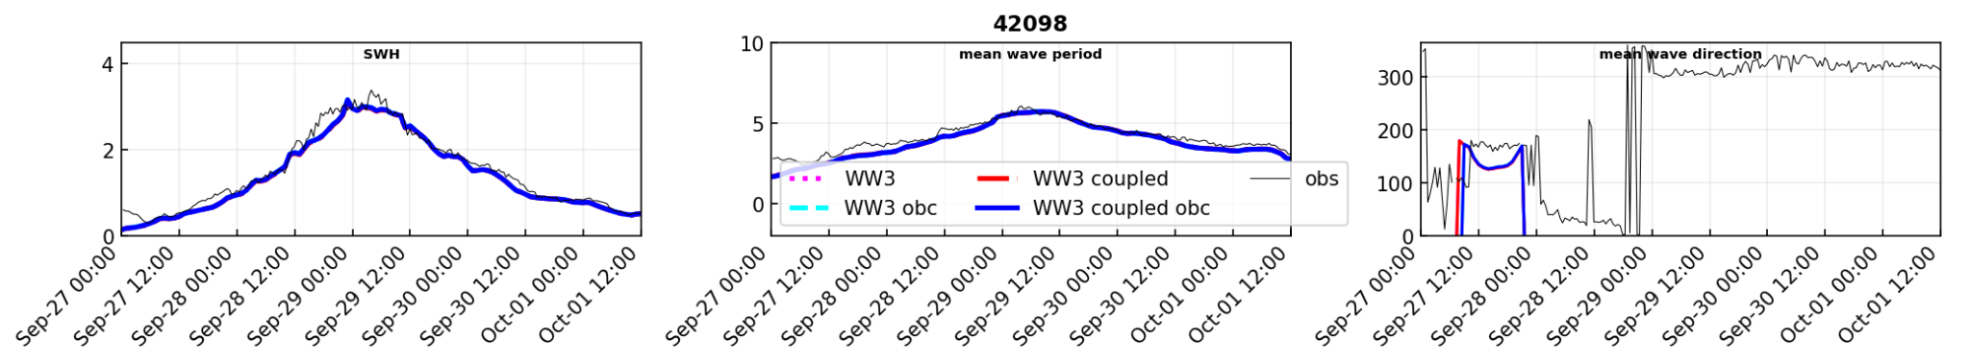
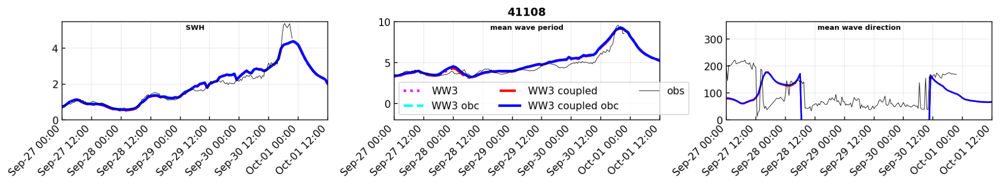
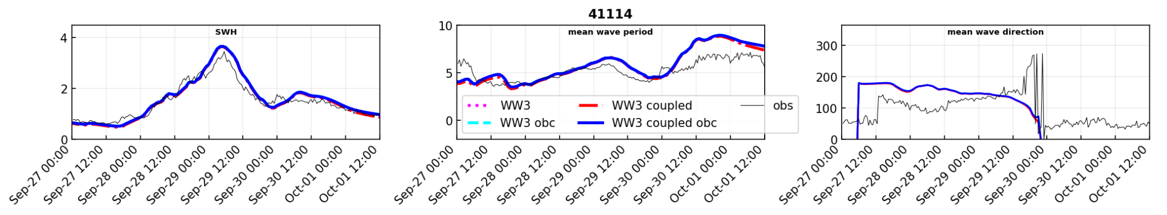
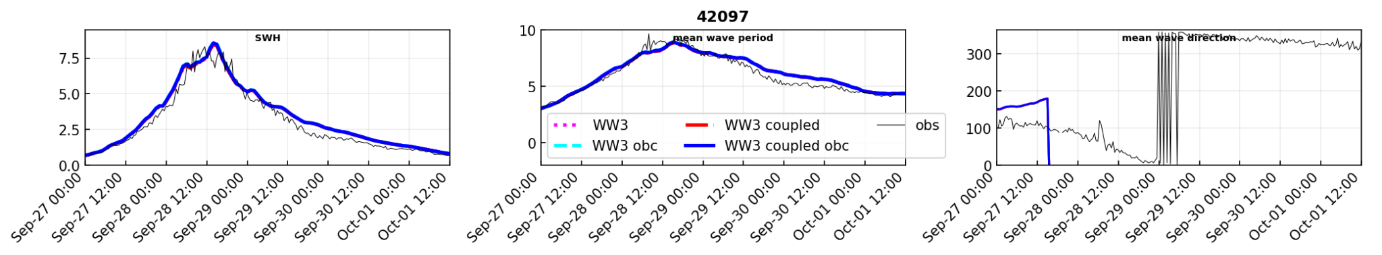
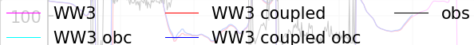
Wave parameter comparisons
NDBC Stations
NOAA/NOS’ Office of Coast Survey
Contact: Yunfang.sun@noaa.gov

Slide 13
Summary
The simulation and analysis of coastal ocean responses to tropical storms is a key use-case for the Unified Forecast System-Coastal (UFS-Coastal) applications.
The wave-current interaction plays an important role in storm surge modeling, and its effects varies at different locations and time.
The experiments for Hurricane Ian demonstrates the predictive capabilities of UFS-Coastal in predicting total water levels, wave heights, and flood inundation regions.
NOAA/NOS’ Office of Coast Survey
Contact: Yunfang.sun@noaa.gov

Slide 14
Next Steps
Multi-meshes ( from low-resolution to high-resolution) will be tested for these 2D cases, after validations and it will be write to a manuscript.
3D SCHISM and WW3 coupling for UFS-Coastal is under development.
The coupled UFS-coastal application for ATM+SCHISM+WW3 will be implemented to Surge and Tide Operational Forecast System (STOFS)-Alaska.
NOAA/NOS’ Office of Coast Survey
Contact: Yunfang.sun@noaa.gov

Slide 15
Thank you for your attention!
Q/A
NOAA/NOS’ Office of Coast Survey
Contact: Yunfang.sun@noaa.gov

