Slide 1

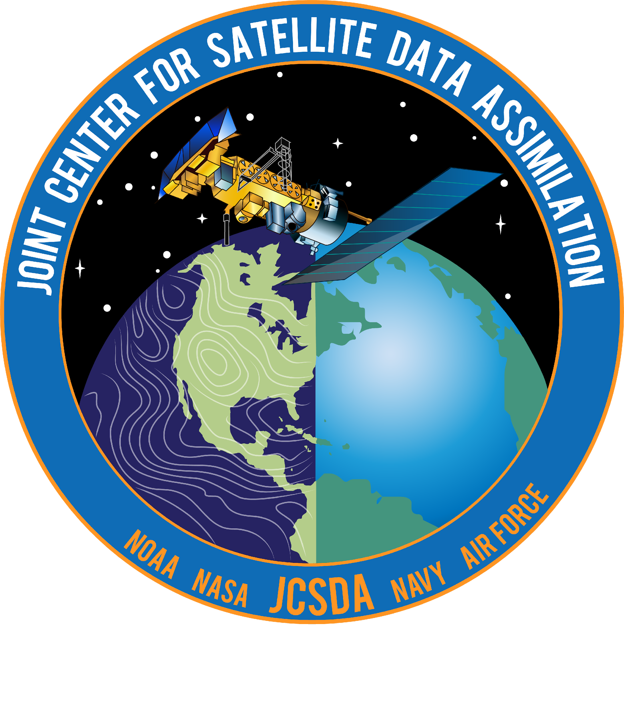
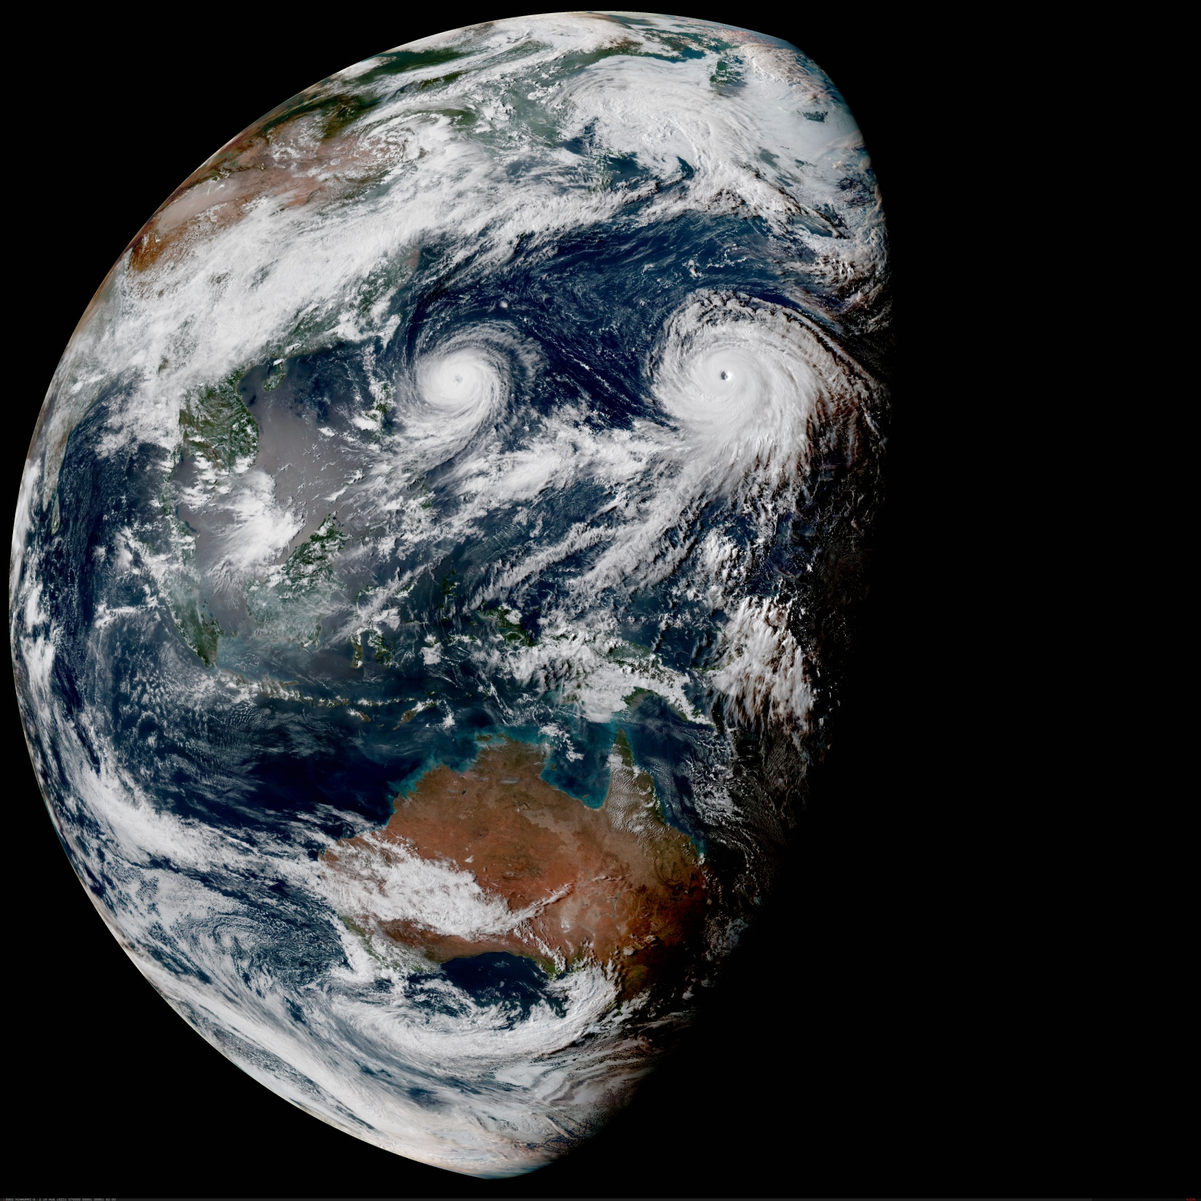
R2O-O2R for UFS Data Assimilation
Tom Auligné and team, Joint Center for Satellite Data Assimilation (JCSDA)
UIFCW:: July 25, 2024:: Jackson, MS.

Slide 2

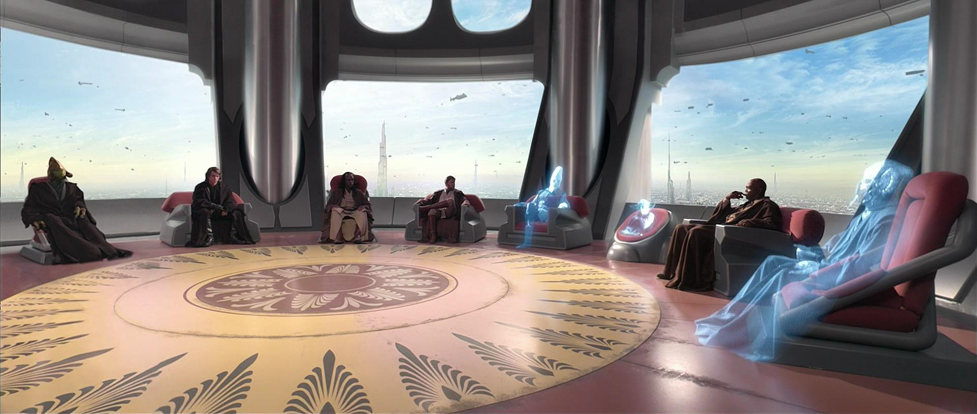



Joint Center for Satellite Data Assimilation (JCSDA)
Vision: An interagency partnership working to become a world leader in applying satellite data and research to operational goals in environmental analysis and prediction.
NOAA
NESDIS
NASA
GMAO
NCAR
UCAR
NOAA
OAR
JCSDA
Team
Air Force
Academia, private sector &
international
partners
Observers
NOAA
NWS
Navy
JCSDA - the force multiplier in bringing agencies’ resources together

Slide 3



The JEDI* “Quiet Revolution”
NOAA, NASA, USAF, Navy, Met Office, NSF-NCAR converging on next-gen, open-source, unified
data assimilation
Consortium of Jointness Share as much as possible without imposing a single approach
*Joint Effort for Data assimilation Integration

Slide 4
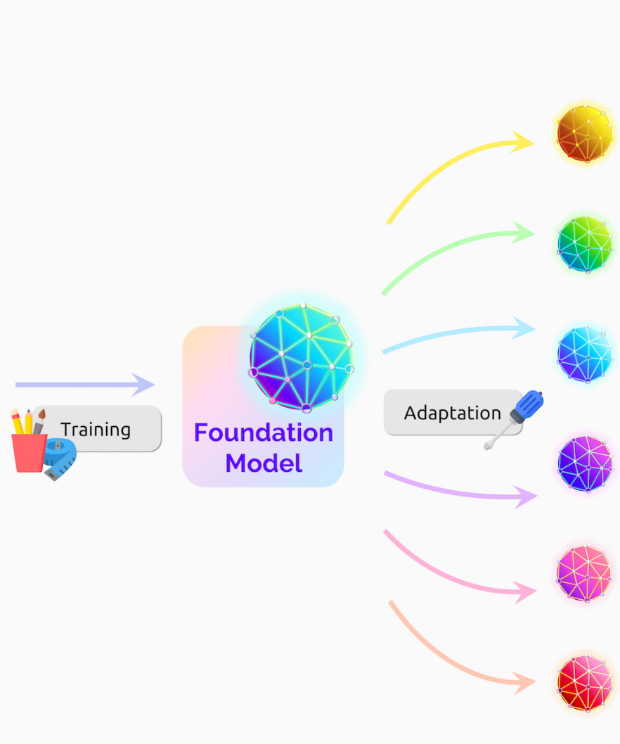
JEDI - The Force Multiplier
JCSDA Core Capabilities
Agency Applications
Global Weather (medium-range, S2S)
Algorithms
Radiative Transfer (CRTM)
Observation Operators (UFO)
Error Covariances (SABER)
DA Solvers (OOPS)
Land, cryosphere, hydrology
Interfaces
with 15+ numerical models
with 50+ observation types
Standard data access (IODA)
Variable transforms (VADER)
Marine, biogeochemistry
(CI/CD)
JEDI
Infrastructure
Data store (R2D2)
Generic Workflow (EWOK)
Hurricane, fire and extreme weather
Software
1.6M lines of open-source code
94% of PRs outside NOAA
97% is generic + reused
Pollution, air quality, carbon cycle, climate
Space weather

Slide 5
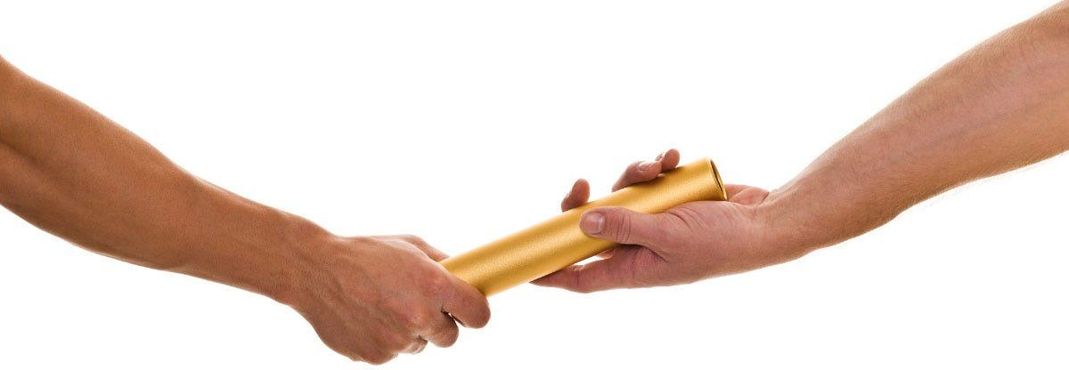
Open-Science Connecting Research and Operations
Joint Requirements
Demonstration
Research
Operations
J
C
S
D
A
Research
to
Demonstration
Foster scientific diversity without reinventing the wheel
Discuss planned contributions ahead of time (inclusive)
Effort is oriented toward optimal genericity (reusable)
Shared ownership of design/code (collaborative)
Basic object-oriented training may be needed (modular)
Developers need to also write tests and doc. (CI/CD)
Keep up with fast evolving system (agile)
Scientific Research
Building community tools to solve complex problems supporting agencies
Community Infrastructure

Slide 6




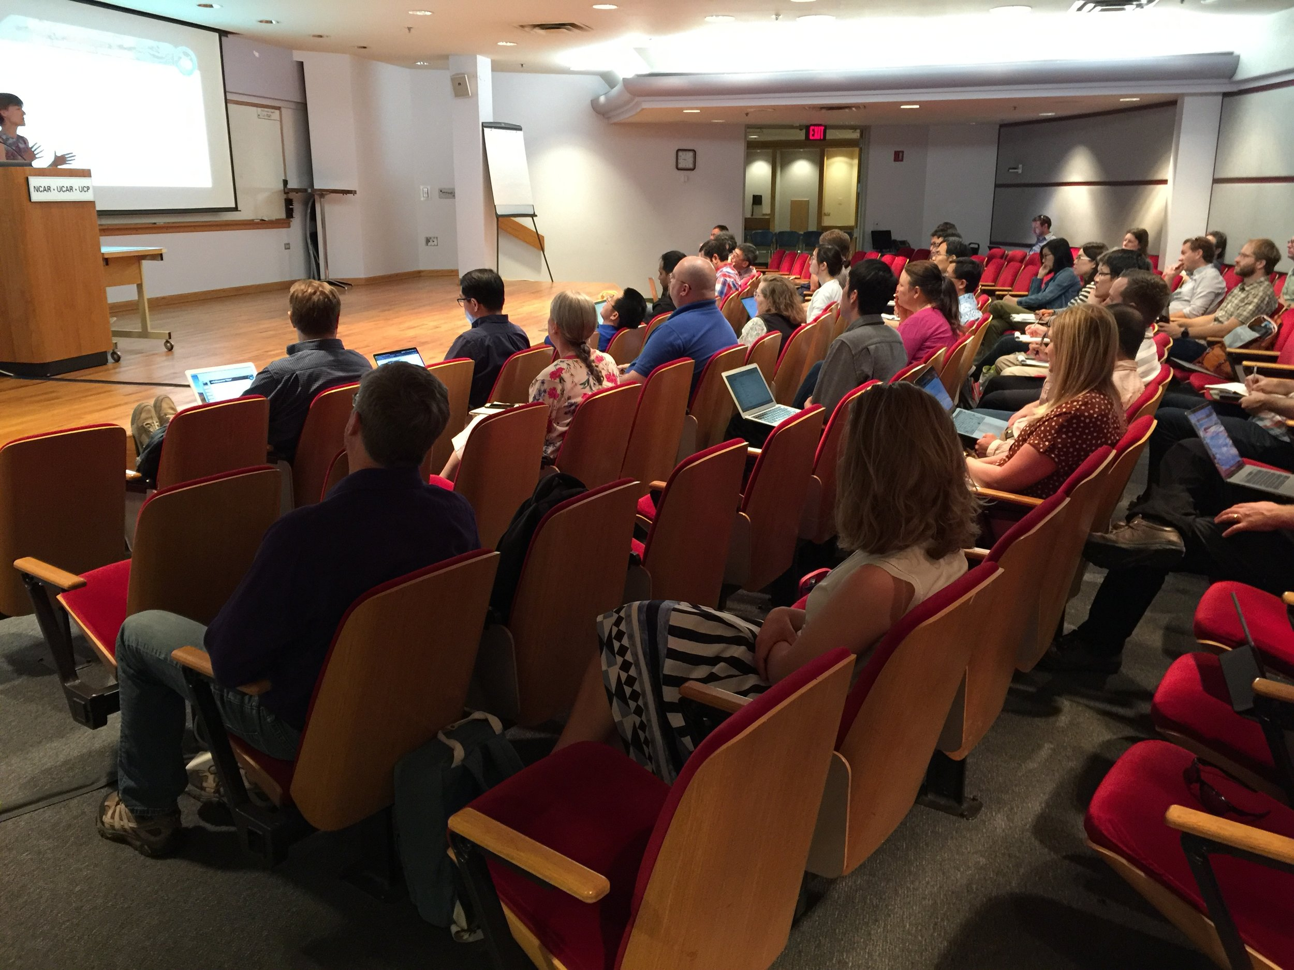
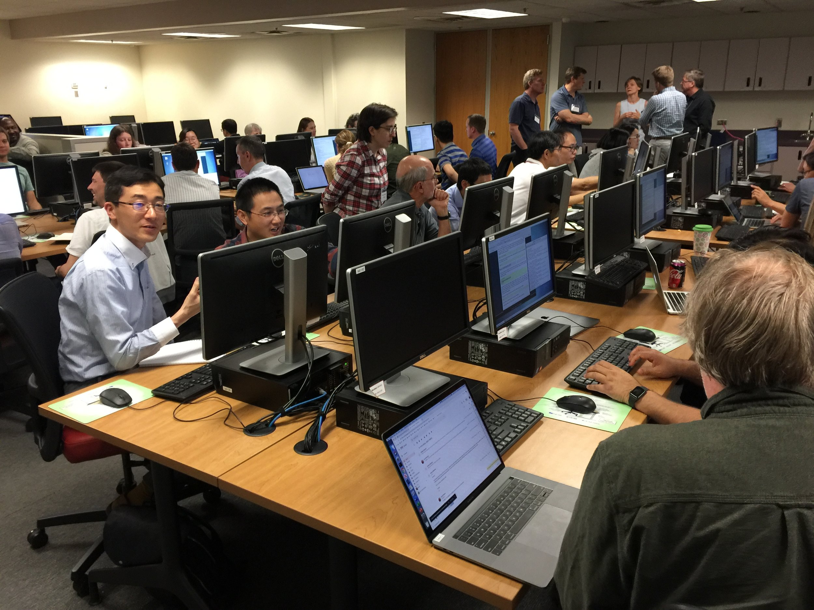
Joint Data Assimilation Testbed: JEDI-SkyLab
Support agencies
transition to operations
SkyLab-Large (T2O Pathfinder)
Continuous delivery of functional system
for downstream operations
End-to-end system hardening & optimization
SkyLab-Medium (Testbed)
Rapid integration and testing toward next-gen DA
Turnkey solution for real-world community experimental testbed
SkyLab-Small (JEDI-EDU)
Package to download + learn + experiment
+ evaluate within minutes on laptop
Integrate in university curriculum
Workforce training & community engagement
Continuous innovation
enabled by JEDI
Online tutorials
7 JEDI Academies
500+ padawans
(35 univ. + 11 private + 9 interna.)
Notes:
Key Goal: Community engagement and collective resilience
Capitalize on investments in the scientific community
Impact of JCSDA : Failed integration of research and operational communities
Stalled innovation due to lack of rapid system integration, prototyping & validation (CI/CD)
Increased susceptibility to key-staff turnover and inadequate workforce training
Reduction in flexibility to explore potentially disruptive technologies
Impact examples
Accumulate technical debt preventing future major innovation by 2025.
…

Slide 7
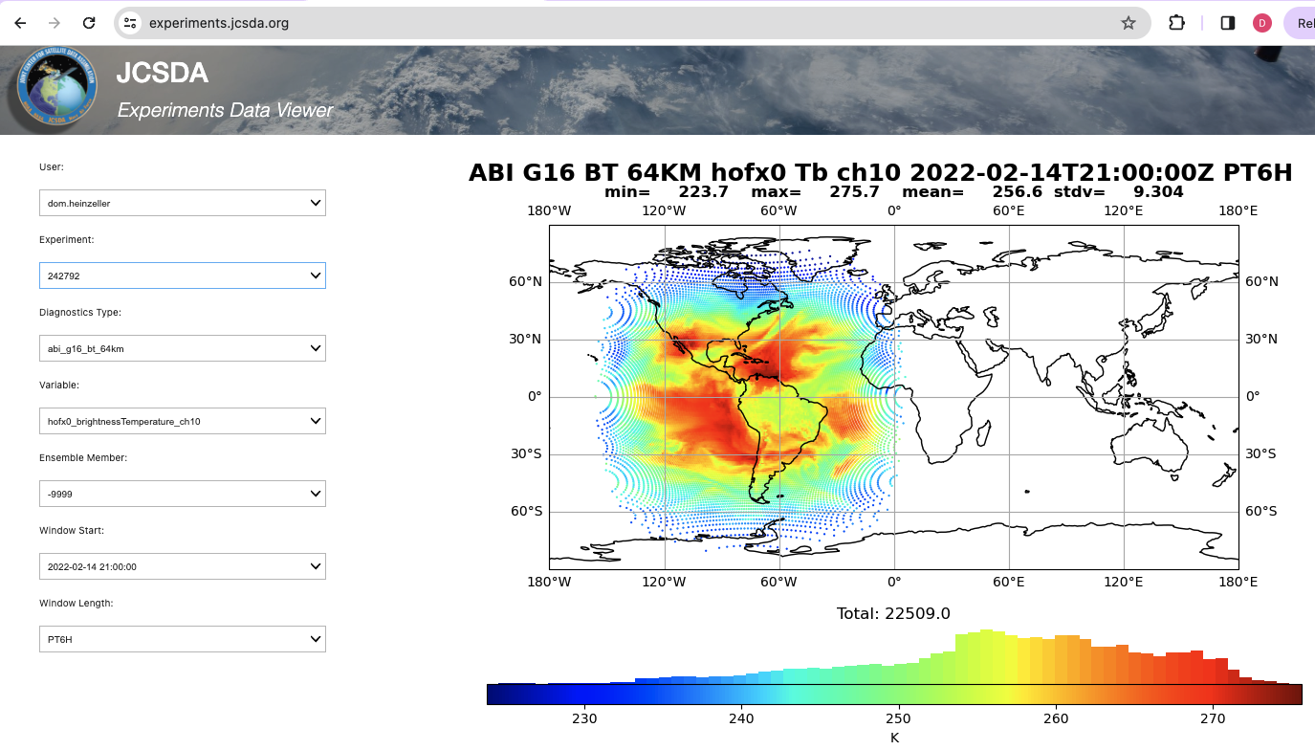

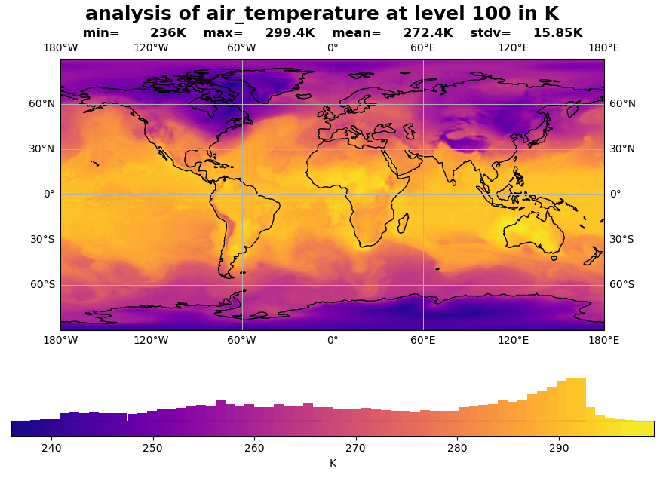

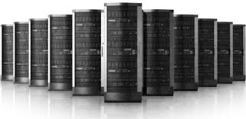
Joint Data Assimilation Testbed: JEDI-SkyLab
JEDI-Skylab is an end-to-end data assimilation system designed for testing, developing and demonstrating JEDI capabilities. It is highly configurable, portable, and exercised in CI, in daily development activities, for near real-time and retrospective experiments, and released quarterly.
JEDI-Skylab
EWOK
R2D2
CI (on AWS)
JEDI (Bundle)
spack-stack
Notes:
Key points:
JEDI-Skylab is the common goal at the Joint Center
fully functional and ready to use for research/development/releases/automated testing

Slide 8










Joint Data Assimilation Testbed: JEDI-SkyLab
Public
Releases
2022-07-18 JEDI-SKYLAB v1
2022-10-11 JEDI-SKYLAB v2
2023-01-09 JEDI-SKYLAB v3
2023-04-17 JEDI-SKYLAB v4
2023-07-17 JEDI-SKYLAB v5
2023-10-06 JEDI-SKYLAB v6
2024-01-18 JEDI-SKYLAB v7
2024-04-17 JEDI-SKYLAB v8
jcsda.org/jediskylab
Aerosols
Code Development and CI/CD
26 repositories, 1.6 Mio lines of open-source code
1,000+ PRs/commits/comments per week
2500 continuous unit + nightly integration tests
Platform support
5 HPCs (23 tested), 3 cloud, laptops
Porting time from months to days
Data Assimilation Applications for UFS
skylab-weather-land (FV3, NOAH-MP)
skylab-weather-variable-grid (MPAS)
skylab-aerosol-weather (GOCART)
skylab-marine (MOM6, CICE6)
SkyLab experiments data viewer: skylab.jcsda.org
Atmosphere
Constituents
JEDI
Ocean
Land
Snow
Waves
Sea ice

Slide 9
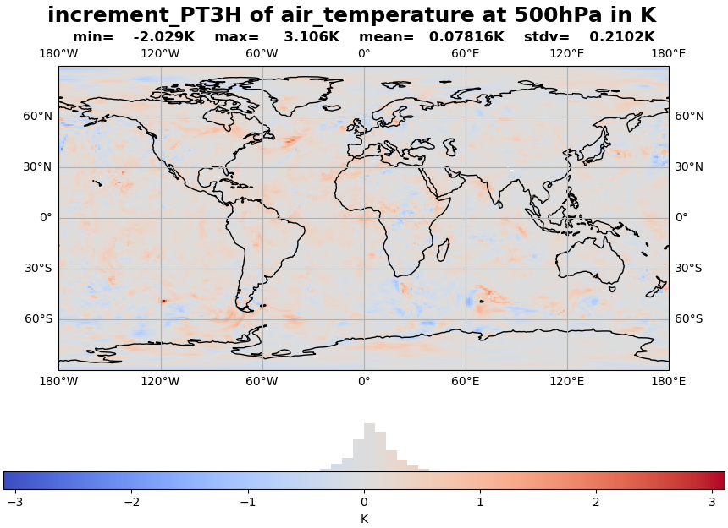
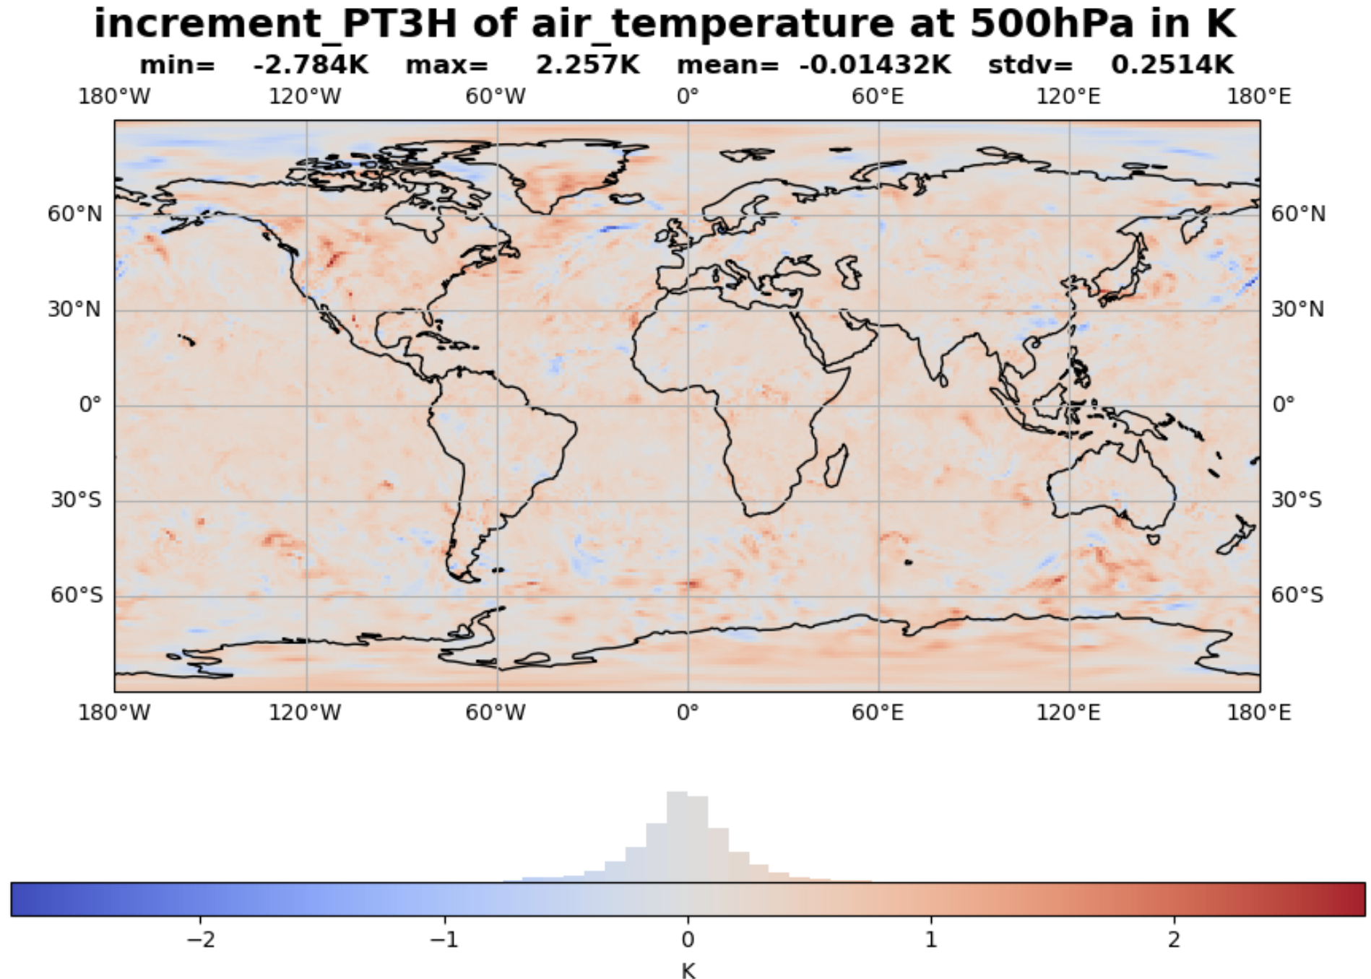
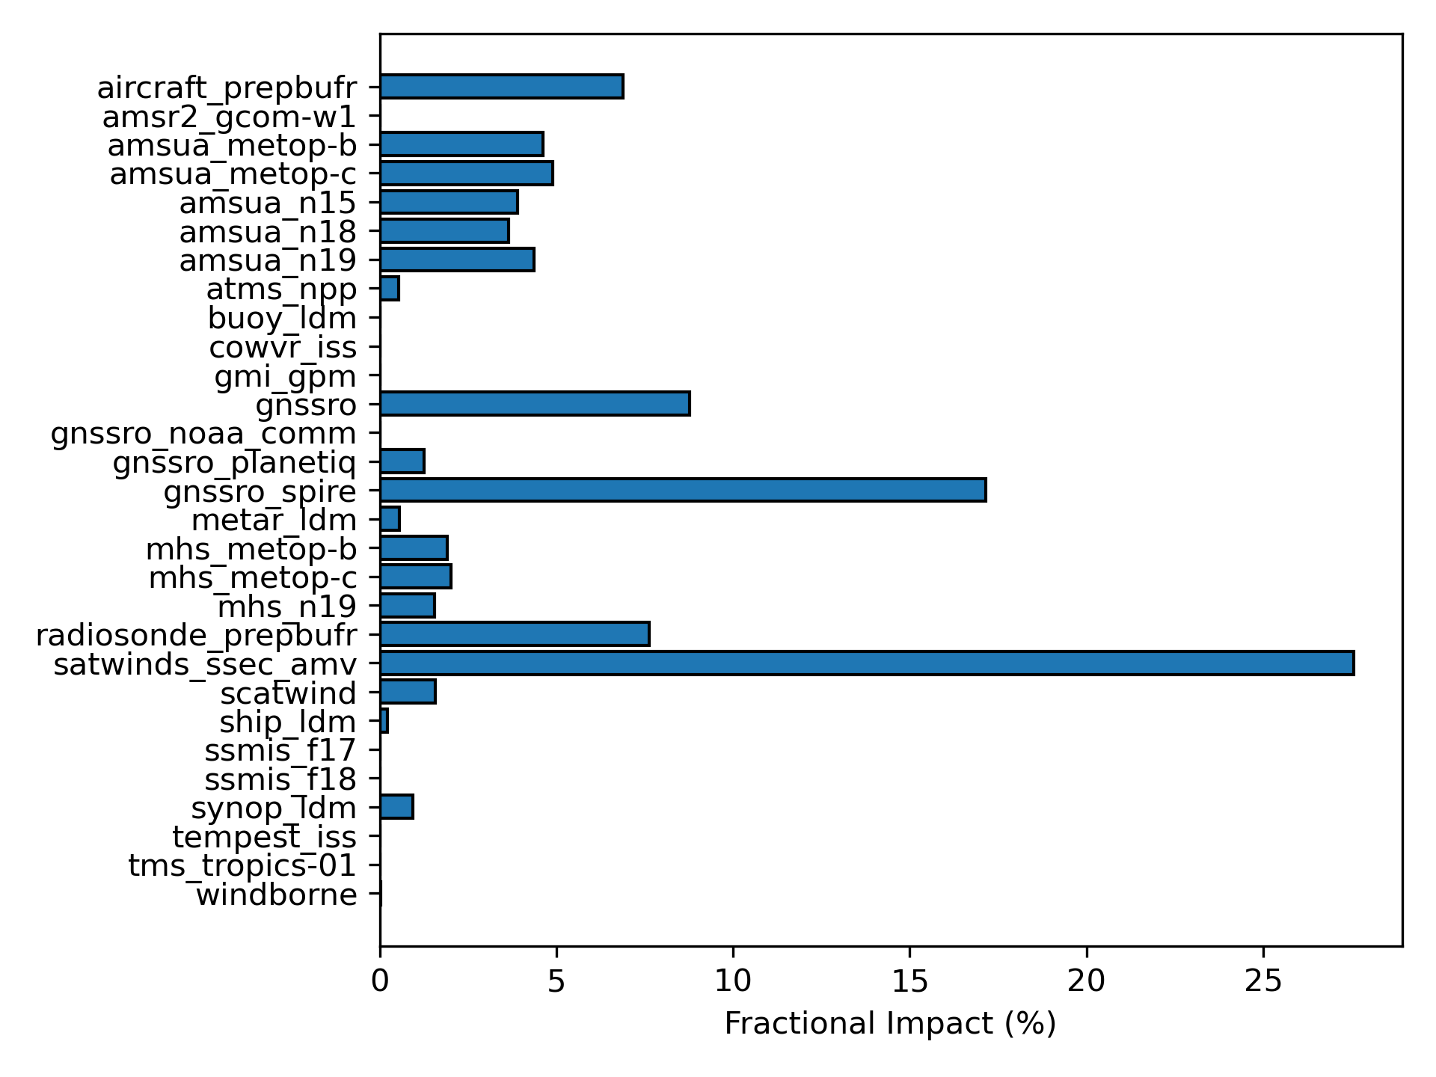
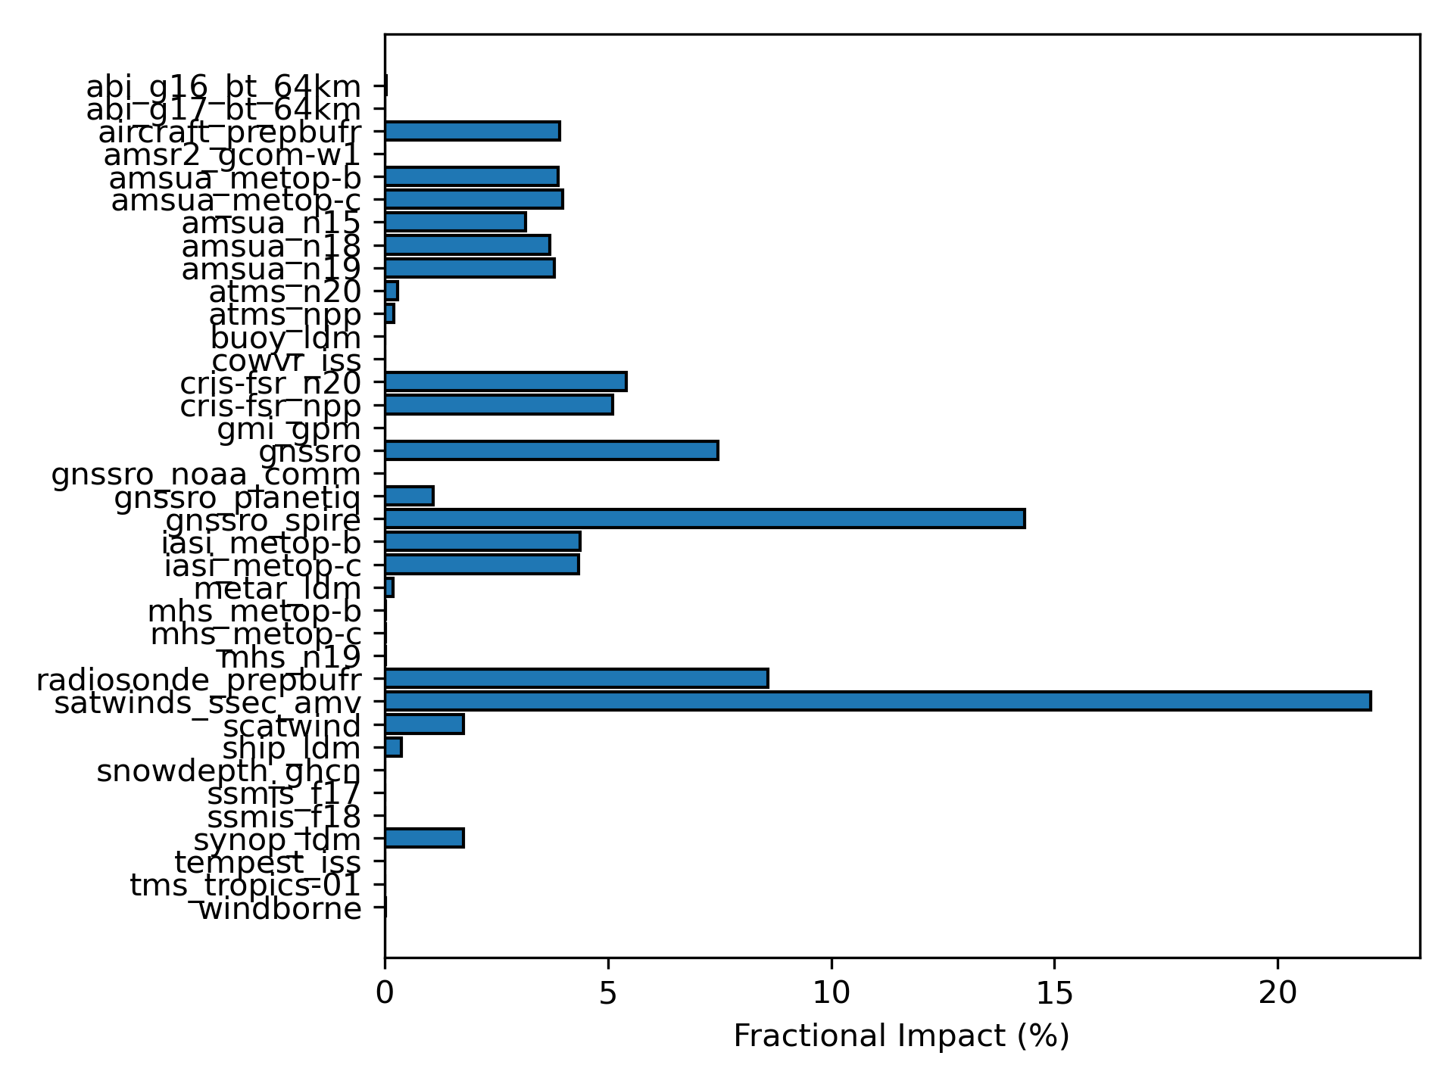
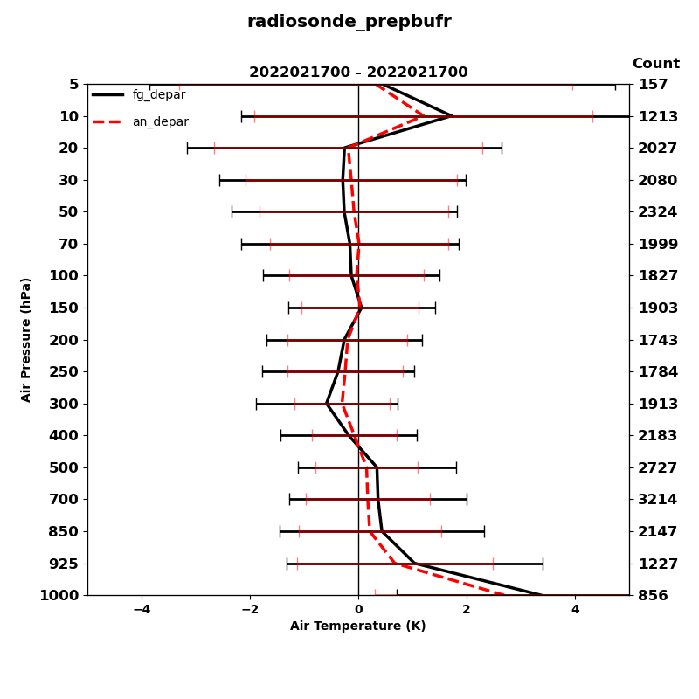
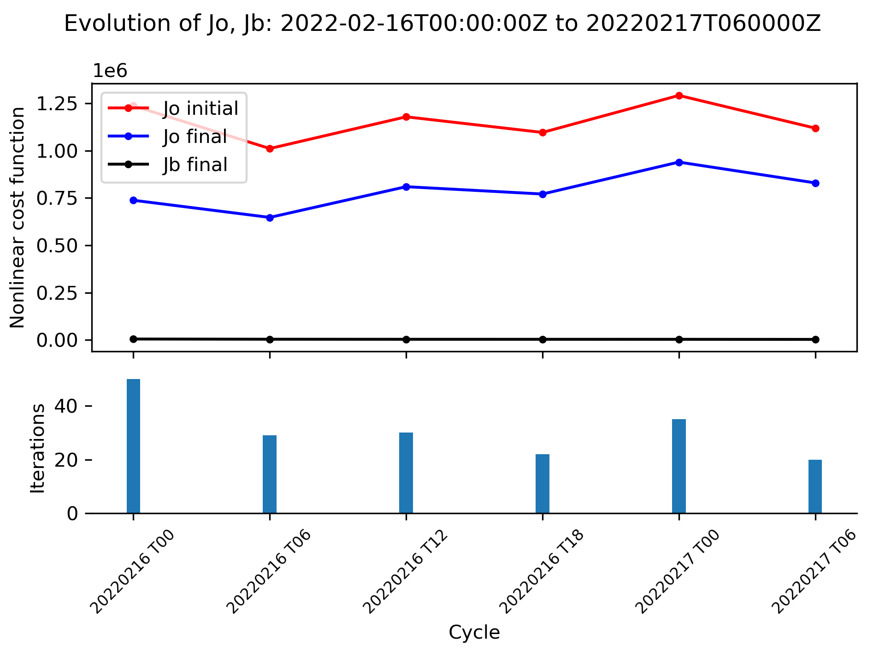
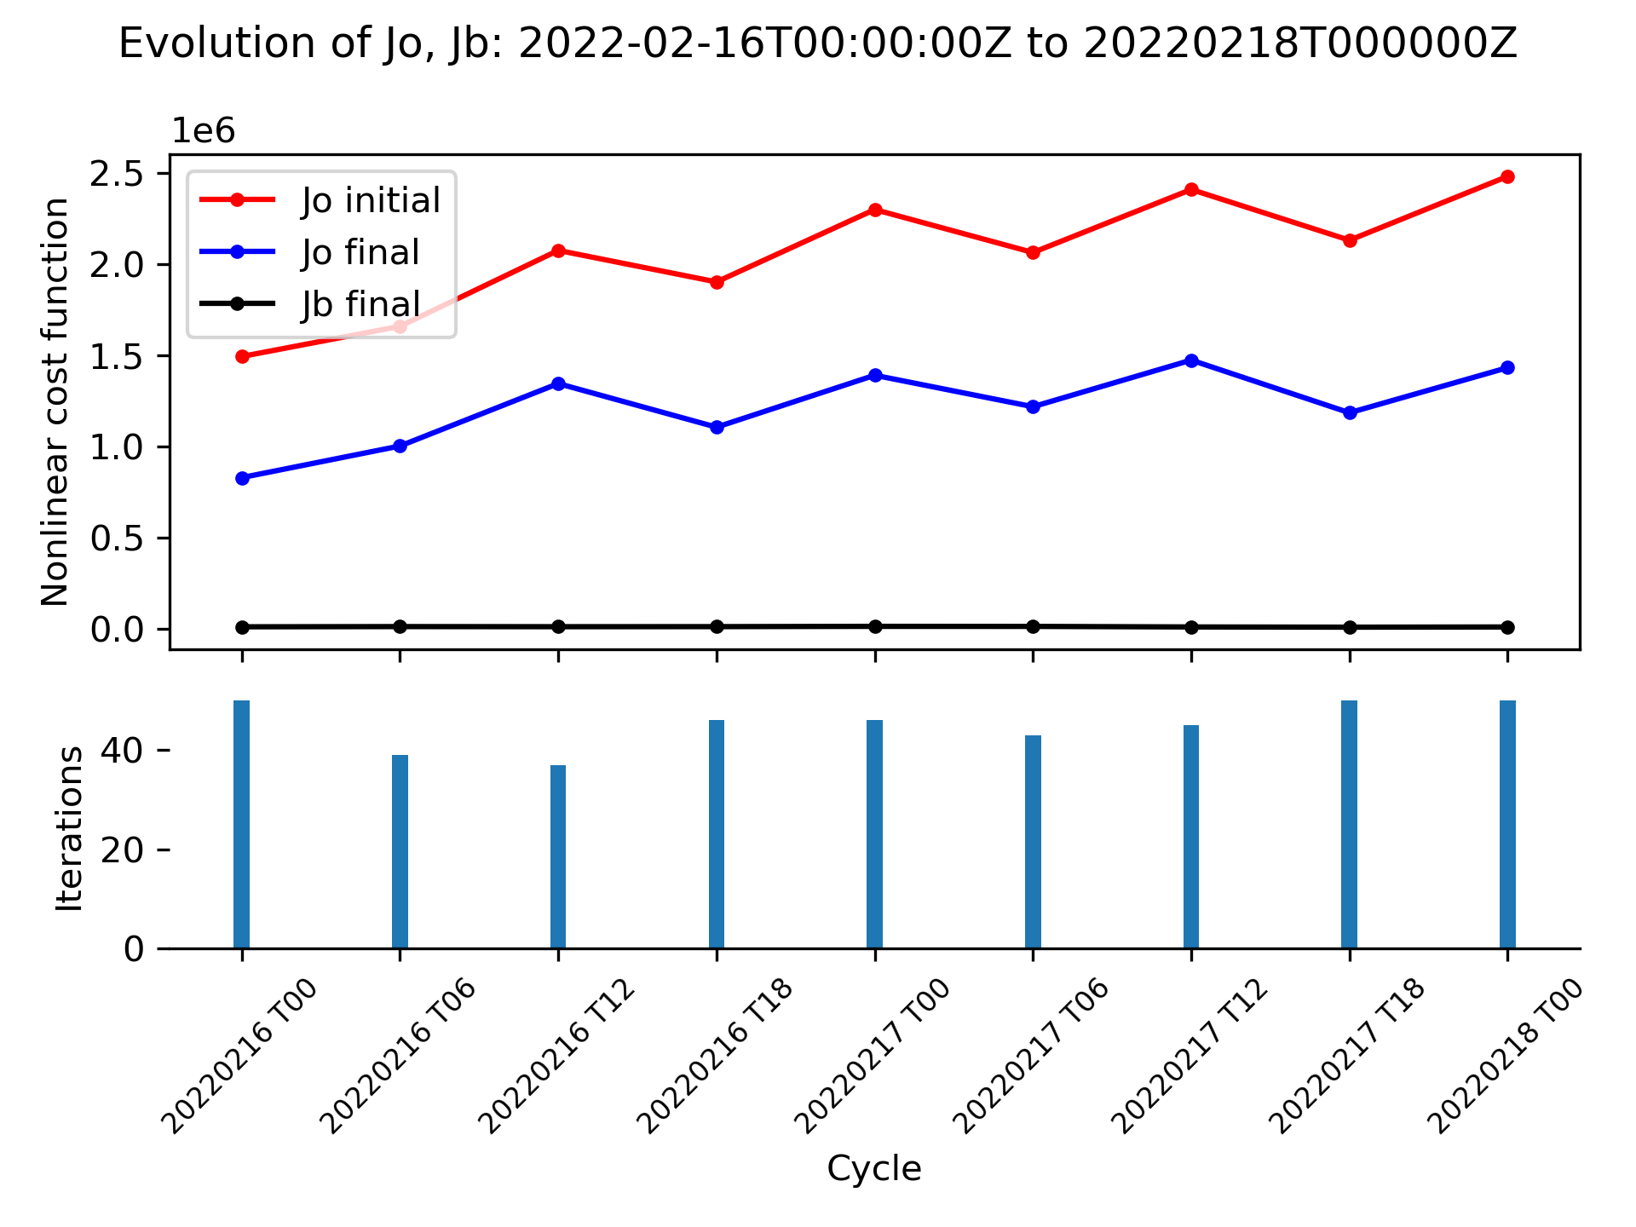
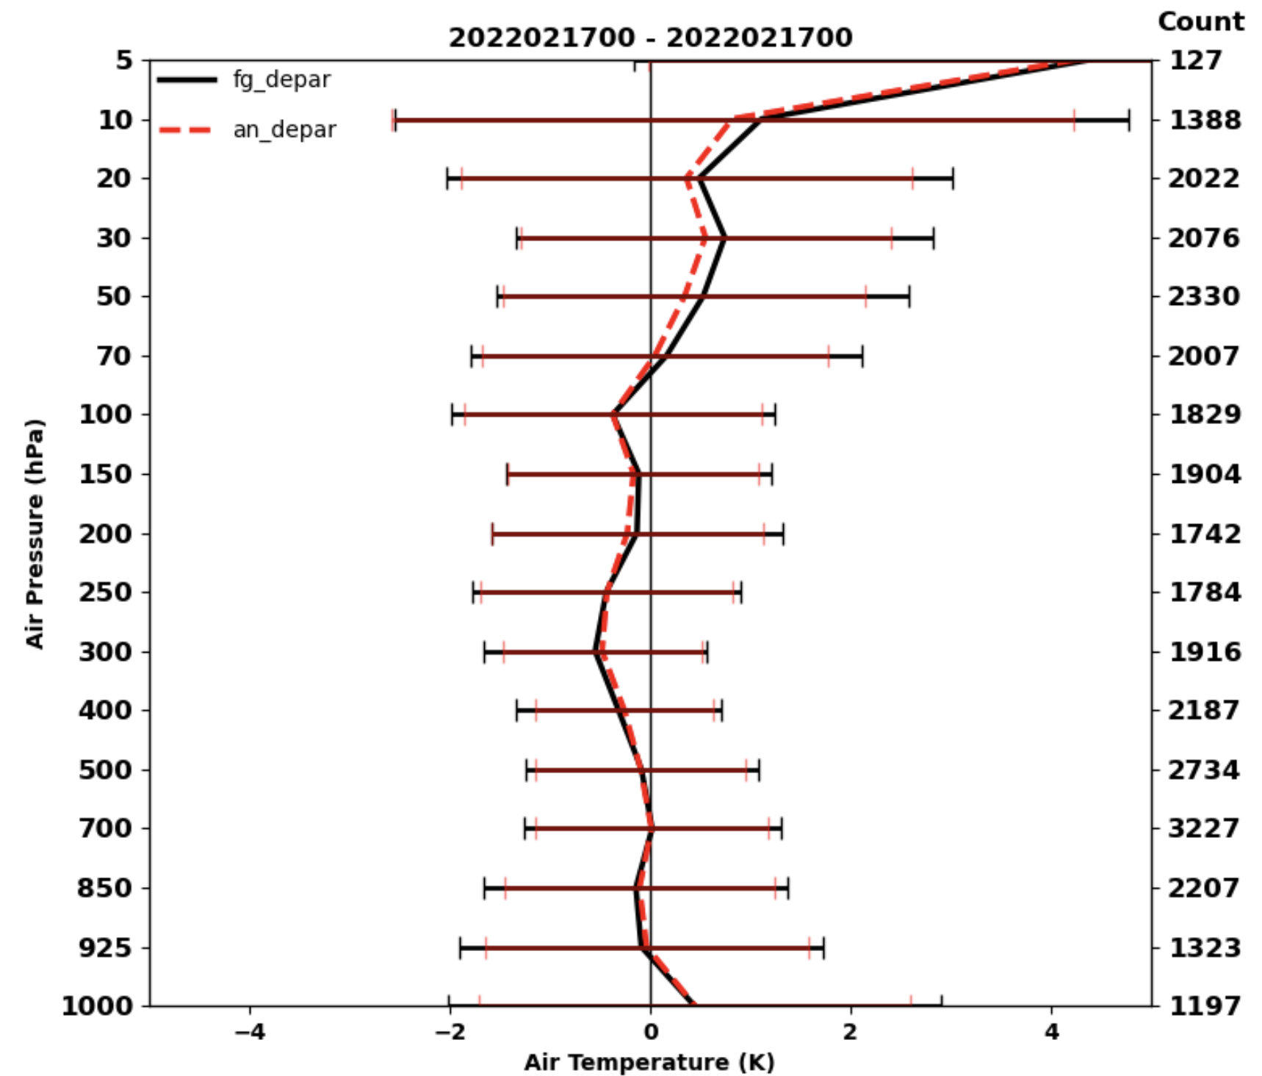
JCSDA SkyLab Testbed v7 (Weather)
JEDI - Release SkyLab v7 (weather)
https://skylab.jcsda.org
UFS (Fully cycled)
High-res (c768): 4D-En-Var with 1hr sub-window
Ensemble (c384): 80 members 3D-Var EDA
MPAS (Fully cycled)
High-res (15-3km): 4D-En-Var with 3hr sub-window
Ensemble (30km): 30 members 3D-Var EDA
UFS
MPAS
MPAS
MPAS
UFS
MPAS
UFS
UFS
JEDI
JCSDA

Slide 10
Final Remarks
The Joint Center for Satellite Data Assimilation
  Found a unique and efficient way to manage jointness
  and provide demonstrable value to partner agencies.
  Delivers critical core technology for UFS
  (spearheading the JEDI revolution)
Vision of success for JCSDA
  World-class use of observations in coupled Earth system models
  Advanced algorithms scaling on future HPCs (hybrid AI/ML)
  Continuous innovation with rapid transition to operations
  Community engagement and collective resilience

