Slide 1
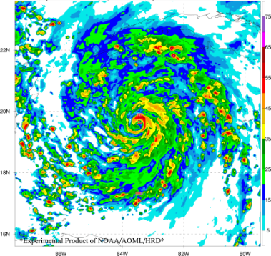
Research and Developments of the Hurricane Analysis and Forecast System
Gopal
HRD/AOML & HFIP
Co-Authors: William Ramstrom, Andrew Hazelton, Lew Gramer, Ghassan Alaka, Xuejin Zhang, Zhang Zhang and Fanglin Yang
Presented at: UIFCW24 Workshop, July 22-26, 2024 , JSU, Jackson, MS
Notes:
Run of Show
HFIP is a partnership between Research (OAR/AOML) and Operations (NOAA/NWS)

Slide 2
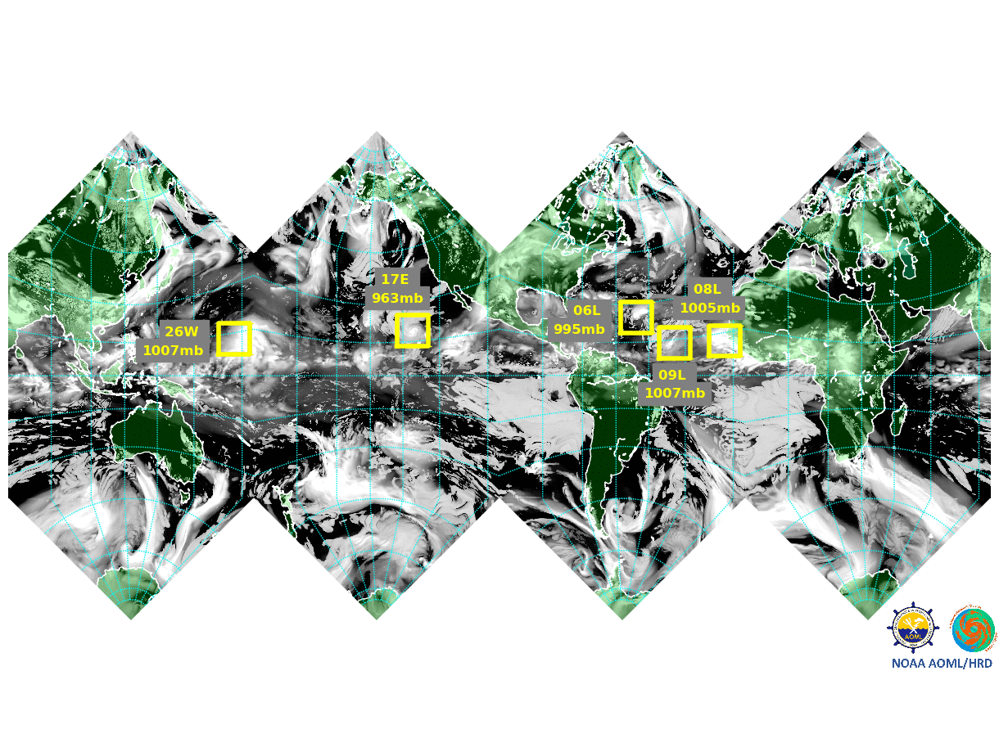
The Hurricane Analysis and Forecast System
HAFS is NOAA’s new hurricane modeling system within the Unified Forecast System (UFS) framework
HAFS is one of the HFIP strategic implementation plan supporting 2017 weather act
Multi-year R2O collaboration between NWS’s Environmental Modeling Center and OAR’s AOML/Hurricane Research Division
HAFS has atmosphere-ocean-wave coupling, improved data analysis and physics, and detailed output following the storm
First version of HAFS, regional with one moving nest at 2 km resolution was implemented operationally in June 2023 and V2 was implemented in July 2024
From Vision
To Reality: 2023
TC Paulette, 2023

Slide 3
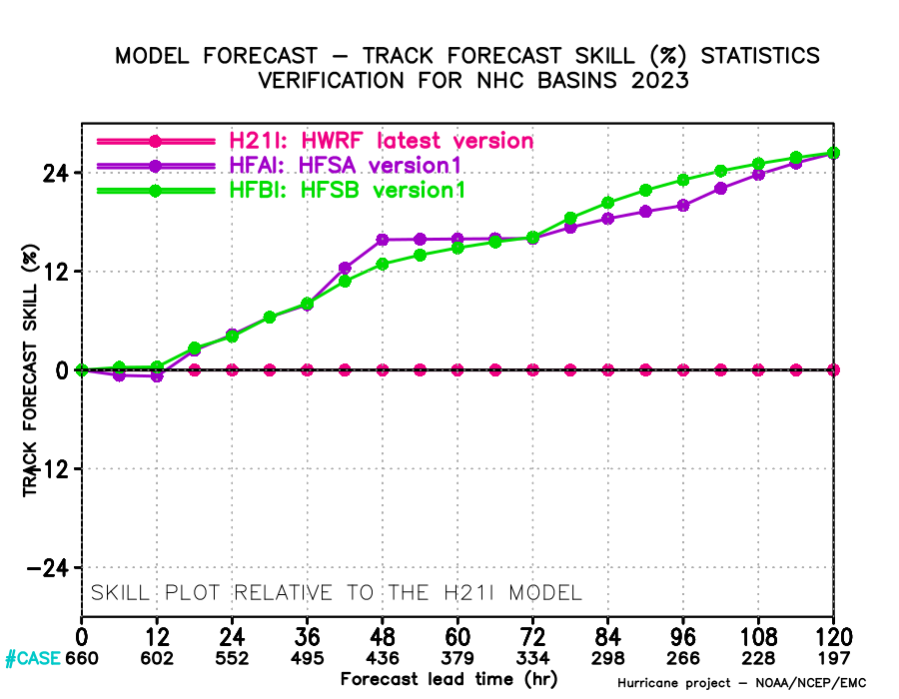
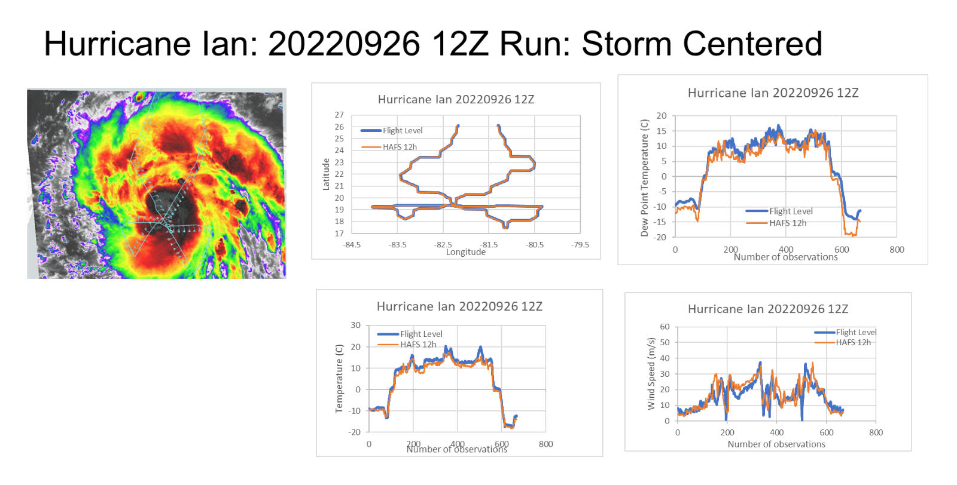
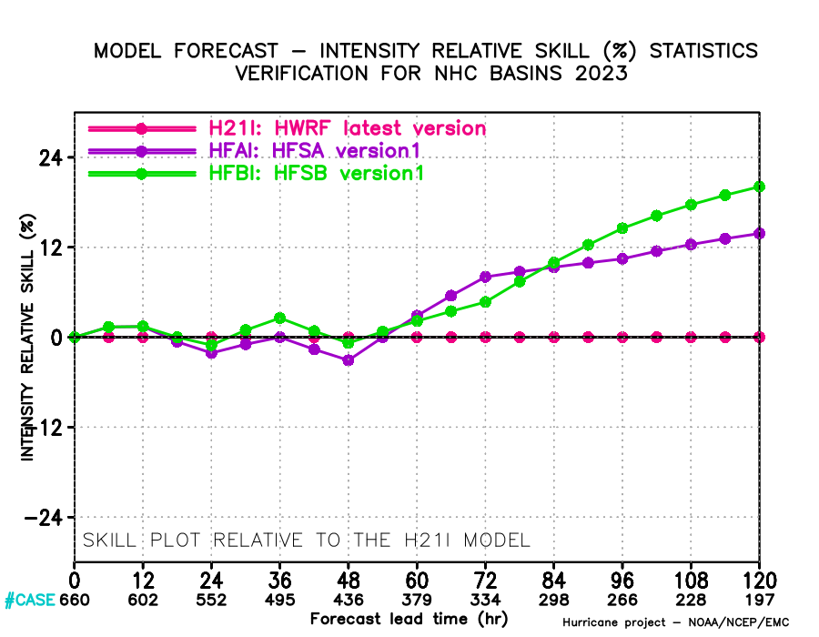
HAFS Performance
An example of inner core structural evaluation of HAFS
Consistent improvements in Track & Intensity forecast -vs-HWRF Excellent representation of inner core structure -vs observations

Slide 4
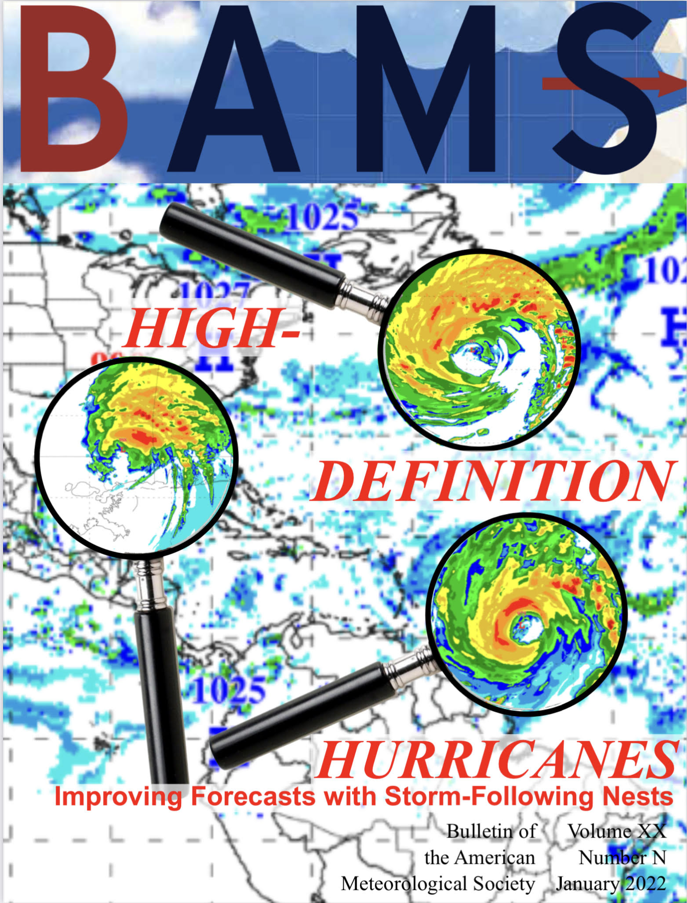
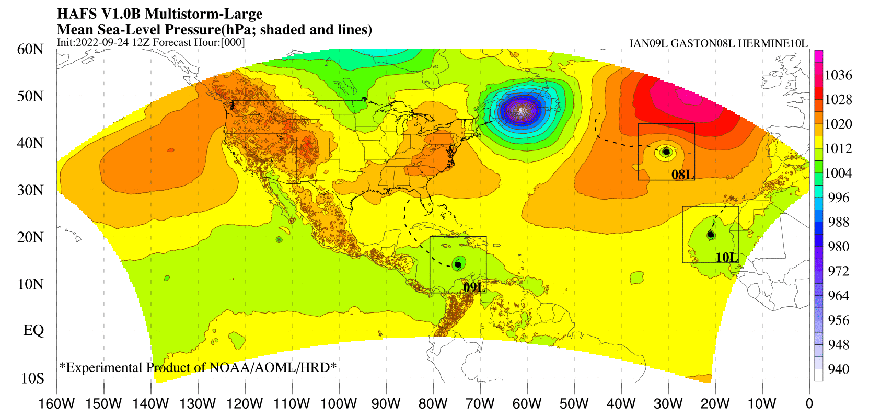
What next? Multiple-moving nest and HFIP real-time
Tropical Cyclones 1000’s of miles apart could influence each other via outflow region. Storm following nests offers a reliable NWP solution for capturing these interactions (Alaka, Zhang and Gopal, 2022)
Ramstorm et al, 2024
We are running the HAFS multi-nested configuration in HFIP Real-Time this season

Slide 5
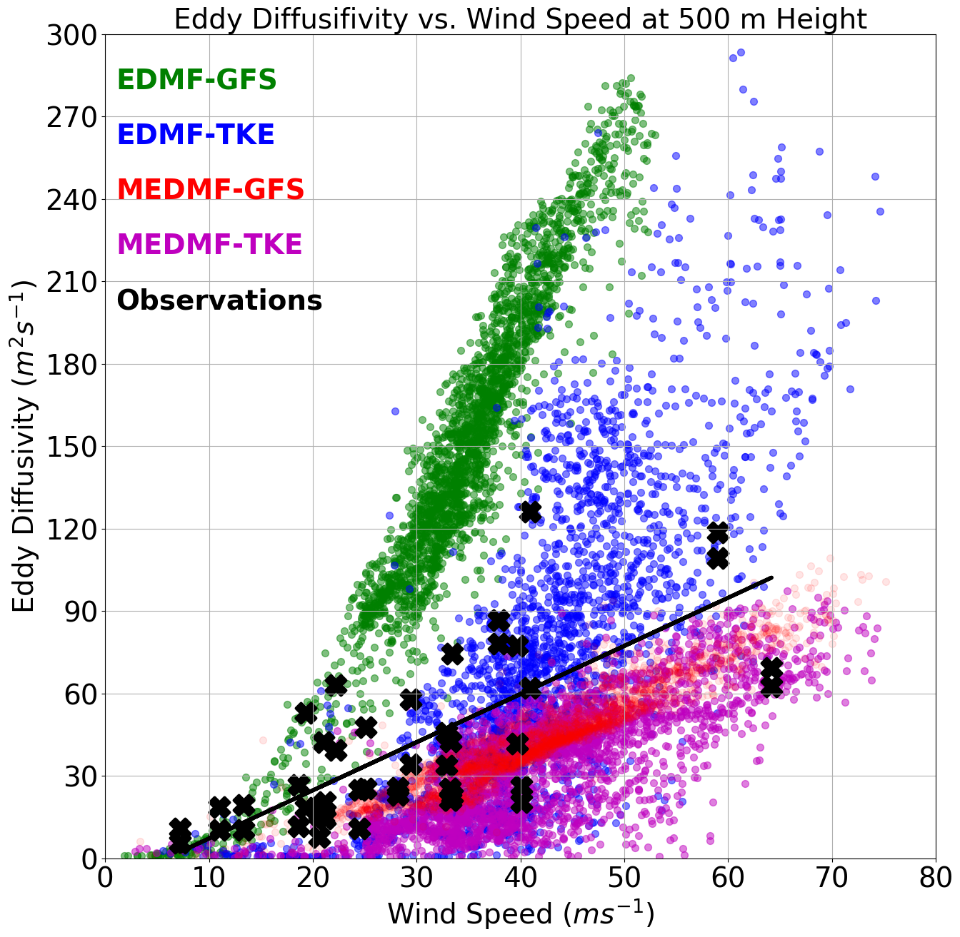
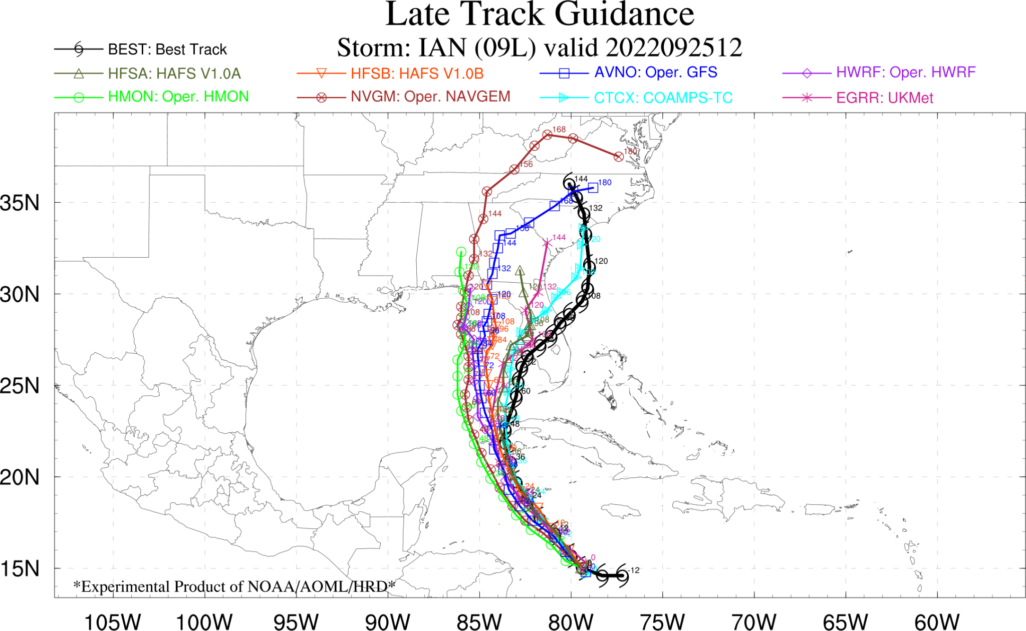
HAFS Physics Improvements & Evaluations
PBL:Use of P3 Observations and composites for Improving HAFS Physics
(Gopal et al, 2013, JAS; 2021; AGU-ESS; Hazelton et al., 2022, WAF)
Convection: Advancement of Tiedtke convection scheme to provide diversity between HAFS-A and HAFS-B

Slide 6
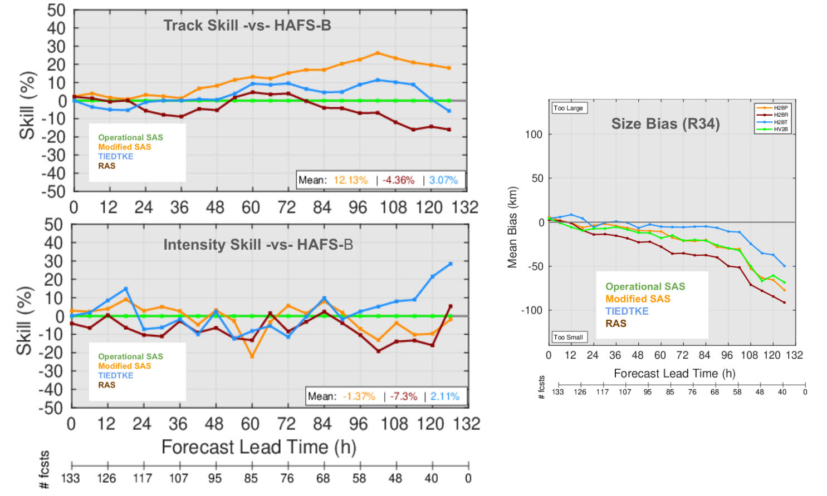
Tiedtke Scheme for HAFS-B
Tiedtke shows promise for further advancements in HAFS

Slide 7
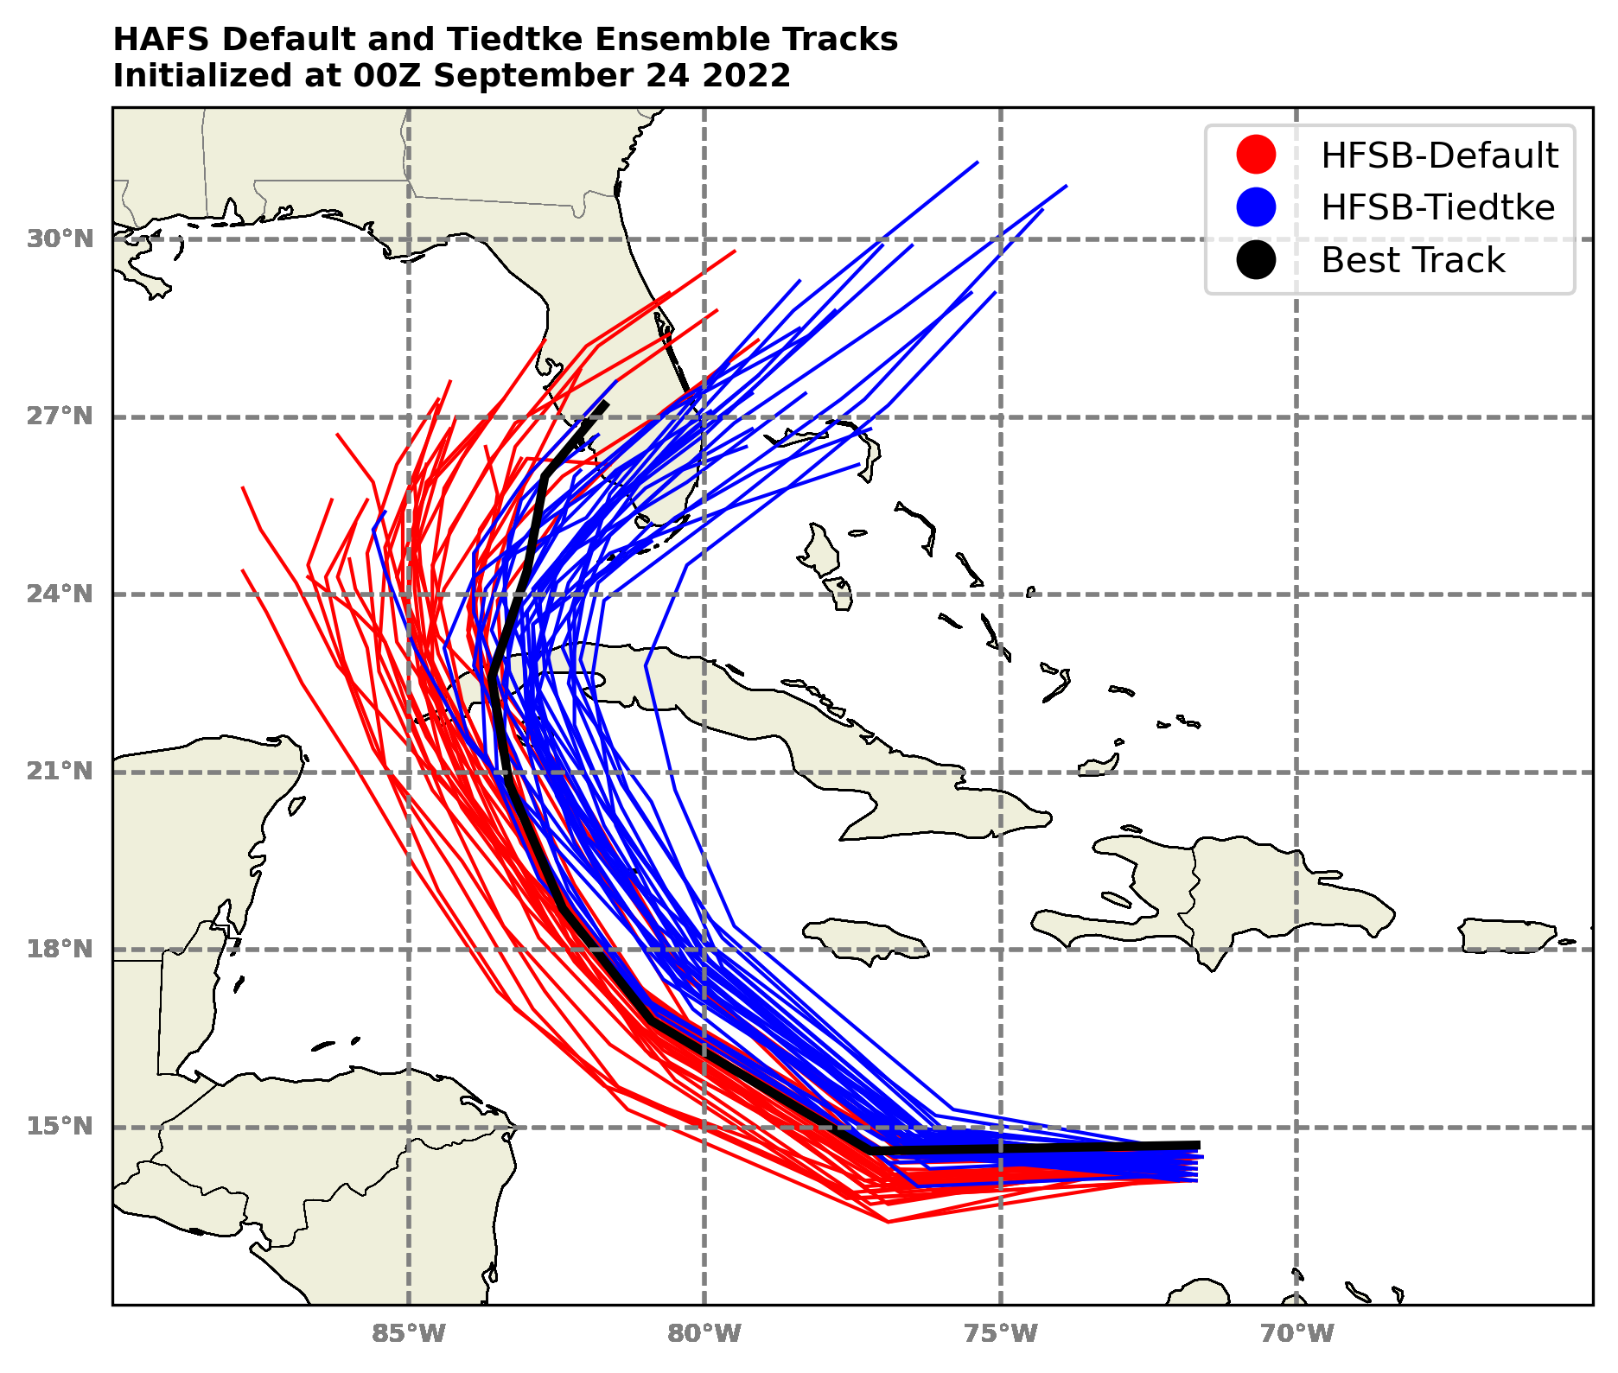
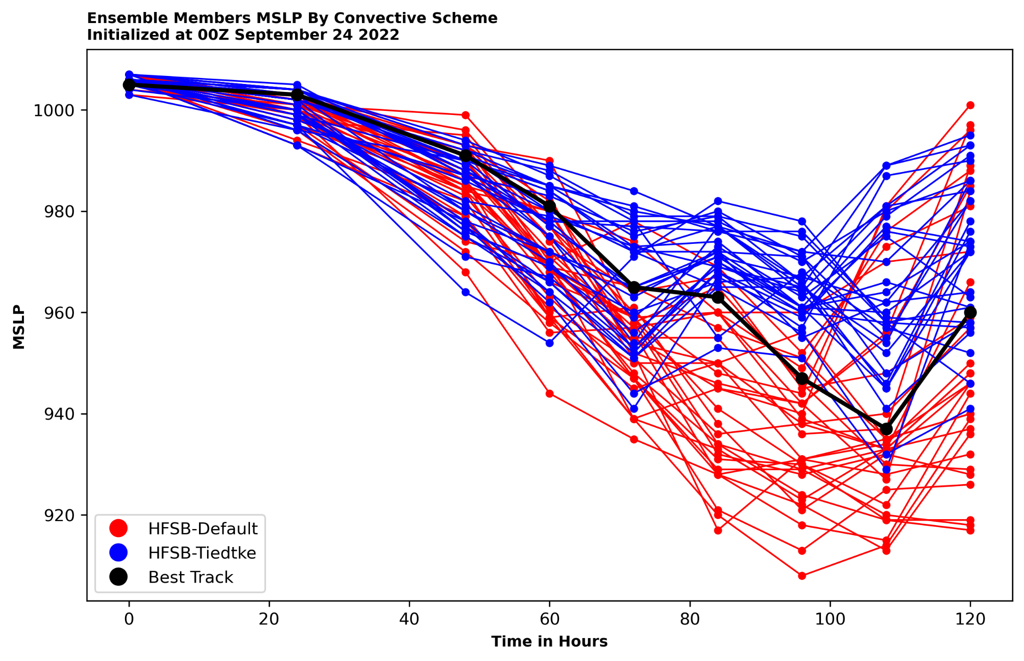
Physics Diversity: Tiedtke -vs- SAS
Hurricane Ian Developed from a tropical wave in the Eastern Caribbean
Rapidly intensified as it turned northward and made landfall in far western Cuba
Reached Category 5 just prior to making landfall near Fort Myers
HAFS-B default (sa-SAS scheme) had left-of-track bias, HAFS-B tiedtke had right-of-track bias
Actual intensity fell between HFSB-default and HFSB-tiedtke as well
Credits to Nikhil Trivedi, Lapenta intern
Tiedtke Provides diversity when used in HAFS ensembles

Slide 8
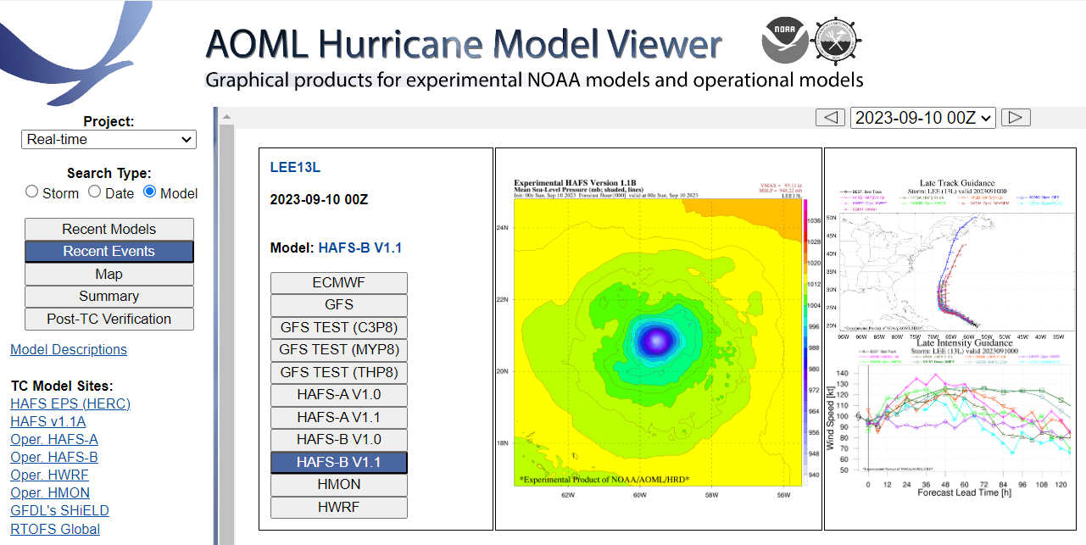
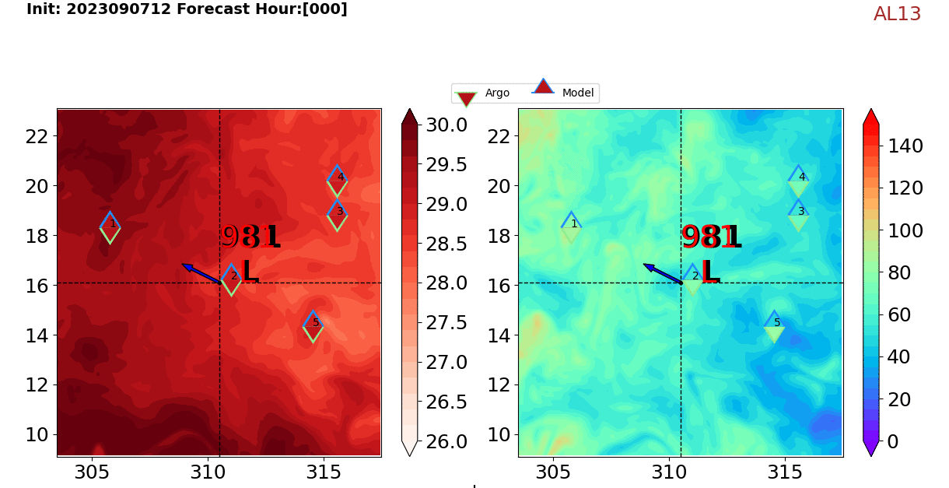
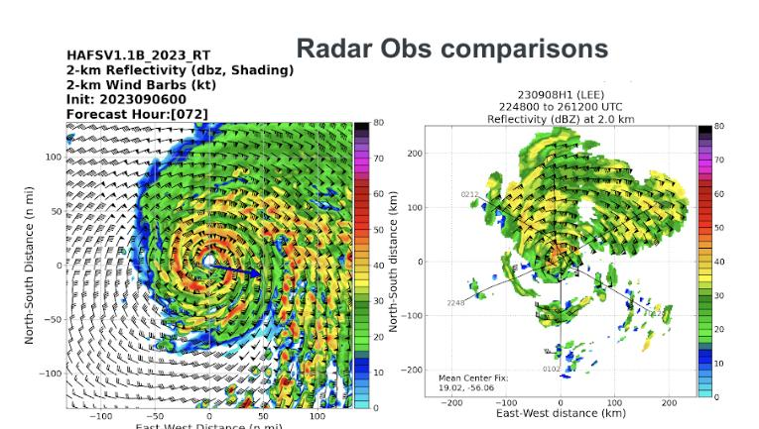
HFIP Experimental Real-Time Products
11 models w/ Lee products!
Ocean Obs. vs. Model Comparisons
Millions of products for experimental & operational models
https://storm.aoml.noaa.gov/viewer

Slide 9
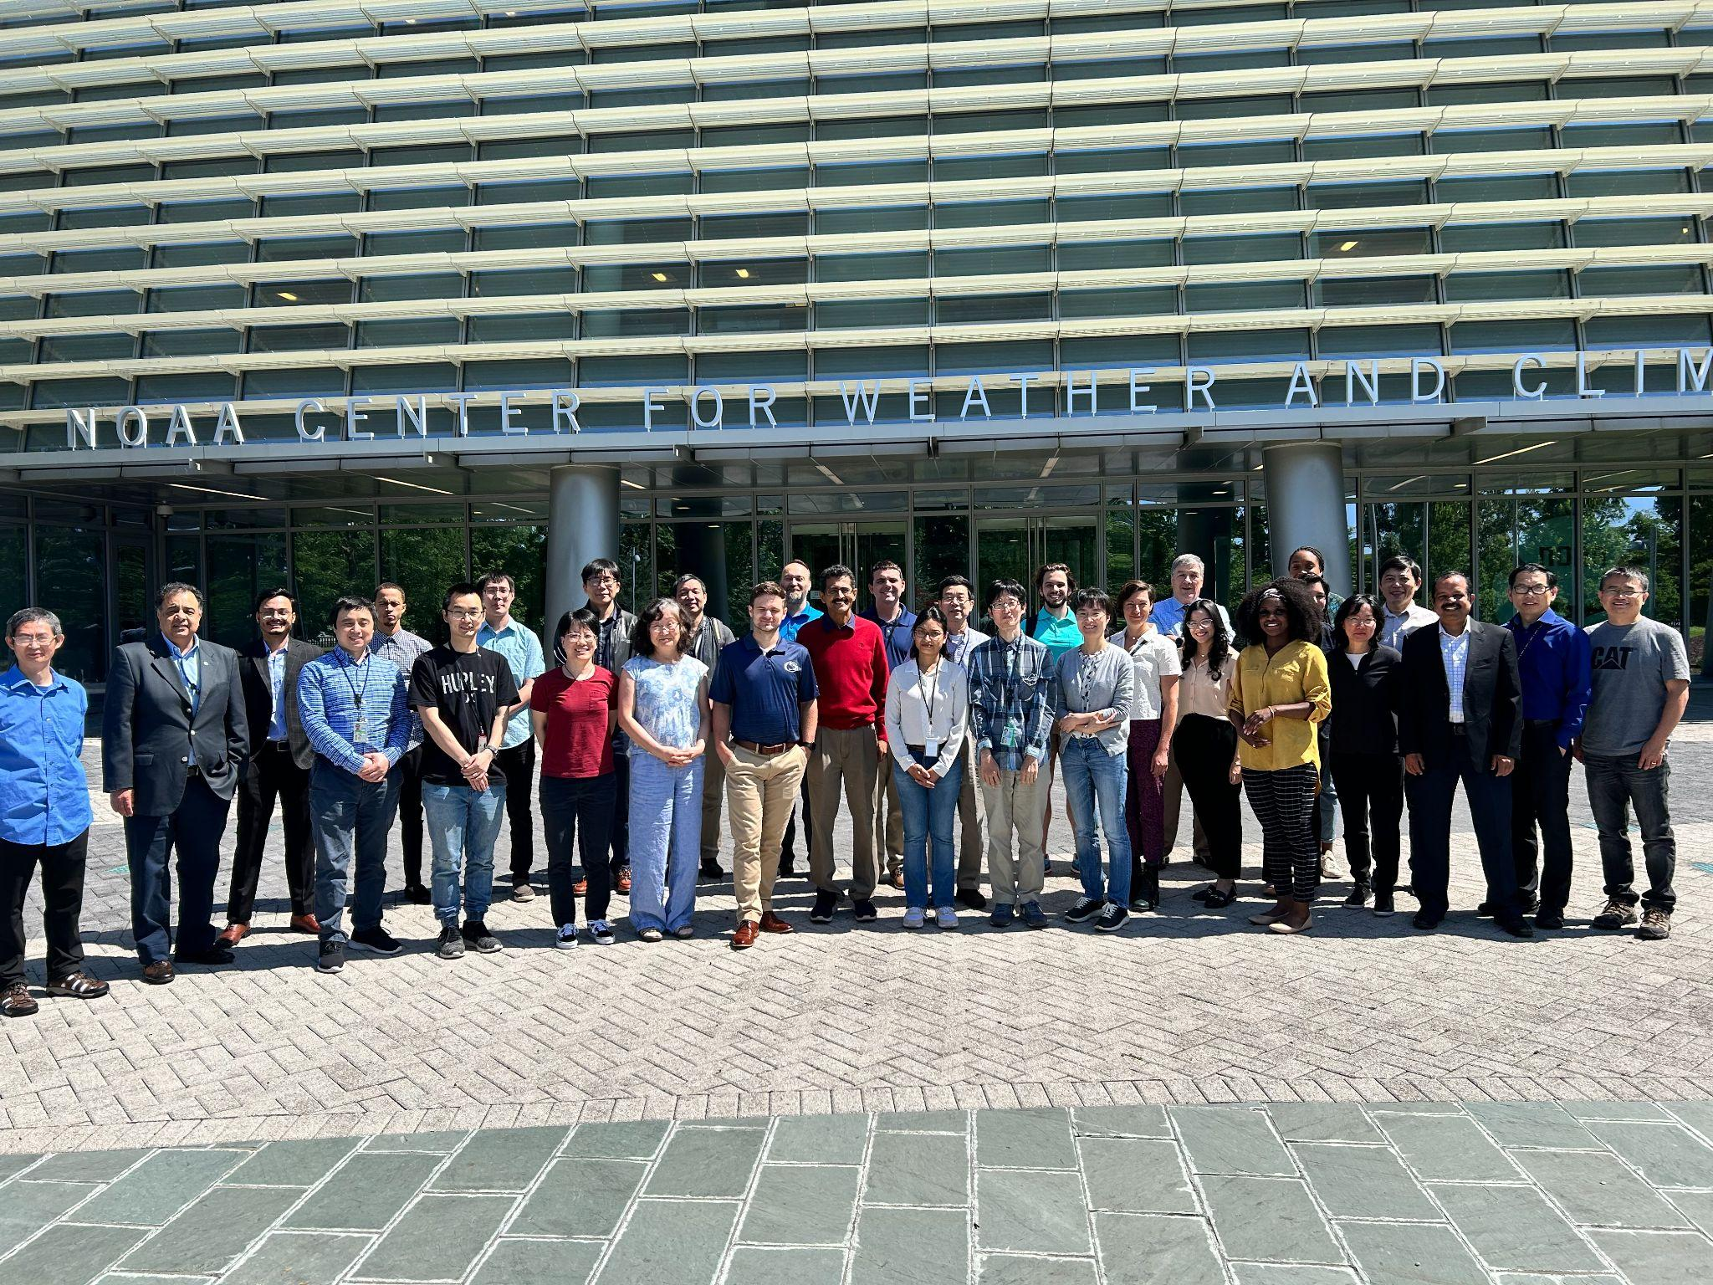
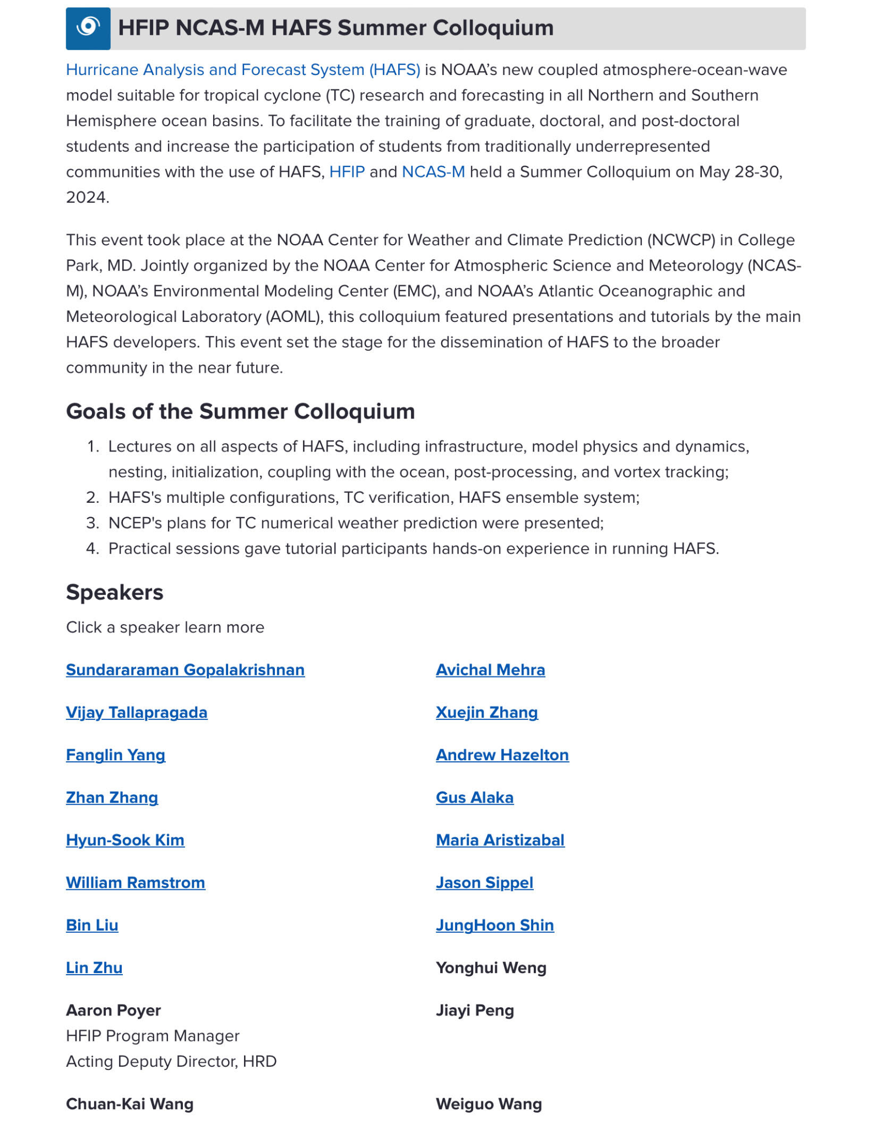
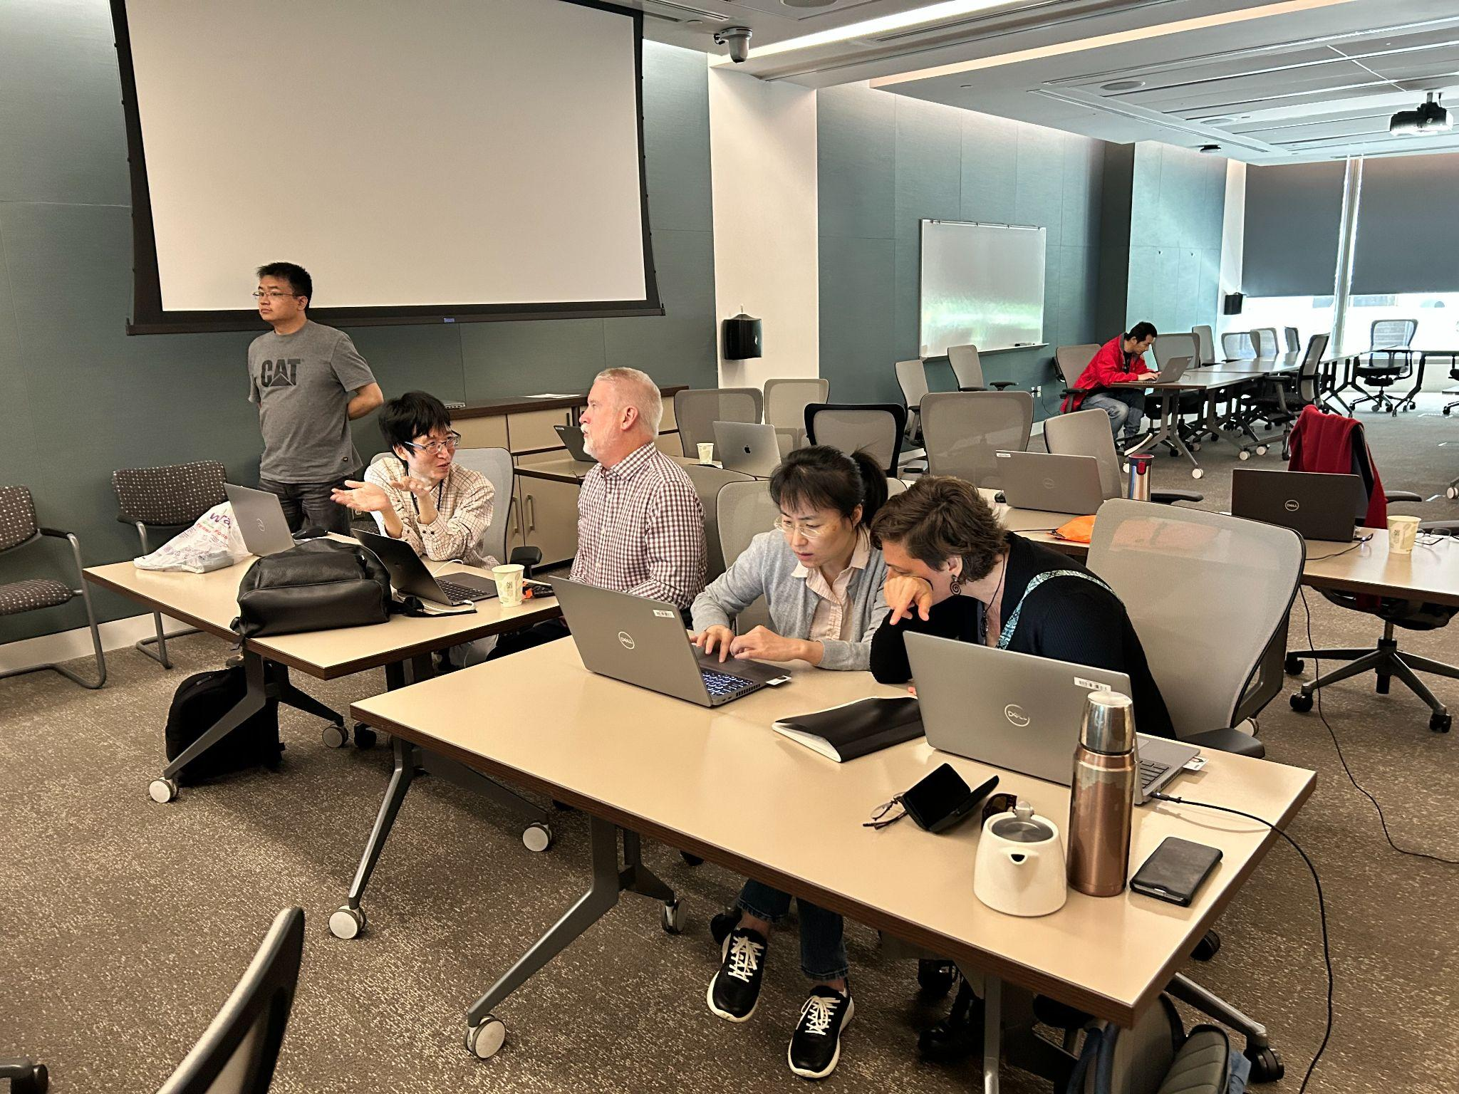
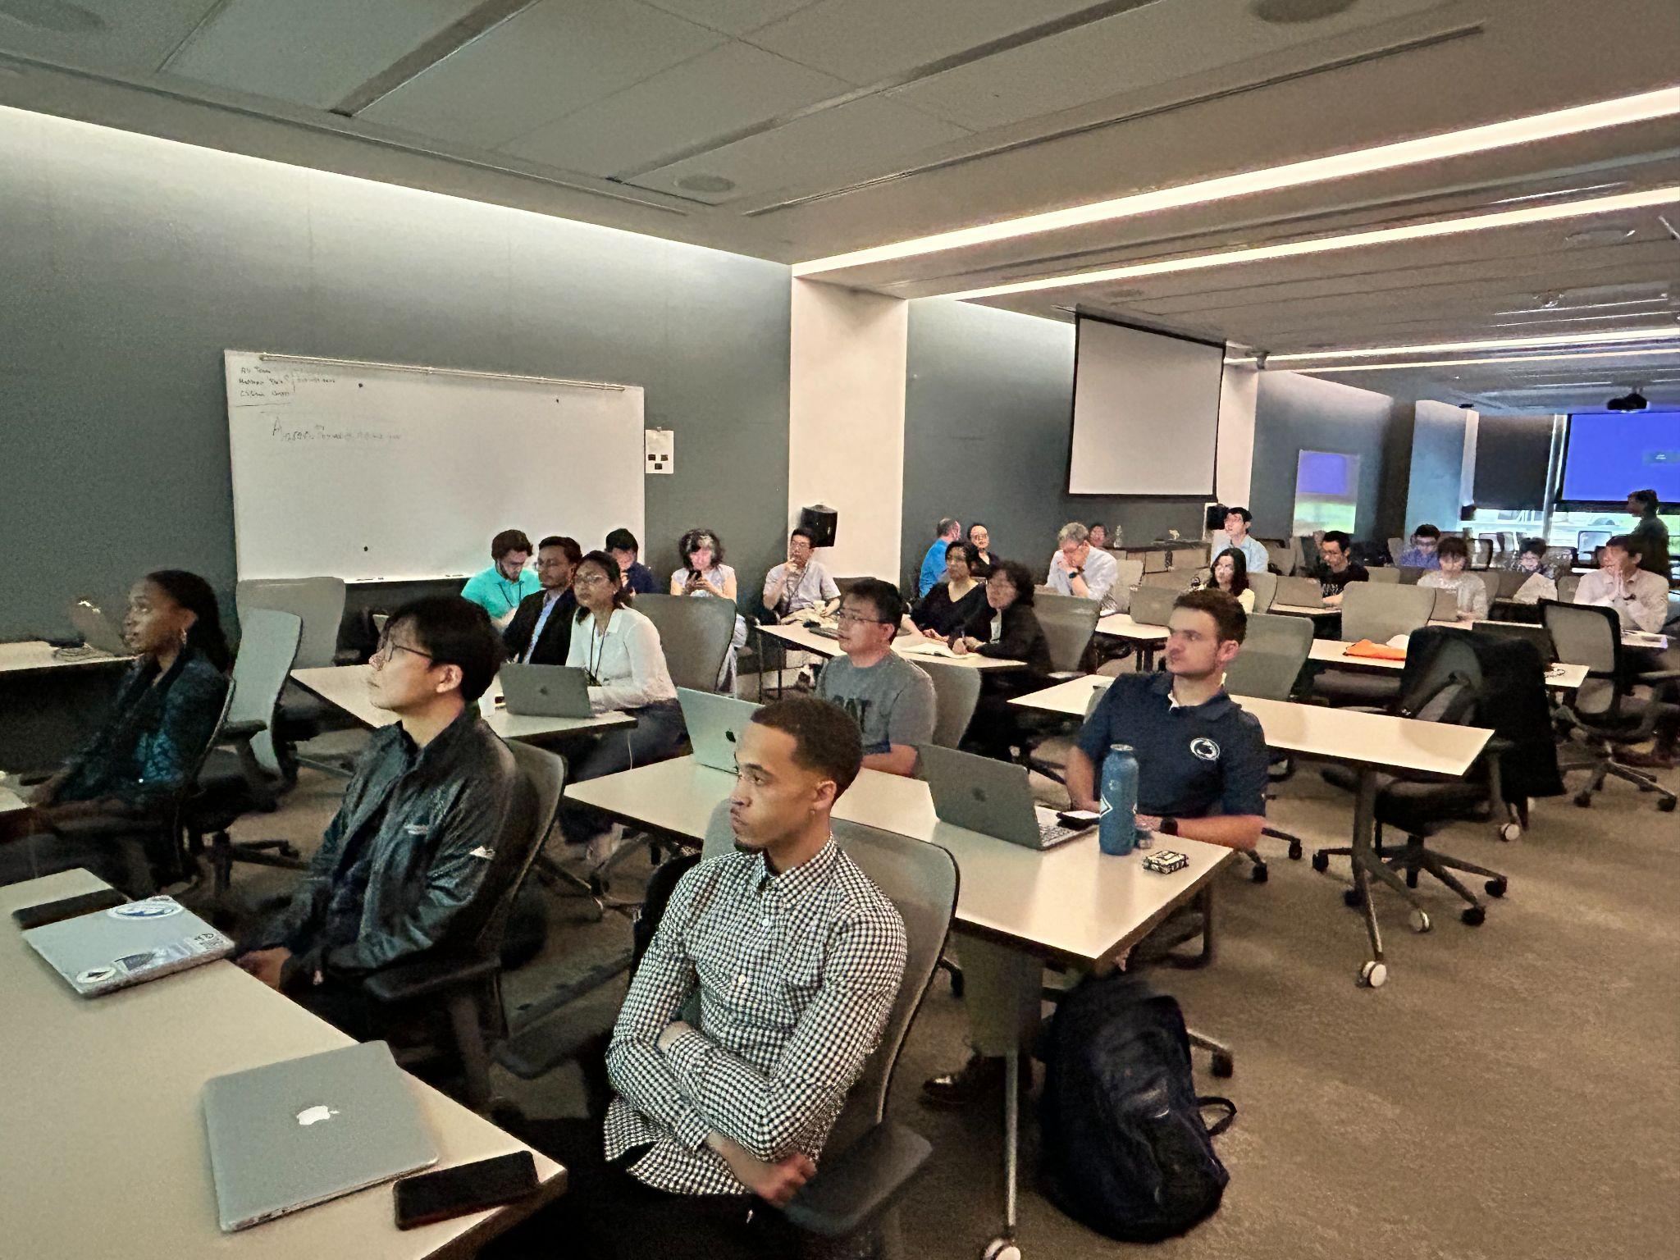
HFIP NCAS-M Summer HAFS Colloquium

Slide 10
Summary
Two configurations of HAFS were implemented in Operations in 2023. Upgraded to V2 in 2024. Could not have happened without NOAA Operations and Research working together!
Multi nested basin-wide HAFS is being developed and will be running in HFIP real-time (HREX), this season
We are working on a 2024 HFIP real-time configuration that includes modified Tiedtke convection and other sensitivity experiments to improve TC structure and intensity in HAFS
Tiedtke shows promise for ensembles as well
HRD observations are being extensively used in evaluating and improving HAFS
We are building a community of users for HAFS. Welcome to be a part!
hfip.noaa.gov

Slide 11
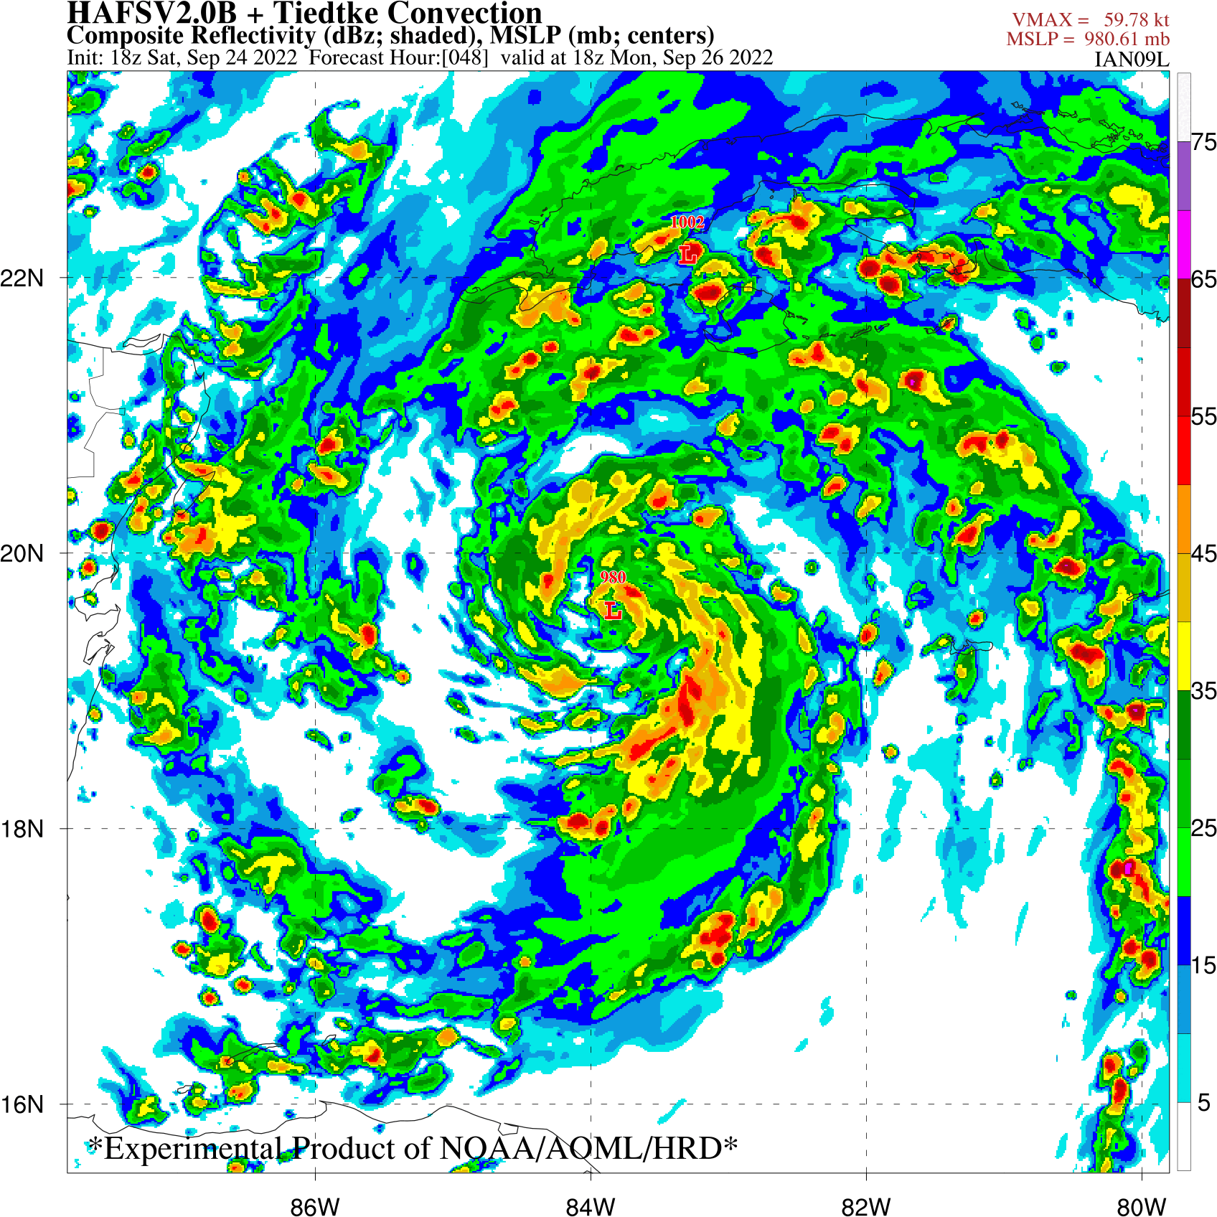
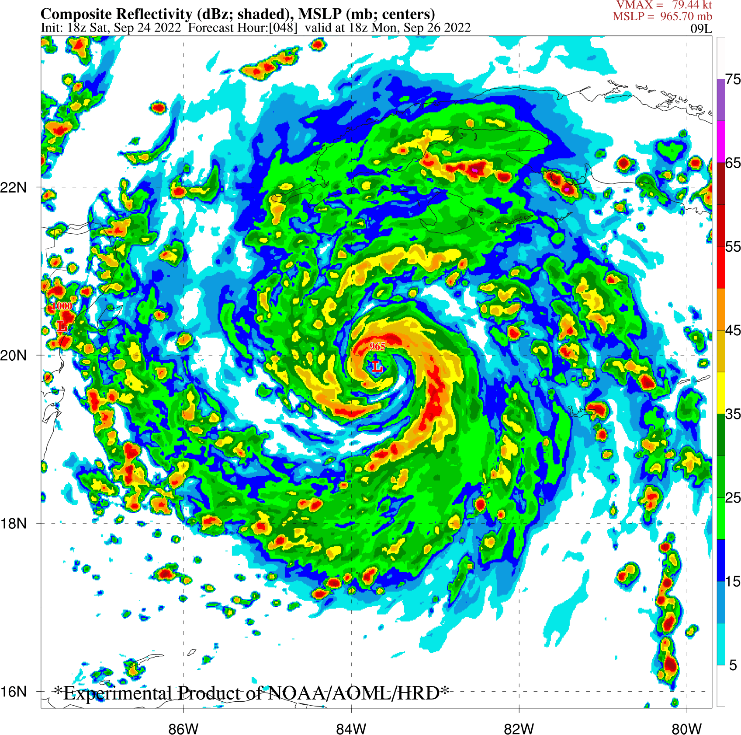
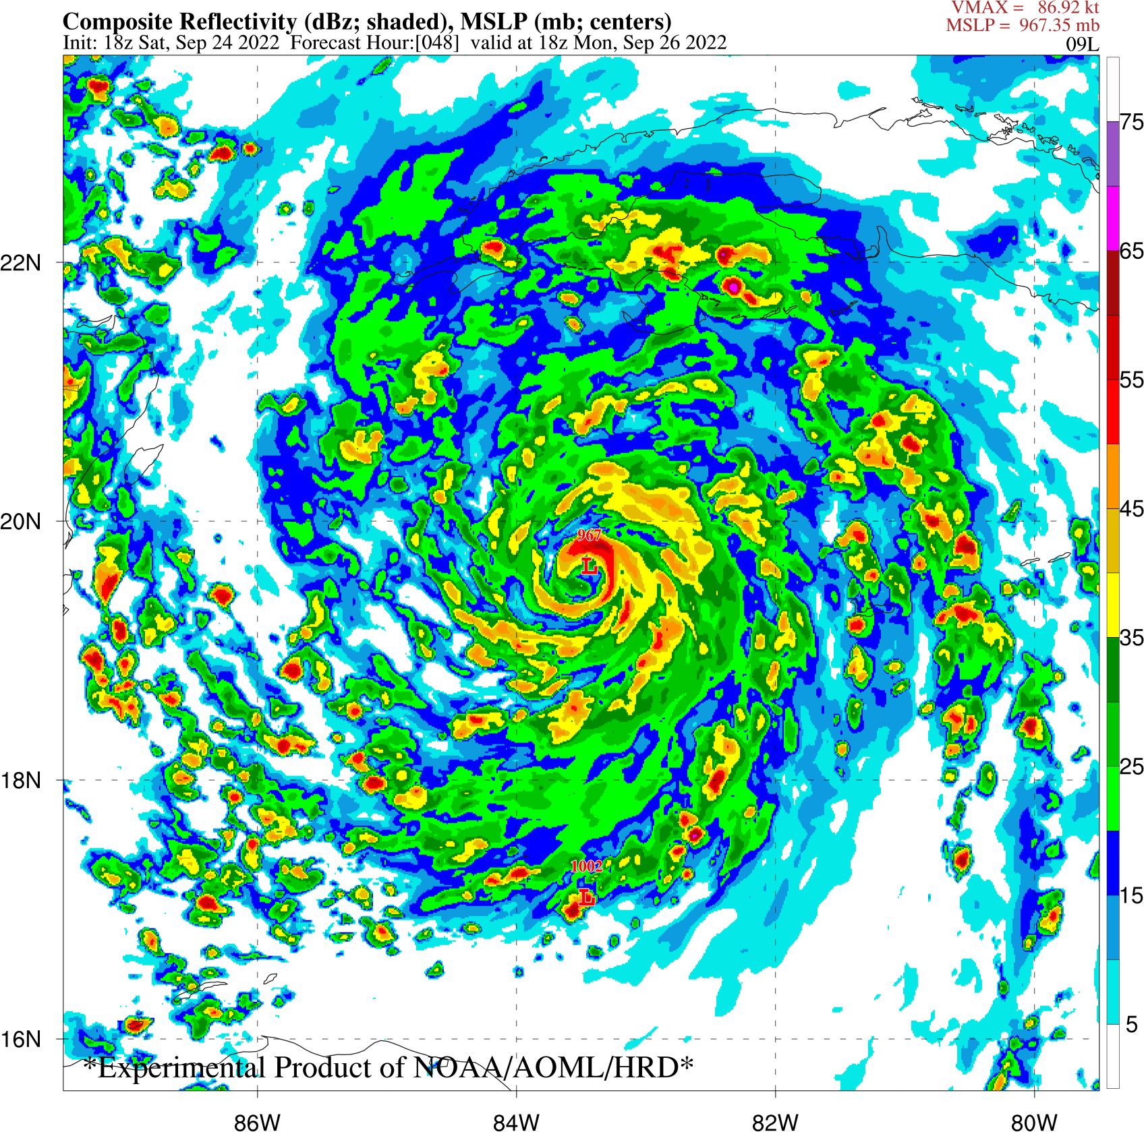
Back-Up: Scale-Aware Tiedtke Scheme Modifications
Tiedtke
Tiedtke + SA Change
Tiedtke + SA Change + elmx/lim_fac Changes
Ian 2418Z
Inner core is more robust with modifications to scale-awareness
Moat regions are not as pronounced
Adding elmx+lim_fac changes further enhances the eyewall convection

Slide 12
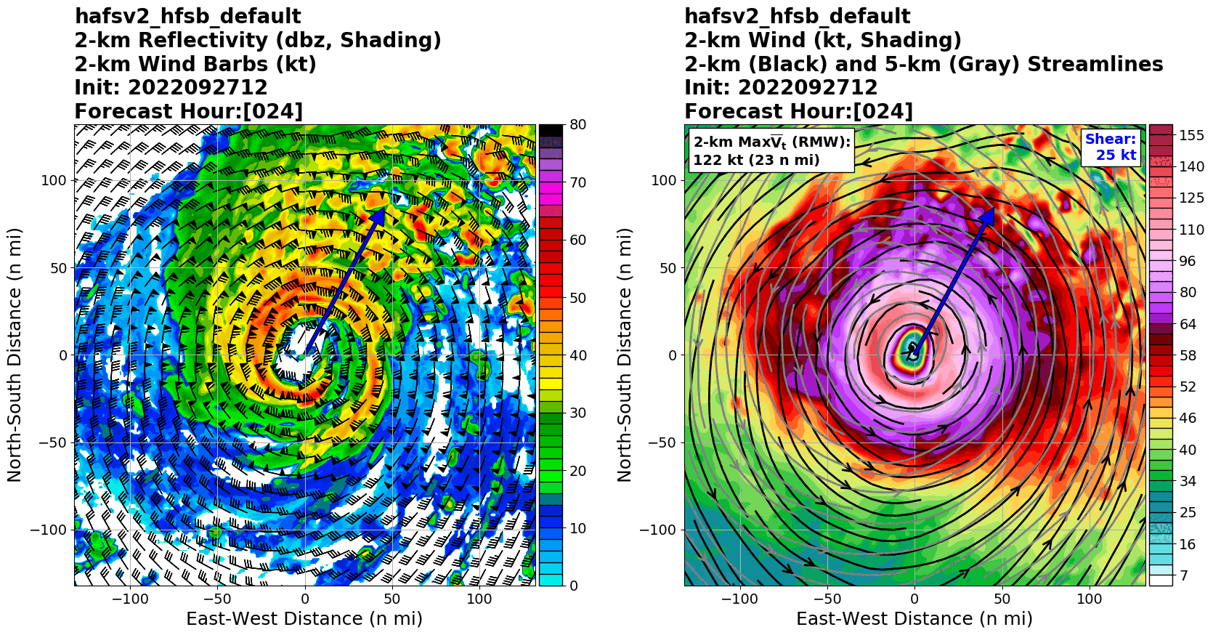
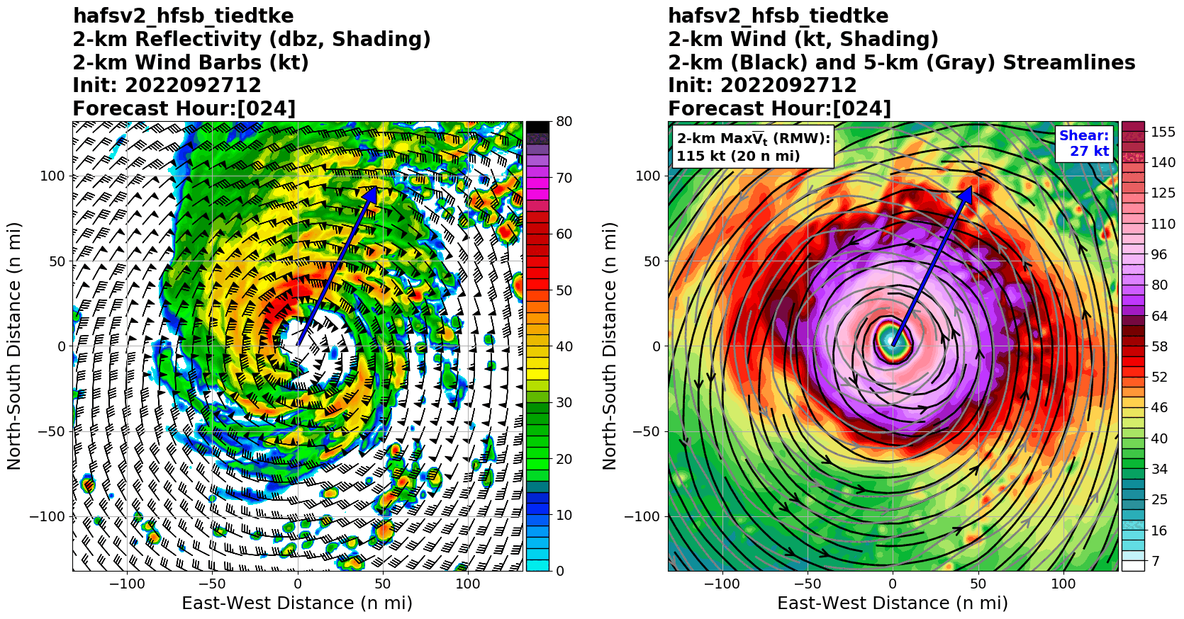
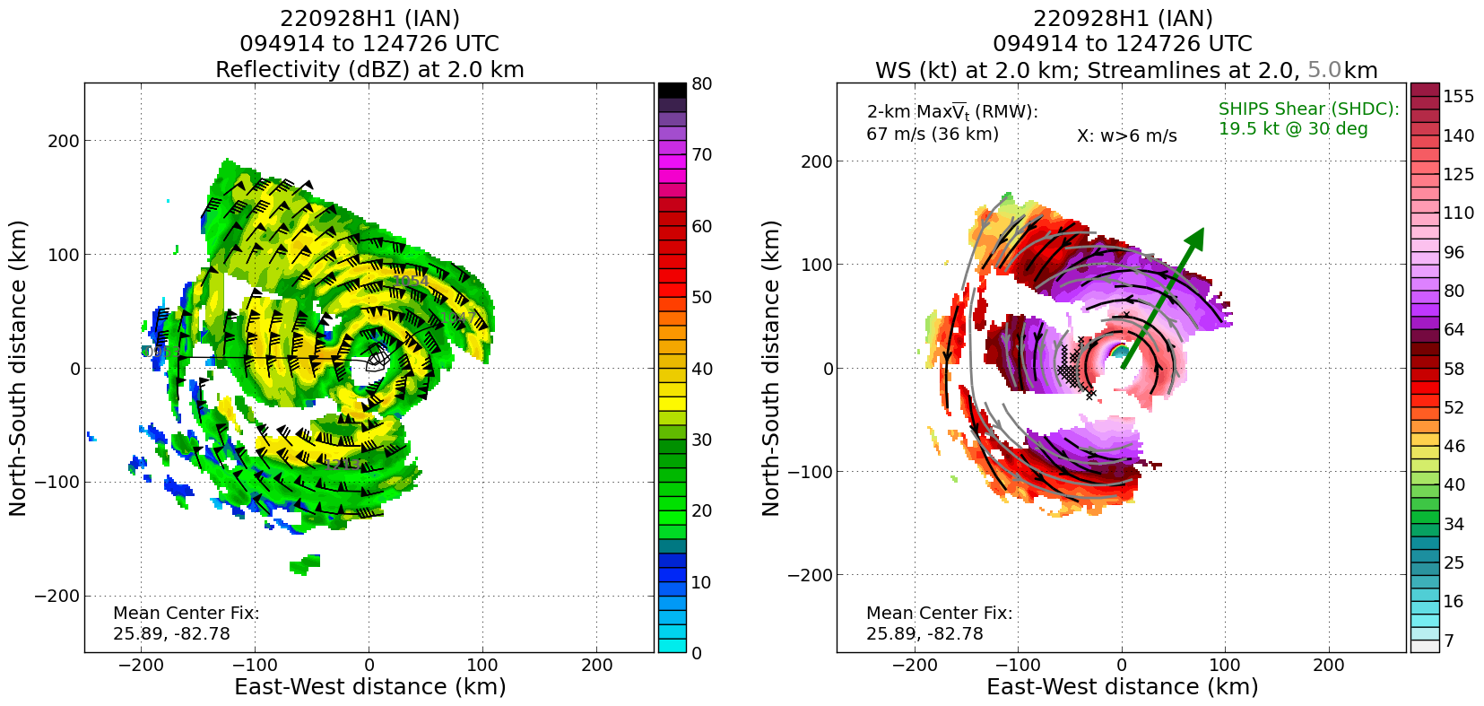
Back-Up: Comparison With Observations
Real-time runs and physics tests compared with P3 observations collected during the Hurricane Field Program
Here, 2-km reflectivity and wind structure are compared for 2 forecasts of Hurricane Ian
The overall structure is similar, although Tiedtke produced a larger eye with slightly weaker winds
The symmetry is similar between the two versions, but for this cycle the SAS scheme was stronger and closer to reality
Default (SAS)
Tiedtke
P3 Raar Observations

